Slide 1
Japan Singapore Partnership Programme for the 21st Century (JSPP21):
Green economy (20 – 24 September 2021)
Japan’s Efforts in Green Investment
-Sep.22, 2021 (14:05 – 15:45 SST)-
Dr. Abdessalem RABHI, Senior Programme Coordinator, IGES

Slide 2
Table of Contents
I. Green Investment: Related concepts and contexts (20mn)
I.1 Green Investment: Definition?
I.2 ESG factors and green investment
I.3 Spectrum of green investment
I.4. Global commitments and green investment (The Paris Agreement and the SDGs)
I.5 key actors in the green investment ecosystem
-> Q&A and/or exercise
II. Japan’s effort in green investment (75mn)
I.1. MOE’s key efforts
II.2 METI’s key efforts
II.3 FSA’s key efforts
II.4 MOE-METI-FSA’s joint efforts
II.5 Bank of Japan (BoJ)’ key efforts
-> Q&A and/or exercise
III. Recap and key takeaways (5mn)

Slide 3
I. Green Investment: Related contexts and scope I.1. Green Investment: Definition?
Green investments are investment activities that focus on companies or projects committed to the conservation of natural resources, the production and discovery of alternative energy sources, the implementation of clean air and water projects, or other environmentally conscious business practices (https://www.investopedia.com/terms/g/green-investing.asp).
There is currently no agreed definition of green investment. The following terms are often used to describe similar investment products (https://www.greenfinanceguide.com/guides/what-is-a-green-investment)
-Eco-friendly
-Green
-Environmental
-Socially Responsible Investing (SRI)
-Sustainable
-Environmental, Social, Corporate Government (ESG)
-Impact investing.

Slide 4
I. Green Investment: Related contexts and scope I.2 ESG Factors and green investment
Environmental, Social, and Governance (ESG) Factors | Environmental Factors | A. Climate change | Climate change mitigation
 |  |  | Climate change adaptation and resilience
 |  | B. Pressures on natural resources | Over-consumption of natural resources -Water -Biodiversity -Land use and forestry -Marine resources
 |  | C. Pollution, waste and a circular economy | Air pollution Water pollution Waste and waste management Circular economy
 | Social Factors | Impacting Internal Stakeholders | Human capital development
 |  |  | Health and safety
 |  |  | Human rights
 |  |  | Labor rights
 |  | Impacting external stakeholders | Stakeholder opposition and controversial sourcing
 |  |  | Product liability and consumer protection
 |  |  | Social opportunities
 |  |  | Animal welfare and antimicrobial resistance
 | Governance Factors | Corporate Accountability | Board structure, diversity, effectiveness, and independence
 |  |  | Reporting and transparency
 |  |  | Financial integrity and capital allocation
 |  | Corporate Alignment | Executive remuneration
Climate Finance
Environmental
/Green finance
Sustainable/
ESG finance

Slide 5
I. Green Investment: Related contexts and scope I.3 Spectrum of green investment

Slide 6
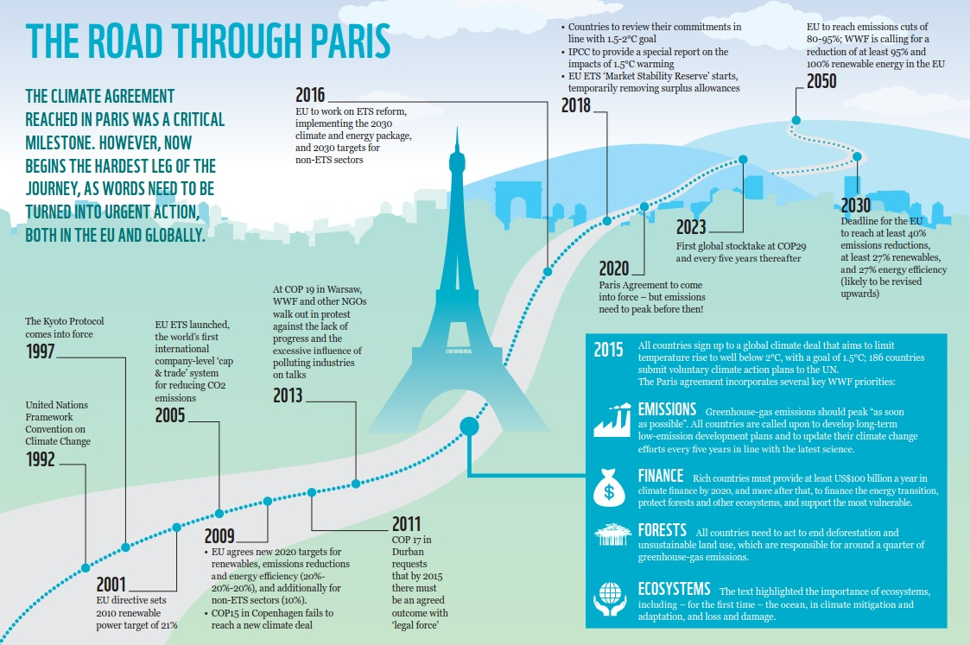
I. Green Investment: Related contexts and scope I.2. Global commitments and green investment
1.2.1. The Paris Agreement (PA) and green investment
Source: https://wwf.panda.org/wwf_news/?264013/100%2Ddays%2Dsince%2DParis%2D3%2Dmissed%2DEU%2Dclimate%2Dopportunities

Slide 7
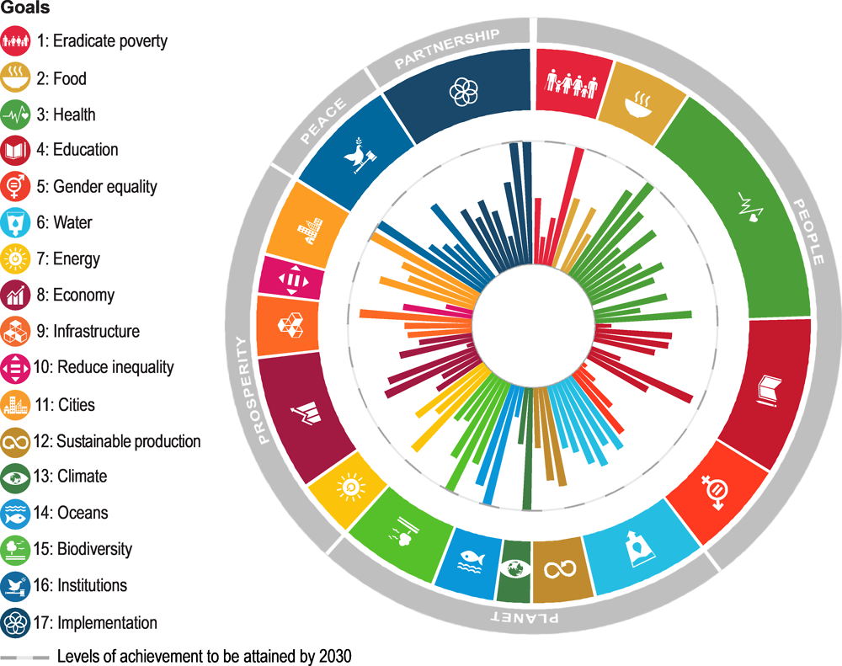
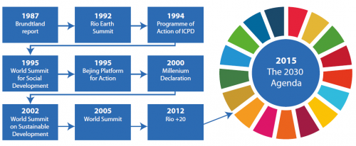
I. Green Investment: Related contexts and scope I.2. Global commitments and green investment
1.2.2 The SDGs and green investment
2015
The 2030 Agenda
Source: https://ec.europa.eu/eurostat/statistics-explained/index.php?title=SDG_-_Introduction

Slide 8
I. Green Investment: Related contexts and scope I.5. Key actors in the green investment ecosystem
1
3
Real Investment
1
e.g. Stewardship Code
4
2
e.g. Corporate Governance Code
1
2
3
e.g. Green Bonds Guidelines
4
e.g. Green Loans Guidelines
Regulators
Source: https://www.un.org/development/desa/dpad/wp-content/uploads/sites/45/PB97_2021-Apr_fig1.png (with author’s minor editing)

Slide 9
Exercise1 “X” needs money to make a medical operation for his son. He offers to sell part of his beer manufacturing company for no less than $100,000, whereas its market price is around $150,000. The company is located near a sunny beach in an attractive, calm city. Due to climate change, there is a concern that Tsunami may hit it in the coming years. The buyer can install a rooftop solar system to substitute the existing diesel generation system resulting in substantial GHG emissions reduction and extra/attractive financial return. Questions: A) Assuming you are a responsible investor, which among the following options you may exclude, and why? 1) Buy it with $100,000 2) Buy it with $120,000 3) Buy it with $150,000 4) Not to buy it B) When installing the rooftop solar panel PV system can be considered as: 1) Traditional investment 2) ESG investment 2) Impact Investment
Q&A and/or Exercise

Slide 10
II. Japan’s effort in green investment
II. Japan government structure

Slide 11
II. Japan’s effort in green investment (75mn)
I.1. MOE’s key efforts
II.1.1 Promoting Green Finance (Green Bonds and Green Loans)
MOE
 | Initiative | Date (M/Y) | Type
 |  |  | Strategy | Guidance | Support | Expert/WG
1 | Pilot Project for Green Bond Issuance | 4/2017 – 3/2018 |  |  | ✓
2 | The Green Bond Issuance Promotion Platform | /2018 |  |  | ✓
3 | Financial Support Program for Green Bond Issuance | 4/2018 |  |  | ✓
4 | Japan Green Bond Awards | 3/2019 |  |  | ✓
5 | Green Bonds Guidelines (revised in 2020) | 3/2020 |  | ✓
6 | "Green Loan and Sustainability Linked Loan Guidelines" | 3/2020 |  | ✓
MOE established several measures to boost the green bond market. Those measures included:
-The Green Bond Guideline in 2017 (revised in 2020).
-Call for model cases (pilot project) to showcase innovative and leading deals;
-The Green Bond Issuance Promotion Platform, intended to serve as an online portal for all information regarding green bonds;
-A Financial (subsidy) Support Programme to cover costs associated with green bond issuance such as external reviews;
Note: The Green Bond Issuance Promotion Platform was expanded into a Green Finance Portal, and the Green Bond Awards were updated and held as the ESG Finance Awards in early 2020, both with intentions to include loans.
MOEJ also developed the Green Loan Guidelines and the Sustainability Linked Loan Guidelines in March 2020 to promote green investment through loans.

Slide 12
II. Japan’s effort in green investment (75mn)
I.1. MOE’s key efforts
II.1.1 Promoting Green Finance (Green Bonds and Green Loans) (Continue)
Fig1 Trend of Green Bond issuance in Japan
Fig.2 Trend of Green Loan issuance in Japan
Note: Although the number of issuances is increasing, compared with other countries, the scale and number of issuances are limited
Note: Green loans have been mainly allocated to renewable energy and green buildings so far
Source: http://greenfinanceportal.env.go.jp/en/bond/issuance_data/market_status.html
Source: http://greenfinanceportal.env.go.jp/en/loan/issuance_data/market_status.html

Slide 13
II. Japan’s effort in green investment (75mn)
I.1. MOE’s key efforts
II.1.2 Promoting ESG Finance
MOE
 | Initiative | Date (M/Y) | Type
 |  |  | Strategy | Guidance | Support | Expert/WG
1 | Support Program for Climate Risk / Opportunity Assessment and Scenario Analysis in line with TCFD Recommendations | 4/2018 ‐ 3/2019 |  |  | ✓
2 | "Practical Guide for Scenario Analysis in line with TCFD Recommendations" | 3/2019 |  | ✓
3 | Establishment of the ESG Finance High-Level Panel | 2/2019 |  |  |  | ✓
4 | "Strategy toward becoming a big power in ESG finance” | 3/2019 | ✓
5 | ESG Regional Finance Promotion Program | 3/2019 |  |  | ✓
6 | ESG Regional Finance Interest Subsidy Program | 4/2019 |  |  | ✓
7 | The ‘ESG Regional Finance Practice Guide 2.0’, and the ‘Green Impact Assessment Guide’. | 5/2021 |  | ✓
1&2 are policies around promoting ESG through enhancing disclosure and supporting corporate investor communication with an emphasis on non-financial information enhancing corporate value;
3-8 are policies around promoting more broadly ESG finance, specifically in the banking sector in the context of Regional Revitalisation. For instance, in late Mar 2021, the MOE announced the ‘Green Impact Assessment Guide’ and the ‘ESG Regional Finance Practice Guide 2.0’ as an outcome of the Positive Impact Finance Taskforce and the Regional ESG Finance Taskforce (that were established under the ESG High-Level Panel in Mar. 2020);
Other Policies also included the Eco Lease Promotion Programme, Green Fund Project, Scenario Analysis Support corresponding to TCFD.

Slide 14
II. Japan’s effort in green investment (75mn)
I.1. MOE’s key efforts
II.1.2 Promoting ESG Finance (continue)
Fig1. Change in the number of TCFD supporting organization by country
Fig2. Trend in ESG Investment in Major Countries
Note: The number of TCFD supporting organizations in Japan is 338, the largest in the world.
Note: Since Japan is a latecomer compared to Europe and the United States, the investment amount is smaller than those countries. However, the compound average growth rate (CAGR) between 2014 and 2018 is 308%, significantly higher than other major countries.
Source: https://fincity.tokyo/wp-content/uploads/2021/01/1611888973-1308ad97907fdffa4fc05be7690f6114.pdf

Slide 15
II. Japan’s effort in green investment (75mn)
I.2. METI’s key efforts
II.2.1 Climate innovation finance and the green growth strategy
METI
 | Initiative | Date (M/Y) | Type
 |  |  | Strategy | Guidance | Support | Expert/WG
1 | Establishment Study Group on Environmental Innovation Finance | 2/2020 |  |  |  | ✓
2 | Climate Innovation Finance Strategy 2020 | 9/2020 | ✓
3 | Announcement of the ‘Green Growth Strategy Through Achieving Carbon Neutrality in 2050’ | 12/2020 | ✓
Fig.1 Climate Innovation Finance Strategy
Fig.2 Five policies tool towards the New Green Growth Strategy

Slide 16
II. Japan’s effort in green investment (75mn)
I.2. METI’s key efforts
II.2.2. METI efforts regarding the TCFD
In 2018 METI produced the Guidance for Climate-related Financial Disclosure (TCFD Guidance) to support companies intending to implement the TCFD recommendations.
In May 2019, METI extended its support to establish the TCFD Consortium, a platform to exchange information on the effective and efficient disclosure of climate-related information.
In Oct. 2019, METI also hosted the first TCFD Summit, bringing on board the TCFD Consortium and World Business Council for Sustainable Development (WBCSD) as co-organizers.

Slide 17
II. Japan’s effort in green investment (75mn)
I.3. FSA’s key efforts
II.3.1 Governance/stewardship codes and
FSA
 | Initiative | Date (M/Y) | Type
 |  |  | Strategy | Guidance | Support | Expert/WG
1 | "Guidelines for Investor and Company Engagement" | 6/2018 |  | ✓
2 | "Corporate Governance Code 2018 (revised version of 2015)" | 6/2018 |  | ✓
3 | "Japan's Stewardship Code” (revised version of 2017) | 3/2020 |  | ✓
4 | Corporate Governance Code and Guidelines for Investor and Company Engagement | 4/2021 |  | ✓
5 | Establishment of the ‘Expert Panel on Sustainable Finance’ | 12/2020 |  |  |  | ✓
6 | Establishment of the “Joint Team for Enhancing Sustainable Regional Economies’ (Jointly with MOE) | 3/2021 |  |  |  | ✓
7 | “Report by the Expert Panel on Sustainable Finance” | 7/2021 |  | ✓
FSA has guided investors and the industry through the Stewardship Code and the Corporate Governance Code. The FSA presented the draft of the revised Corporate Governance Code and Stewardship Code in early April. The proposed revisions would make the guidance stronger and clearer on sustainability-related disclosure.
The FSA and MOE announced establishing a ‘Joint Team for Enhancing Sustainable Regional Economies’ to move forward on regional ESG finance.
The “report by the Expert Panel on Sustainable Finance” outlines recommendations for policy actions needed to promote sustainable activities in Japan.

Slide 18
II. Japan’s effort in green investment (75mn)
II.4. MOE-METI-FSA’s key Joint efforts
II.4 Transition Finance
MOE-METI-FSA’s key efforts on transition finance
 | Initiative | Date (M/Y) | Type
 |  |  | Strategy | Guidance | Support | Expert/WG
2 | Establishment of the ‘Taskforce on Preparation of the Environment for Transition Finance’ | 12/2020 |  |  |  | ✓
3 | Issuance of the ‘Basic Guidelines on Climate Transition Finance’ | 5/2021 |  | ✓
4 | Announcement of the ‘Asia Energy Transition Initiative (AETI)’ (only by METI) | 5/2021 |  |  | ✓
The “Basic Guidelines on Climate Transition Finance” aims to contribute to the achievement of the Paris Agreement and carbon neutrality in Japan by 2050 through the introduction of more funding, particularly in sectors in transition where emissions are difficult to be reduced.
The guidelines intend to promote the spread of climate transition financing that has just started and increase the credibility of financing conducted under “transition finance.”
Transition finance focuses not only on individual projects that require funding (the targets for the funding) but also makes a comprehensive judgment of the project operators’ “transition strategies” toward decarbonization and the reliability and transparency with which those strategies are implemented.

Slide 19
II. Japan’s effort in green investment (75mn)
II.5. Bank of Japan’s (BOJ) Keyy efforts
II.5 Sustainable regional economy and sustainable finance
Bank of Japan (BOJ)
 | Initiative | Date (M/Y) | Type
 |  |  | Strategy | Guidance | Support | Expert/WG
1 | Zero-interest funds to lenders serious about climate change | 07/2021 |  |  | ✓
2 | Pilot exercises to conduct climate-risk scenario analysis | tbd |  | ✓
3 | Buying green bonds using BoJ foreign reserves | 07/2021 |  |  | ✓
Monetary policy: The Bank of Japan (BoJ) is launching a new climate lending facility that offers interest-free loans to banks so that they can, in turn, provide financing for environmentally friendly projects or companies;
Financial system:
The BOJ, in collaboration with Japan's banking regulator Financial Services Agency, is working on pilot exercises to conduct climate-risk scenario analysis on large financial institutions.
The Bank will encourage financial institutions to enhance their disclosures, both qualitatively and quantitatively, based on the TCFD framework.
International Finance: The Bank will purchase foreign currency-denominated green bonds issued by governments and other foreign institutions using its foreign reserves as part of efforts to promote global investment in activities combating climate change.

Slide 20
Q&A and/or Exercise
Questions
A) What measures are being taken by your government to enhance green investment/ESG?
B) Which among the following measures could be the most needed to be considered by your government to encourage investors, financial institutions and companies to engage in green/ESG investments?
1) Policy/Regulation
2) Clear definition/taxonomy/standard
3) Financial incentives
4) Information sharing and capacity building
5) Other(s)

Slide 21
Conclusion and key takeaways
There is currently no agreed definition of green investment however, they mainly refer to investment activities that into consideration the environmental factors; hence that generate positive environmental impacts;
Two global commitments are driving green investments: The Paris Agreement and the 2030 Sustainability Agenda (SDGs);
In Japan, policy directions are discussed under various expert committees/study groups informing policymaking by way of issuing summary reports;
There is no single overarching framework document or policy specifically on green investment in Japan. Green-investment-related policies have been undertaken across a number of ministries, mainly the Ministry of the Environment (MOE), the Ministry of Economy, Trade and Industry (METI), and the Financial Services Agency (FSA). Each ministry operates within the bounds of its mandate, and the related policies are interpreted and implemented to serve their respective agendas;
Japan’s policy is more distributed between climate action and a wider sustainability agenda (i.e., SDGs and/or Regional Revitalization).

Slide 22
Recap and key takeaways
Japan places finance as a key pillar for climate transition and achieving reduction targets. However, regarding investment mobilization, Japan has not publicly committed to quantitative goals;
Almost all Japanese policies are on a voluntary basis, and are structured to provide guidance and technical support to the private sector and strengthen its competitiveness in the global context. There is very strong emphasis/support to the disclosure in line with the TCFD framework;
It was acknowledged that there is more need for synergy among the ministries. This seems to has been addressed through several recent joint initiatives such as the ones between FSA, METI, and MOE since 2020.
Supporting green finance in Japan was directly and indirectly through financial and nonfinancial support, including (subsidies, awards, preferential interest rate (financial), registration system, guidelines, information and knowledge-sharing platforms, project piloting, etc.

Slide 23
Appendix
Useful links for further reading:
-White Paper on Sustainable Investment in Japan: https://japansif.com/wp-content/uploads/2021/06/wp2020en.pdf
-Sustainable finance in Japan: https://www.adb.org/publications/sustainable-finance-japan
-Tokyo Green Finance Initiative (TGFI): https://www.seisakukikaku.metro.tokyo.lg.jp/pgs/2021/07/images/TGFI_overview.pdf
-Government Pension Investment Fund (GPIF): https://www.gpif.go.jp/en/about/philosophy.html
-Japan sustainable finance policy update: https://www.iges.or.jp/en/pub/japan-sustainable-finance-policy-update-mar21-may21/en
-Japan EU Comparative Analysis on Sustainable Finance Policy: https://www.iges.or.jp/en/about/staff/morishita-maiko?page=%2C1

Slide 24
Appendix
Definition of Transition Finance – ICMA “Climate Transition Finance Handbook”

Slide 25
Thank you for you attention

