Slide 1
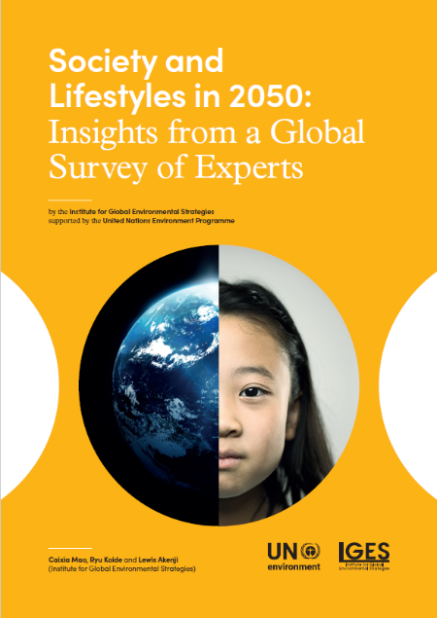
Society and Lifestyles in 2050: Insights from a Global Survey of Experts
2019 Hong Kong Conference of the Global Research Forum on
Sustainable Production and Consumption,
Hosted by Hong Kong University of Science and Technology (HKUST)
4th International Conference
26 June - 29 June 2019
Caixia Mao, Ryu Koide, Lewis Akenji
Sustainable Consumption and Production Area
Institute for Global Environmental Strategies (IGES)
https://pub.iges.or.jp/pub/society-and-lifestyles-2050-insights-global-0

Slide 2
Outline
Introduction to the report
Survey methodology
The impact of foresighted changes of society to future lifestyles
Determining factors of future sustainable lifestyles in 2050
Foresight as an instrument towards future sustainable lifestyles

Slide 3
Introduction of the report
Provides a basis for discussions on future lifestyles by different stakeholders and citizens in a more participatory process.
Teases out contested views and possibilities of multiple futures.
Looks at future beyond hard technology and economy aspects of society, and more than consumption domains of lifestyles.

Slide 4
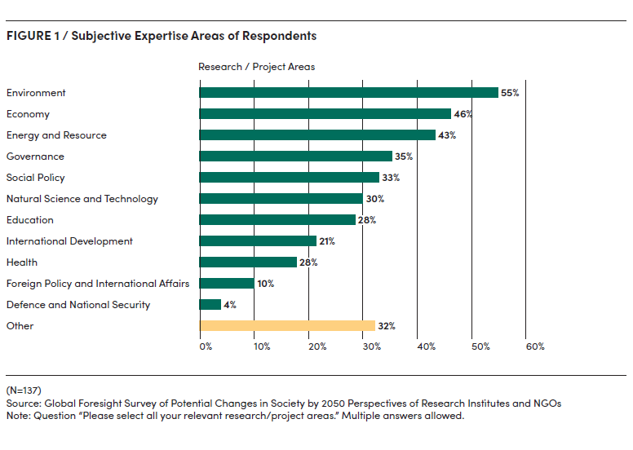
2. Survey methodology
Free-text format survey to look at broader society (culture and social norms, governance, economy, technology and innovation, environment and natural resources, and demography), day-to-day living (food, consumption of manufactured goods, mobility, housing, education, work, leisure, health and social connections and relationships), and stakeholder roles.
Respondents: future oriented experts (N = 137)
Experts that conduct research about future in multiple fields (energy, economy etc.)
Experts that are not necessarily only doing future studies but specialize in fields within which they research the future

Slide 5
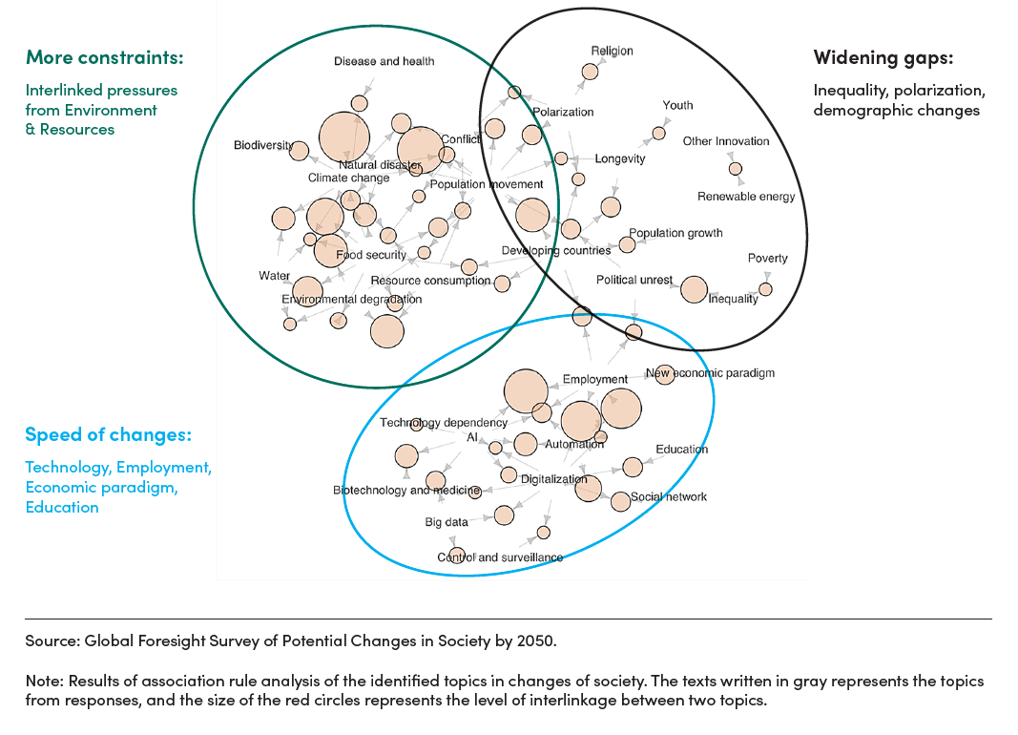
3. The impact of foresighted changes of society to future lifestyles
The rate of changes in both physical infrastructure and people’s norms would accelerate due to technological disruption.
More constraints due to ecological pressure, widening inequality and population increase.
Widening gaps between aspirations of individuals (what people want) and the reality in the foresighted future (what people will have).

Slide 6
4. Determining factors of future sustainable lifestyles in 2050
Food
Consumption Manufactured Goods
Housing
Mobility
Consumption
Voluntary less consumption and forced less consumption: Constraints arising due to the scarcity of resources and increasing environmental and health impact of food and manufactured goods which could lead to diet and habit shift.
Infrastructure
Affordability and accessibility of technology advancement: due to the cost to access, technology advancement only accessible to those who can afford them.

Slide 7
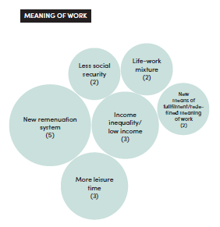
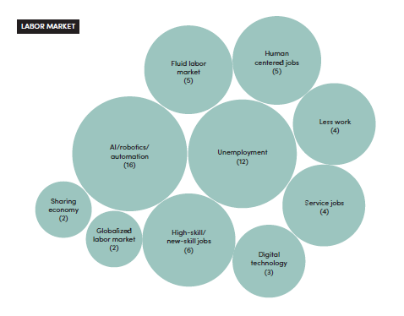
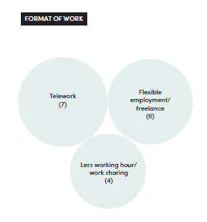
4. Determining factors of future sustainable lifestyles in 2050
Time use and the meaning of life – Work
Source: Caixia Mao, Ryu Koide, and Lewis Akenji. 2019. Society and Lifestyles in 2050: Insights from a Global Survey of Experts, IGES Discussion Paper: Institute for Global Environmental Strategies, Hayama, Japan.

Slide 8
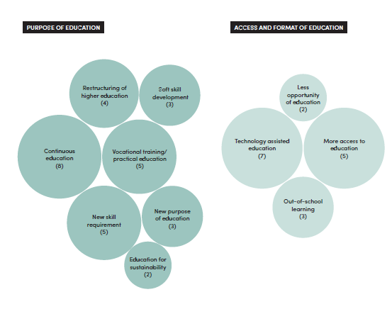
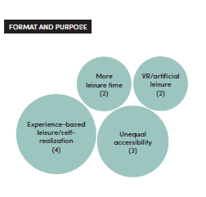
4. Determining factors of future sustainable lifestyles in 2050
Time use and the meaning of life – Education and Leisure
Source: Caixia Mao, Ryu Koide, and Lewis Akenji. 2019. Society and Lifestyles in 2050: Insights from a Global Survey of Experts, IGES Discussion Paper: Institute for Global Environmental Strategies, Hayama, Japan.

Slide 9
Work
Education
Health
Social Connections and Relationships
Leisure
4. Determining factors of future sustainable lifestyles in 2050
Time use and the meaning of life
Fair distribution of benefits from automation and identity beyond work: replacement of human labour by automation is the critical factor and people need to search the alternative identity beyond work, and the purpose of education to be based on more than contribution to the economy.
Physical and mental health
Active elderly life and connecting in a digital age: longevity does not guarantee a healthy and active elderly life, and more digital connections does not necessarily fulfill emotional needs for deeper connection.

Slide 10
5. Foresight as an instrument towards future sustainable lifestyles
The future can be co-created by bringing those engaged in preparing for it together with opportunities.
Contribute to the realisation of more a sustainable future by interpreting also through changes in the soft aspects to provide a richer and more dynamic understanding of future lifestyles.
A more “people-centred” view enables citizens to be better engaged on how future changes could affect their lives and how a more sustainable future can be built.

Slide 11
Thank you!
Link to the report:
https://pub.iges.or.jp/pub/society-and-lifestyles-2050-insights-global-0

