Slide 1
Tripartite Environmental Cooperation: Observations from a Review of TJAP(2010-2014) and the Current Climate Activities
Xianbing Liu
Climate and Energy Area, IGES
E-mail: liu@iges.or.jp
Tel.: +81-46-855-3810

Slide 2
The change of TJAP priority areas
TJAP(2010-2014): TEMM12, 44 activities
Environ. Education, Environ. Awareness and Public Participation
Climate Change
TJAP(2015-2019): TEMM17, 37 activities
Air Quality Improvement
Biodiversity
Sound Management of Chemicals
Chemical Management and Environ. Emergency Response
Transboundary Movement of E-waste
Biodiversity Conservation
Dust and Sand Storms
Pollution Control
Environ.-Friendly Society/3R/Sound Resource Recycle Society
Environ. Governance in Northeast Asia
Environ. Industries and Technology
Circulative Manage. of Resources/3R/Trans. Movement of E-Waste
Climate Change Response
Conservation of Water and Marine Environment
Transition to Green Economy
Environ. Education, Public Awareness and CSR
Rural Environ. Management

Slide 3
Planned activities in climate change area of TJAP
TJAP(2010-2014) | TJAP(2015-2019)
A1: Constructive Work together for Positive Outcome of COP and CMP of UNFCCC | A1: Climate Change Mitigation Technology Research and Demonstration Experience Exchange
A2: Exchange Information on Policies and Actions
 | A2: Information Sharing on Co-Control Technology
A3: Exchange information on policies and Experiences on a Co-Benefit Approach to address both Climate Change and Environmental Problems
 | A3: Climate Change Adaptation Experience Exchange
A4: Green economy policy seminar
 | A4: Research on Low Carbon and Environment-Friendly Cities Construction
A5: Joint research on ‘Green Growth & Low carbon Society’

Slide 4
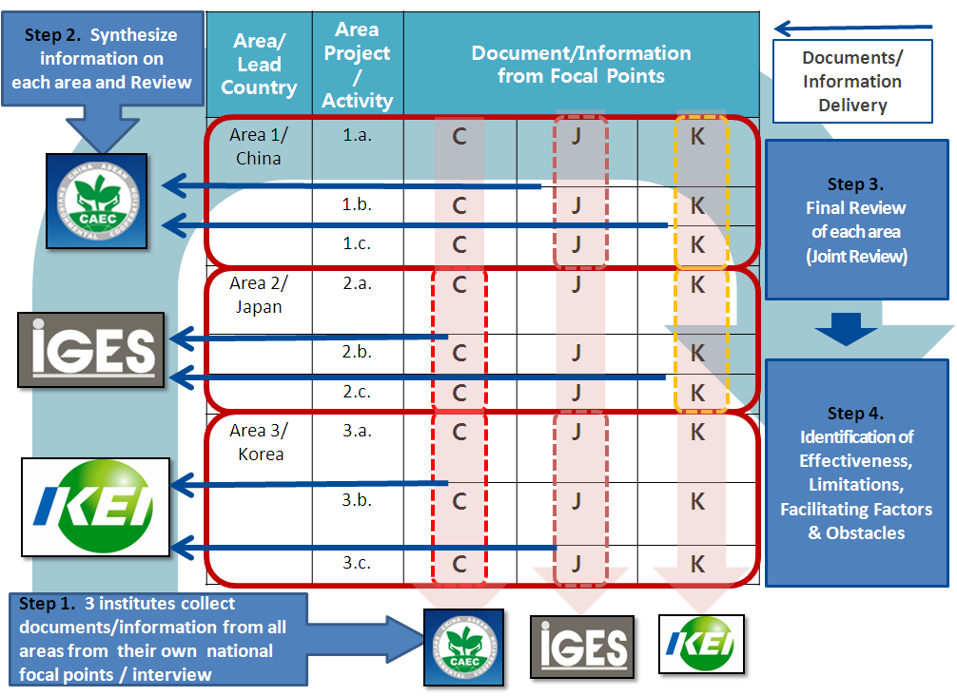
Review process of TJAP(2010-2014)
Source: TJAP review report of CAEC, IGES and KEI, March, 2015.

Slide 5
Overall review results and recommendations
Overall progress:
◈ Significant progress and achievements were obtained;
◈ The progress varied with different areas;
◈ A large number of activities were done successfully;
◈ Useful results were produced.
Results:
◉ Enhanced mutual understanding;
◉ Enhanced information and knowledge sharing;
◉ Increased public environ. awareness and knowledge;
◉ Improved the policymaking.
Suggestions:
◘ Essential for sufficient financial, technical and human resources;
◘ Stability and good communication of FP;
◘ Need to strengthen technical and research cooperation;
◘ Continue in most existing priority areas;
◘ Some areas/activities to be coordinated and combined.

Slide 6
Implementation and evaluation of climate change area
Objectives:
Reaffirm their commitment and work together to promote the full and effective implementation of the UNFCCC and its KP.
Progress:
A1: Exchanged views via bilateral meetings toward a successful outcome at COP20;
Evaluation:
The cooperation has enhanced information and knowledge sharing in the area;
A2: Ministers exchanged information on climate policies and actions at the annual TEMM;
A3: No actual cooperation activities on the co-benefit approach;
A4: China hosted the Tripartite Green Economic Policy Seminar in 2010; and, three countries participated in Green Finance Seminar held in 2011 and 2013;
A5: KEI, PRCEE and IGES conducted a joint research on how to promote green economy at city level.
Sufficient financial resources need to be allocated to continue this area;
Policy dialogue, seminars and joint research should be conducted in a more continuous and regular manner;
The cooperation was bilateral rather than trilateral;
Activities in the climate change area is still in the beginning stage and the implementation of relevant activities was limited.

Slide 7
Non-TEMM activity: Low carbon training in FY2017
Time and place
Dec. 5-7, 2017
Tokyo, Kanagawa
Participants (7)
NDRC
NSCS
Beijing, Shanghai, Guangdong
Tsinghua Univ.
ECC, MOEP
Meeting with MOEJ
Meeting at Keidanren
Meeting at Tokyo Gov.
Site visit
Source: https://www.iges.or.jp/jp/climate-energy/20171205.html

Slide 8
Non-TEMM activity: J-C climate policy workshop 2017
Date: Sep. 6-7, 2017; Place: Beijing, China
Host: MOEJ; Co-organizers: IGES, ERI/NDRC
Current State of Climate Change Policies in China and Japan
The Role of Leading Cities towards De-carbonization and Sustainable Development
Long-Term Low Emission Development Strategies and Scenarios
Building a Positive Feedback Loop between National Actions and International Processes
Group photo
Presentation
Source: https://www.iges.or.jp/jp/climate-energy/20170906.html

Slide 9
Non-TEMM activity: JCK carbon pricing forum 2017
Presentation
Group photo
Venue: Seoul, Korea
Date: 21-23, Dec., 2017
FP: IGES, THU, KECO
Policy inform. sharing
Carbon market in the region
Official meetings
Site visit
Econ. effect of CP
Technical aspect of carbon market & offset

Slide 10
Observations to the cooperation under TEMM
Problem complexity
Diverse and complex environ. problems (Local, regional and global);
Large difference among the three countries in political system, economic development, culture, resource endowment, energy structure, decision-making process, etc.
Comprehensive approach
Continue the focus on information sharing and the construction of related mechanisms and networks to promote mutual understanding and trust;
Enhance more advanced cooperation, i.e., capacity building, joint research, strengthening policies, and impact generation on actual environmental outcomes;
Three strategic approaches: Information sharing → Research → Action
More research, technical and scientific cooperation;
More input of financial and human resources;
Better communication and coordination of activity FP;
Linkage with non-TEMM frameworks;
Increasing capacity of China and more opportunities of mutual learning;
Increasing joint contribution to other developing Asian countries
Future direction

