Slide 1
The 2nd JITMAP dialogue meeting
-18 Jan. 2018, MCCIA Trade Tower, Pune-
JITMAP: Promoting Japanese low carbon technologies and best practices in India
Abdessalem RABHI, PhD.
Programme Manager, IGES

Slide 2
About IGES: Outline
Name of the Institute
The Institute for Global Environmental Strategies (IGES)
Establishment March 31, 1998
Location
>Headquarter: Hayama, Kanagawa, Japan
>Tokyo Office: Chiyoda-ku, Tokyo
>Kitakyushu Office: Kitakyushu-city, Fukuoka
>Kansai Research Centre (KRC): Kobe, Hyogo
>Overseas Offices/Desks: Bangkok (Thailand), Beijing (China), Delhi (India).
IGES headquarters （Hayama, Kanagawa）

Slide 3
IGES-TERI’s efforts to promote low carbon technologies and best practices in India
-Technology Assessment and Stakeholders’ Matchmaking-

Slide 4
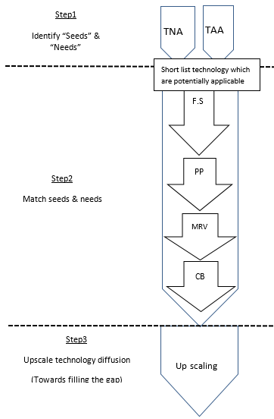
Overall process of intervention
Technology Need Assessment (TNA)
Technology Availability Assessment (TAA)
JICA/JST Funding)
(FY2010-2013)
Feasibility Study
Demonstration projects
MOEJ Funding
(FY2014, 2015, 2016, 2017)
Evaluation
Capacity Building
JBIC, EESL funding?

Slide 5
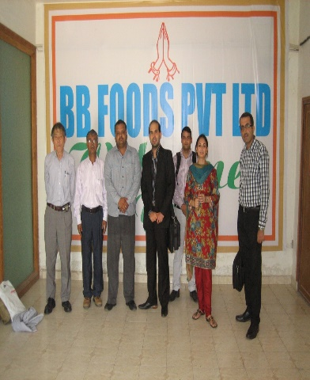
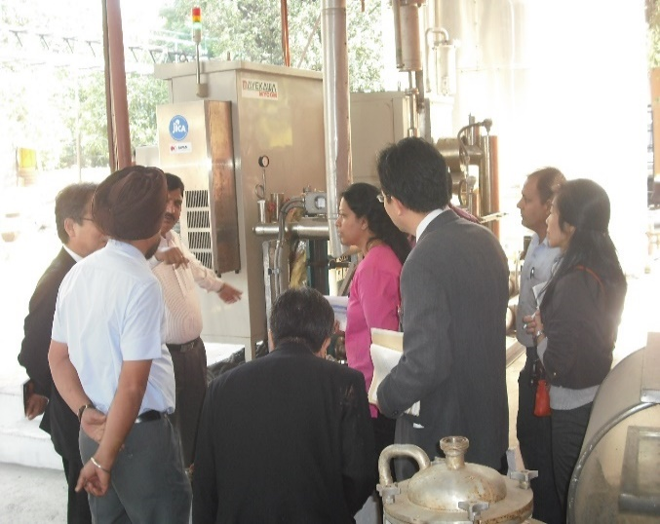
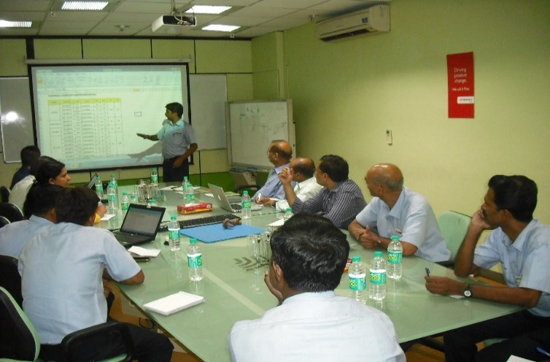
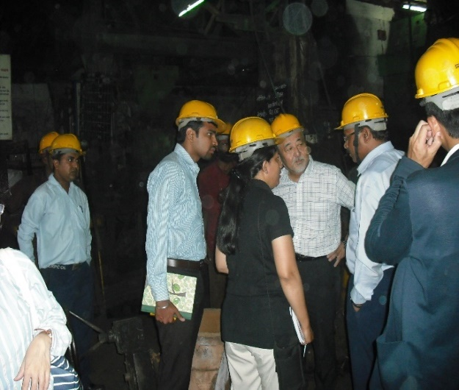
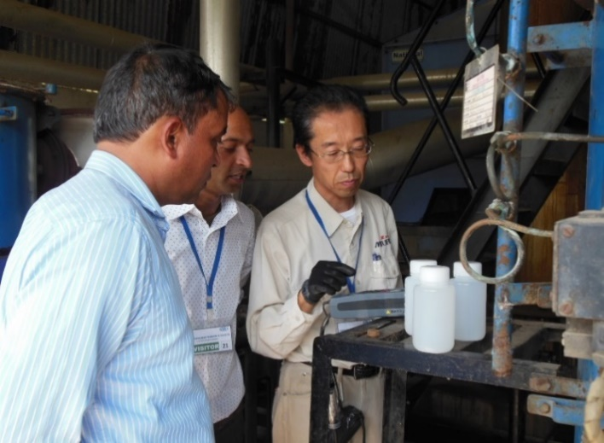
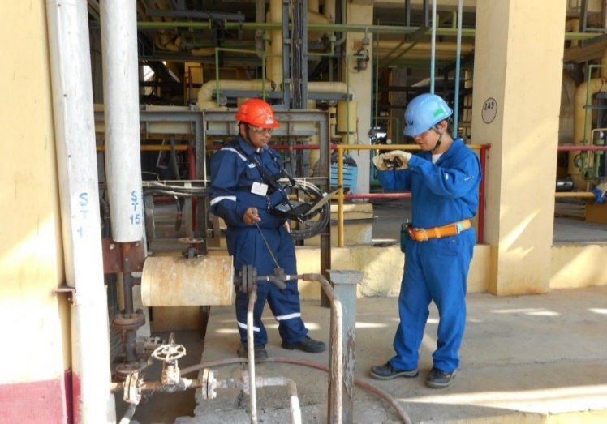
B2B Matching: Feasibility studies
FS on Gas Heat Pump (GHP)
FS on Electric Heat Pump (EHP)
FS on Compressed air (CA)
FS on Induction Furnace (IF)
FS on Once Through Boiler (OTB)
FS on Steam System Optimization (SSO)

Slide 6
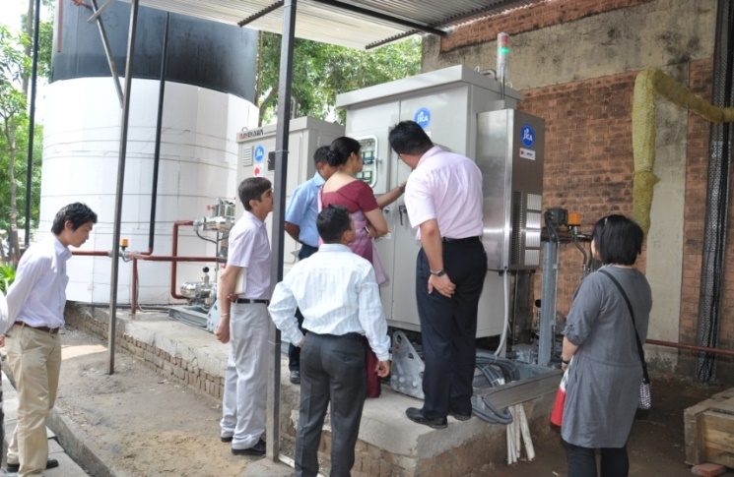
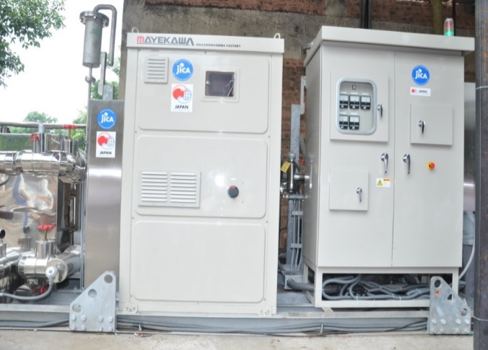
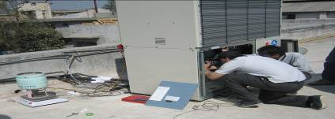
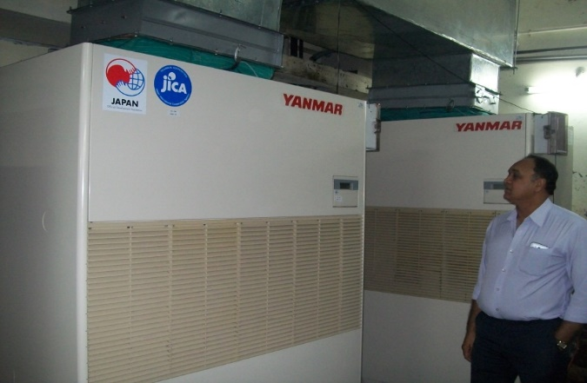
B2B Matching: Demonstration projects and impact evaluation
Electric Heat Pump (EHP): 30%-40% energy saving due to reduction in fuel consumption of boiler and electricity consumption of chiller
Gas Heat Pump (GHP): 35%-45% energy saving due to switch from electricity to Natural Gas as source of energy

Slide 7
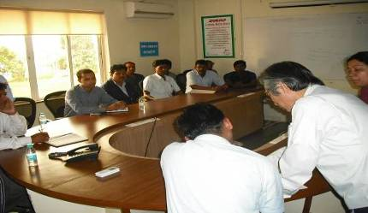
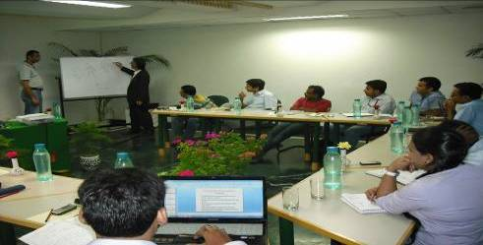
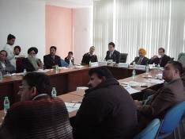
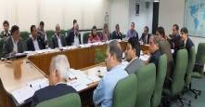
B2B Matching: Awareness creation and capacity building
On site trainings for plant engineers
In house trainings for energy auditors (TOT)
Awareness creation and capacity buildings for businesses managers and/or owners
Notes:
7

Slide 8
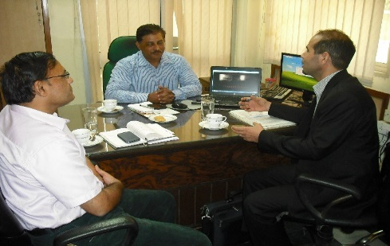
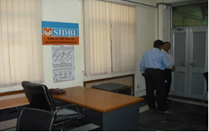
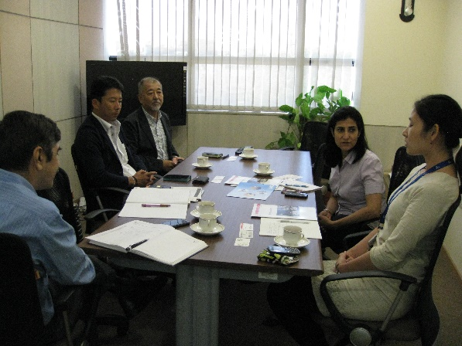
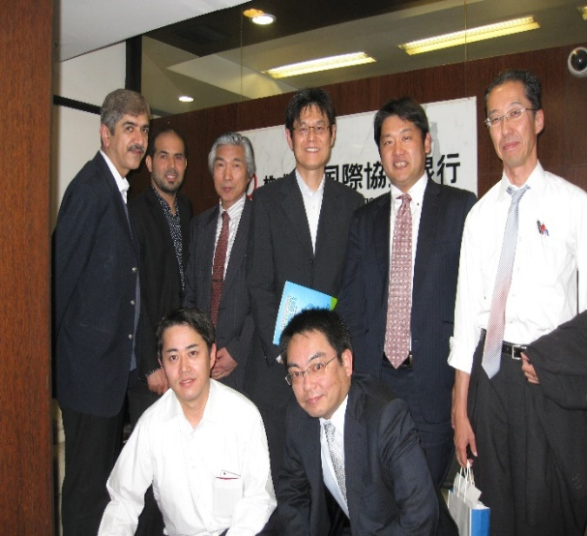
B2F Matching: Explore potential financing options
Mtg. with Small Industries development bank in India (SIDBI)
Mtg. with JICA (India)
Mtg. with JBIC (India)

Slide 9
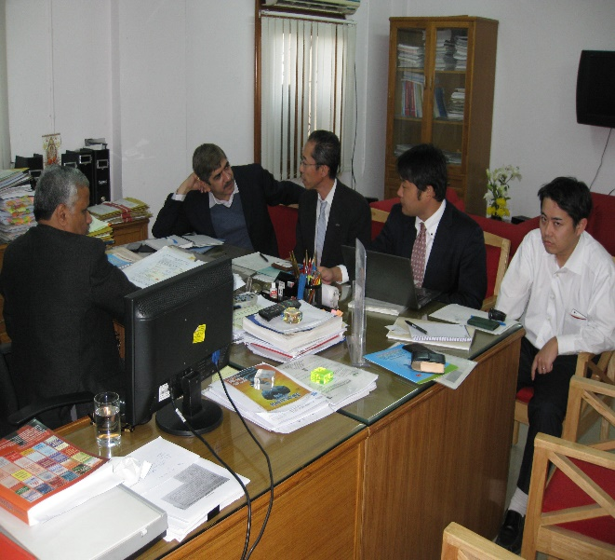
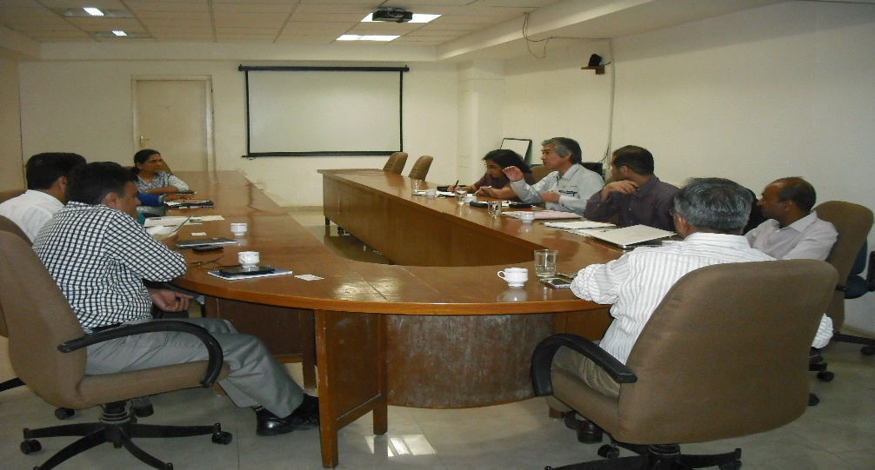
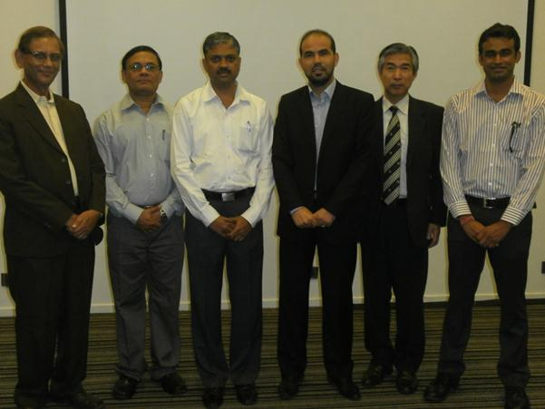
B2P Matching: Explore supporting policy/programme options
e.g. mtg. with Central Boiler Inspectors regarding IBR
e.g. Mtg. with Gujarat Energy Development Agency (GEDA)
e.g. mtg. with MCCIA

Slide 10
Insights and lessons learnt
Case study1: Installing Electric Heat Pump in India

Slide 11
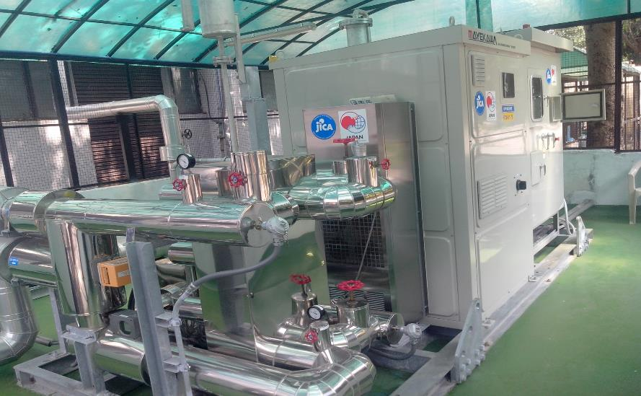
ELECTRIC HEAT PUMP INSTALLED
AT FOOD COMPLEX, MOGAR

Slide 12
YEARLY CO2 REDUCTION
Notes:
Average CO2 reduction is 180 ton/year (almost twice what was initially estimated)
Note: In Year 2013, EHP started operation in 23 Jul.
Year 2015, EHP was under breakdown for 4 months
Year 2017, the data was just until Mid July.

Slide 13
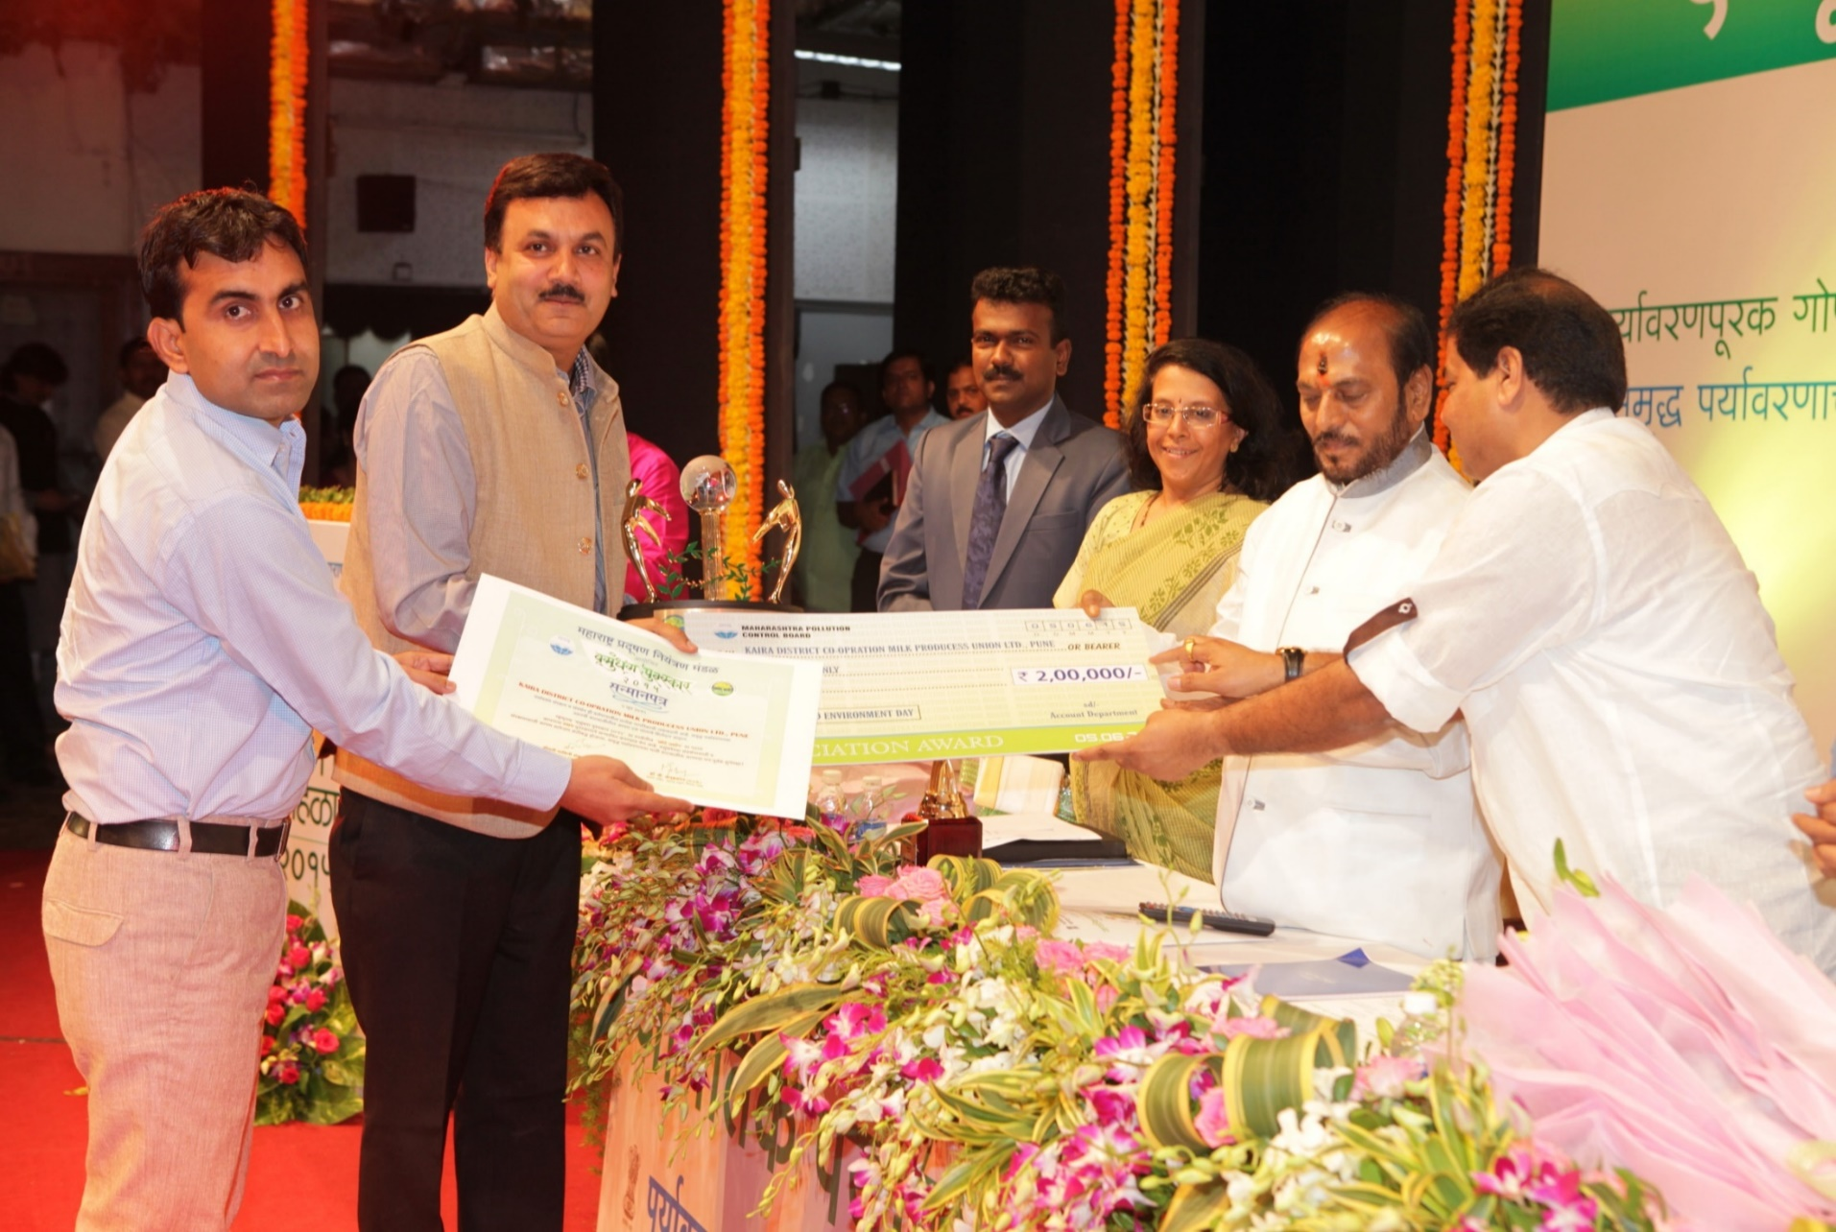
Recognitions from Energy and Environmental Savings
Vasundhara Award -2015

Slide 14
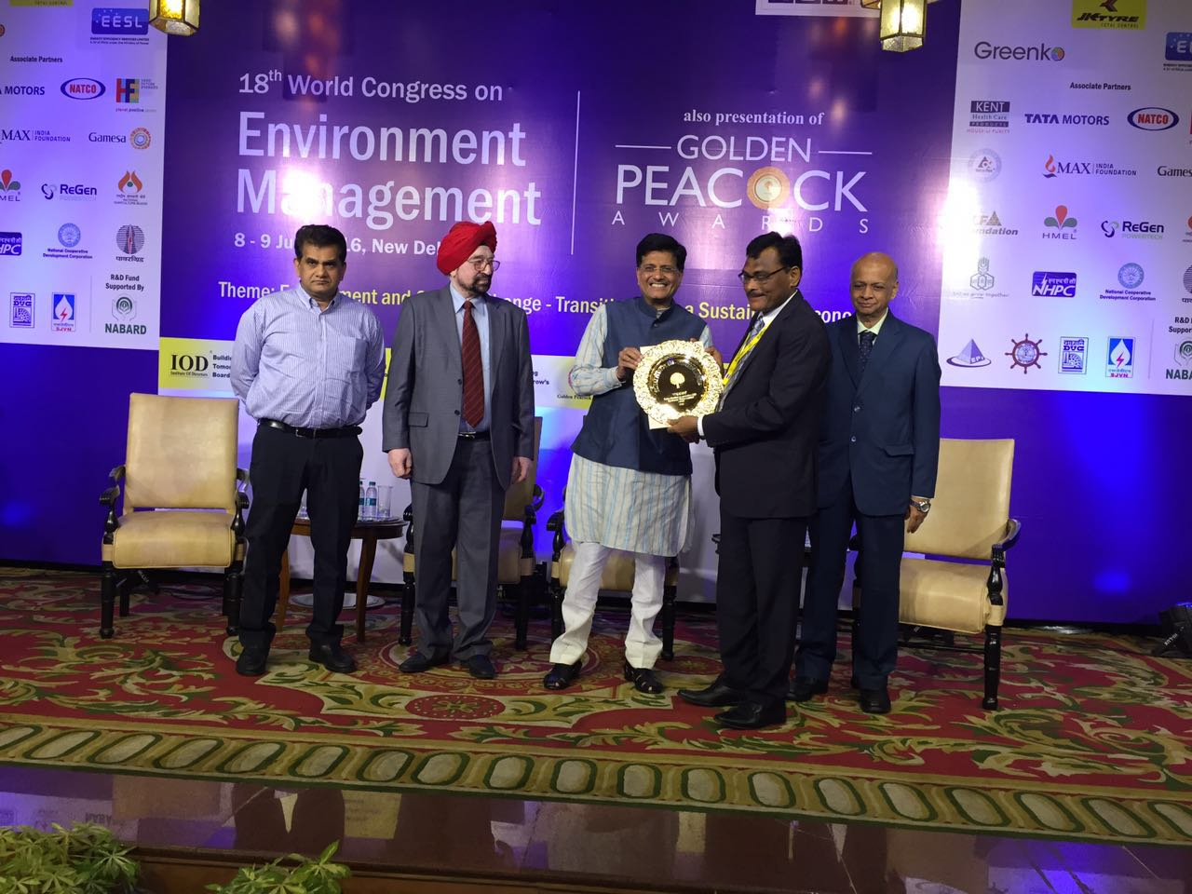
Recognitions from Energy Savings
and Innovations
Golden Peacock Award- 2016
(National Level)

Slide 15
Key insights based on the EHP case study
Implementing demonstration project “show case” is needed towards green technology transfer;
Continuous and timely technical assistance/follow up is needed to ensure the success of the demonstration project;
Technology transfer is a continuous process where synergy among efforts/stakeholders is needed;

Slide 16
Insights and lessons learnt
Case study2: Investigation on compressed air system

Slide 17
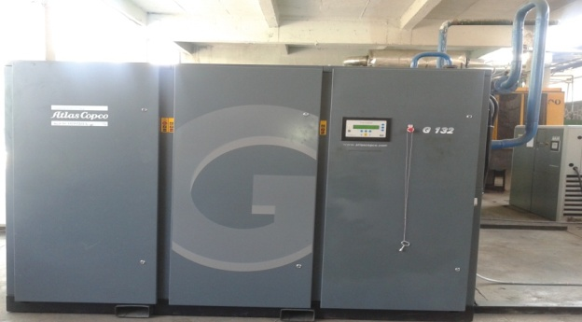
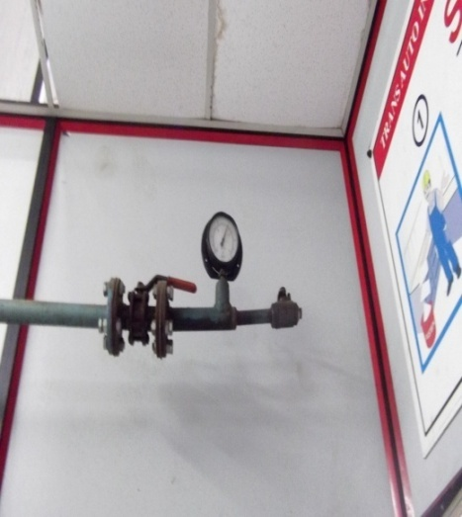
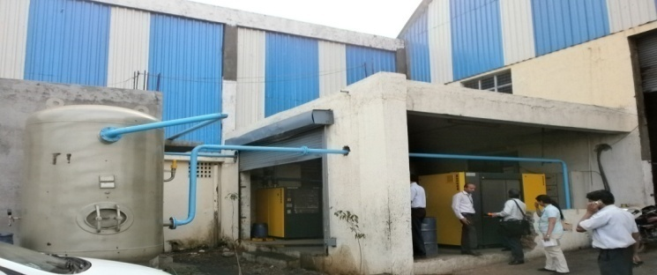
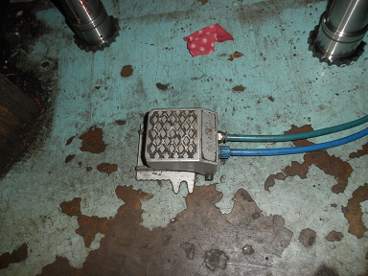
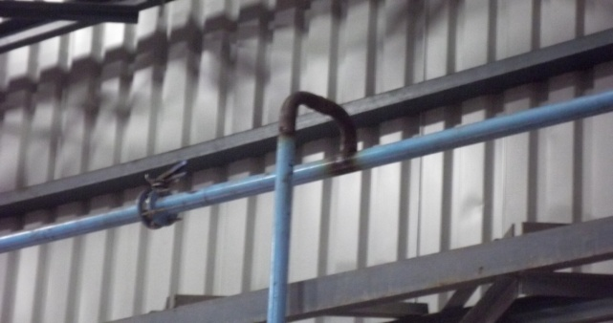
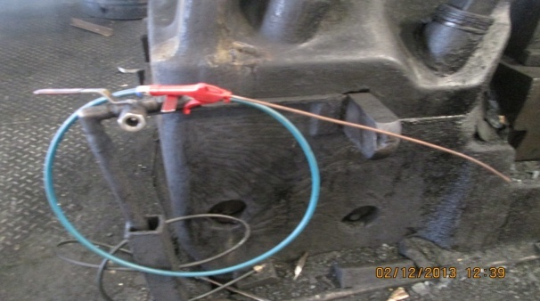
Expected benefits of improving compressed air system: Energy saving: 20% -30%
Installation of new receiver and new air compressors (not inverter type)
Adjusting pressure setting
Reduce air leakage through installing foot switch
Reconsider pipe size and design
Start the use of efficient air gun

Slide 18
Example of identified potentials

Slide 19
Key question: What kind of support is actually needed?
Financial capacity
Matching B2F is also required
Matching B2F and B2P is also required
Required project funding
e.g.: Install oil free inverter type air compressor
e.g.: Install several efficient standard air compressors
Maximum Own Capacity
e.g.: Install Inverter type oil injected air compressor
e.g.: Install one efficient standard air compressor
Matching B2B is sufficient
Matching B2P is also required
Technical capacity
Note:
B= Business
F= Finance
P= Policy/programme
Current “Appropriate technology” Zone?
Maximum Own Capacity
Required capacity through training programme

Slide 20
Key insight based on compressed air case study
What kind of support is actually required: Awareness creation, financial, or technical?
Which specific stakeholder has/able to provide such support?
To address the above, mapping; matching, follow-up are key activities to be considered.

Slide 21
Key findings from IGES-TERI’s activities in India
Huge potential/market for Japanese technologies deployment in India, however:
High upfront cost of Japanese technologies;
Significant information/knowledge gap exists;
Incomplete, fragmented, and uncoordinated efforts to tap opportunities;
Communication barriers (mindset, language, etc.).
>> It was concluded that there is a need to initiate a stakeholders' matchmaking platform to address all the above challenges in practical and systematic manner.

Slide 22
Initiating Japan-India Technology Matchmaking Platform (JITMAP)

Slide 23
Key feature of the platform
Bilateral: Specific focus on Japan and India;
Practical: unique forum where matching B2B, B2F and B2P can occur on the ground as well as online in faster way;
Comprehensive: Information and knowledge sharing about various aspects (technologies data base, policies data base, financing options data base, etc). not just about one of them as in most existing platforms;
Systematic: It addresses all the stages of Technology Transfer process, with special focus given to follow up activities;
Ultimate goal is to materialize the opportunities rather than just identifying them; Develop information rather than just collect and share it;
It is not an alternative option to existing platforms, but rather a complementary one to them.

Slide 24
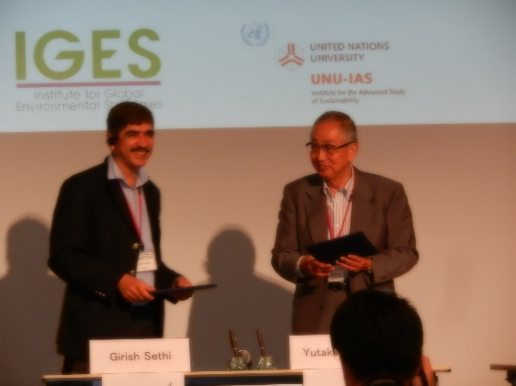
Japan-India Technology Matchmaking Platform (JITMAP)
JITMAP was initiated/launched as a trial basis on Jul. 13th, 2016. IGES and TERI as core members.
Leading Indian organizations has joined as dialogues members, namely: GEDA, MEDA, MCCIA, GITCO. Others are also expressing interests, from India and Japan.

Slide 25
Key activities under JITMAP
IGES and TERI, in coordination with JITMAP Dialogue Members, enable matchmaking of B2B, B2F and B2P through the following activities:
Mapping for matching
Information collection, management and assessment
=>Develop database on “Seeds” and “Needs” (technologies, stimulating policies & regulations, stimulating financing schemes, etc.)
“On the ground” matchmaking
Stakeholders matching
(B2B, B2F and B2P)
Feasibility studies, project proposals, bankable proposals, project implementation, follow-up activities, etc
Stakeholders’ awareness creation and capacity building
Technical and financial assistances, Workshops, Trainings, joint planning for replication at wider level, etc.
- JITMAP members dialogue meetings
- Experts consultation meetings
“Online” Information and knowledge sharing
“Online” Information and knowledge sharing
through JITMAP website
http://jitmap.org
“Outputs
Databases, directories, case studies, proposals (projects/strategies/roadmaps), training materials, etc.

Slide 26
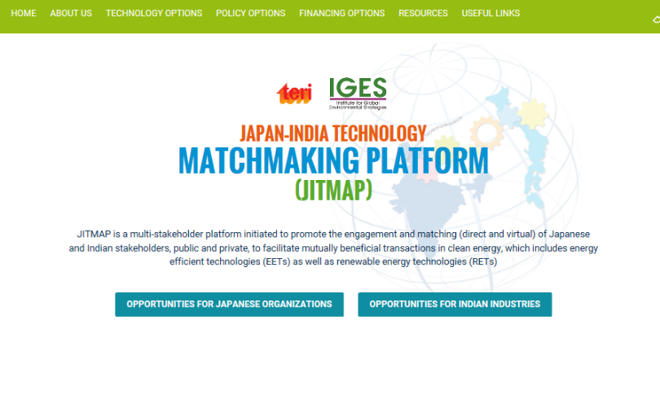
Japan-India Technology Matchmaking Platform (JITMAP)
http://jitmap.org (PW: asdf1234)

Slide 27
Conclusion
There is no shortage of technologies, no shortage of funding, no shortage of initiatives, but there is shortfall in coordination/synergy among efforts to develop and implement projects;
Key challenges to promote green technology transfer include:
-High upfront cost of Japanese technologies;
-Significant information/knowledge gap exists;
-Incomplete, fragmented, and uncoordinated efforts;
-Communication barriers (mindset, language, etc.).
Successfully matching B2B, B2F, and B2P creates synergy among efforts, fills part of the information/knowledge gap, reduce communication barriers, and ultimately alleviates part of overall business cost (reduction of transaction cost, information cost, etc.);
Bilateral matchmaking platforms could be considered as innovative business model assuming that they include the “Appropriate” matchmakers.

Slide 28
Thank you for your kind attention

