Slide 1
GCF Capacity-Building Workshop and Expert-led Exchange
-6-8 December 2017, Holiday Inn, Songdo, South Korea-
Insights based on lessons learned from IGES work
Abdessalem RABHI, PhD.
Programme Manager, IGES

Slide 2
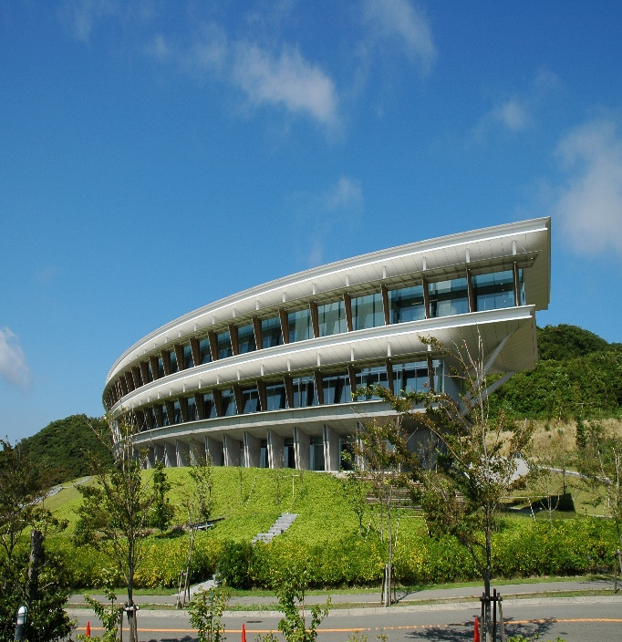
About IGES: Outline
Name of the Institute
The Institute for Global Environmental Strategies (IGES)
Establishment
March 31, 1998
Location
>Headquarter: Hayama, Miura-gun, Kanagawa
>Tokyo Office: Chiyoda-ku, Tokyo
>Kitakyushu Office: Kitakyushu-city, Fukuoka
>Kansai Research Centre (KRC): Kobe, Hyogo
>Overseas Offices: Bangkok (Thailand), Beijing (China).
IGES headquarters （Hayama, Kanagawa）

Slide 3
Example of IGES activities
1) Technology Assessment and Mapping

Slide 4
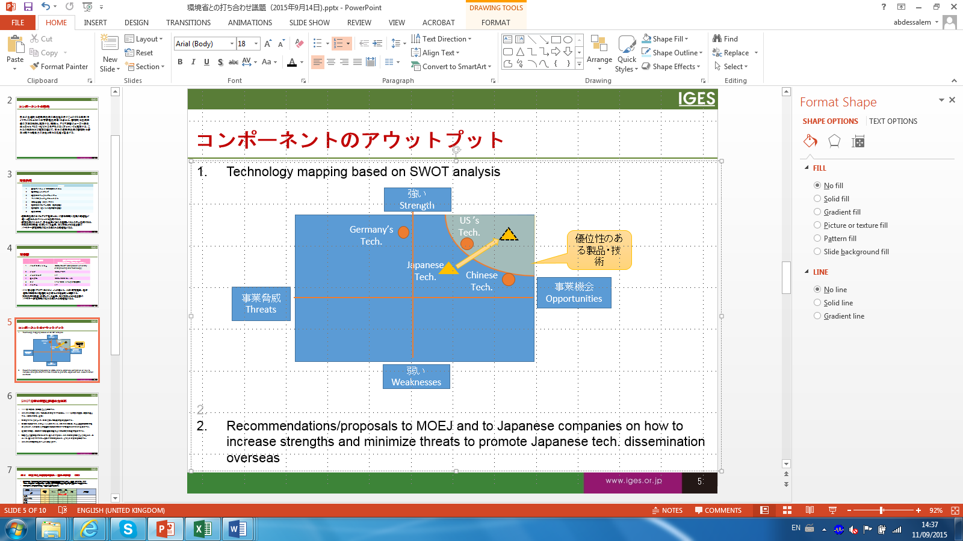
Framework
Selection of countries
Selection of technologies
Assessment of the mutual interests (supply/Demand sides) and of the local conditions to identify best matching of “seeds” and “needs”
Assess the Opportunities/Threats for prioritized tech. for each targeted country
Assess the Strengths/Weaknesses of prioritized tech. for each targeted country
SWOT Mapping
Recommendations/Proposal(s) on way forwards

Slide 5
Technology Mapping
Example of mapping a Japanese technology (i) in country (j) based on Strength Weaknesses Opportunities Threats (SWOT) analysis
Based on the technology mapping, recommendations/proposals are developed on how to increase strengths and minimize weaknesses and/or to enhance opportunities and minimize threats to promote Japanese technology dissemination overseas
Strength
Tech.1
Tech.2
Japanese
Tech
Product B
Tech.3
Threats
Opportunities
Weaknesses

Slide 6
List of selected countries/technologies
 | Targeted countries
1 | Bangladesh
2 | India
3 | Indonesia
4 | Mongolia
5 | Thailand
6 | Vietnam
 | Selected Technologies
1 | Once Through Boiler/Steam control and management system
2 | Heat Pump for Industrial use
3 | High Efficient air compressor
4 | Biogas Micro cogeneration system
5 | Solar PV
6 | Waste to Energy
7 | Waste Heat Recovery
8 | Efficient lighting (LED)

Slide 7
Example of IGES activities
2) Technology Assessment and Stakeholders’ Matchmaking

Slide 8
Identification of “Seeds” and “Needs” to kick off the matching process
IGES identifies potential technologies which are commercially available in Japan, “Seeds”, and TERI identifies potential technologies needed in Indian industries “Needs”. Technologies which are identified simultaneously as “Seeds” and “Needs” could be considered for further investigation through feasibility studies (FS).
Example of technologies covered so far:
Gas Heat Pump (GHP)
Electric Heat Pump (EHP)
Once Through Boiler
Steam System Optimization
Compressed air system
Induction furnace

Slide 9
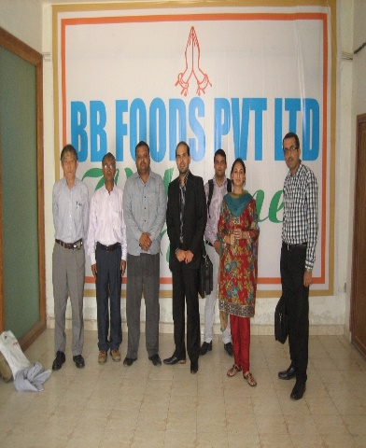
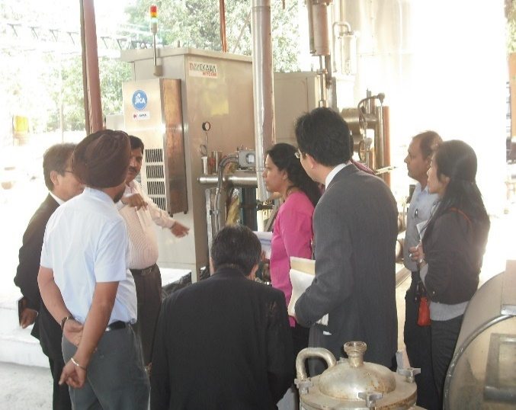
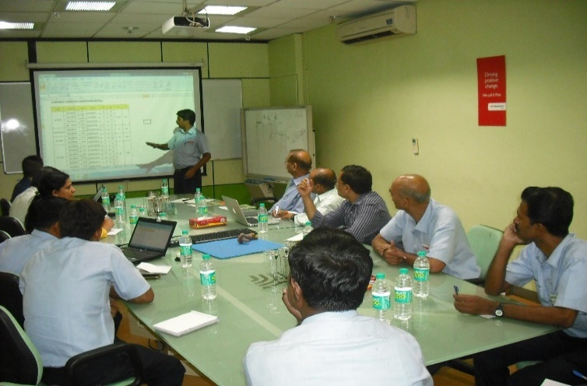
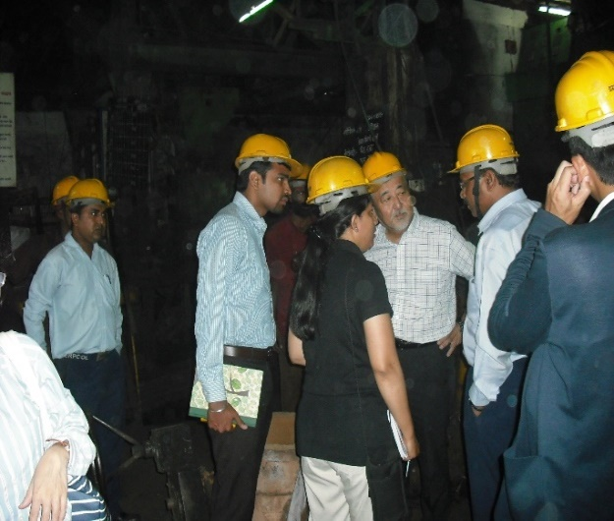
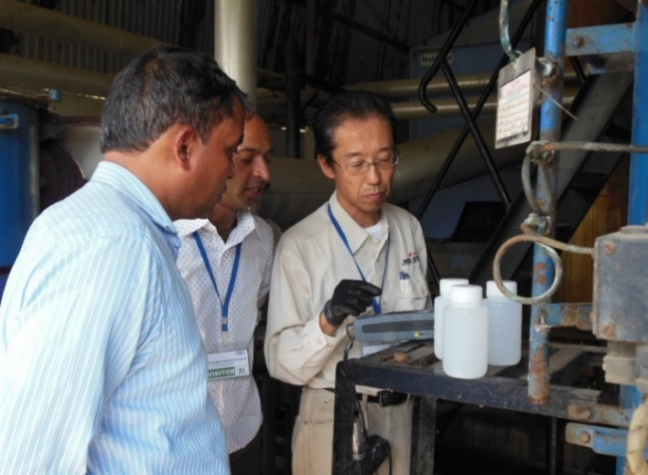
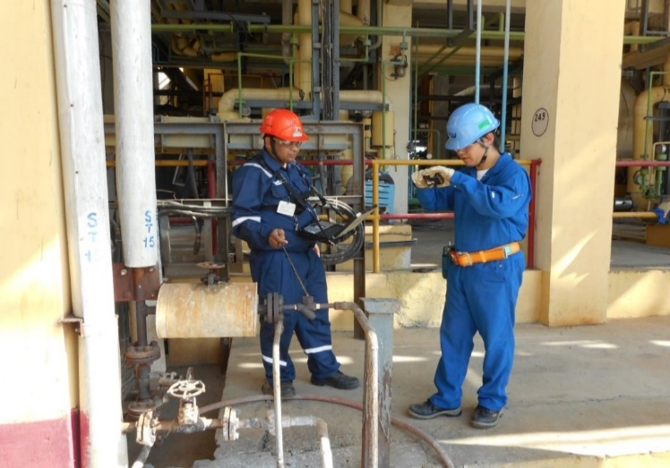
B2B Matching: Feasibility studies
FS on Gas Heat Pump (GHP)
FS on Electric Heat Pump (EHP)
FS on Compressed air (CA)
FS on Induction Furnace (If)
FS on Once Through Boiler (OTB)
FS on Steam System Optimization (SSO)

Slide 10
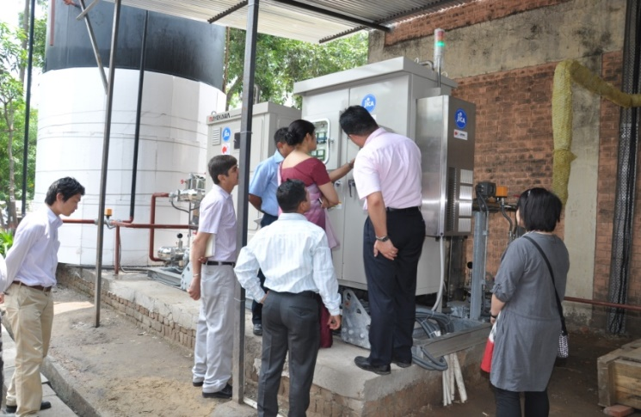
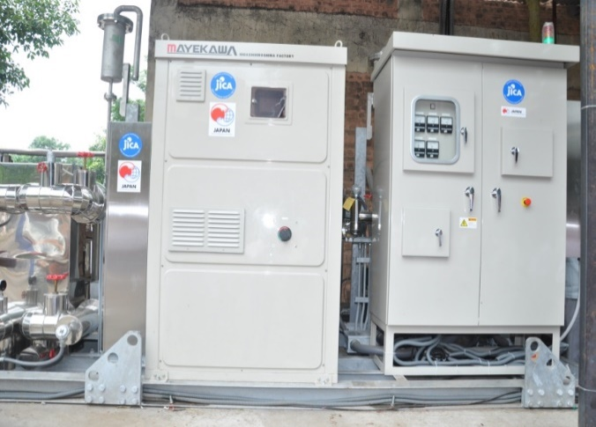
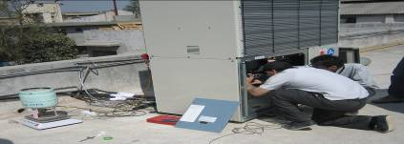
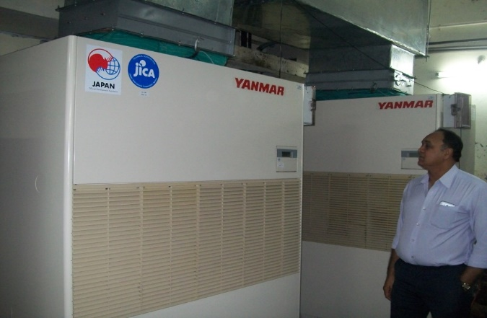
B2B Matching: Demonstration projects and impact evaluation
Electric Heat Pump (EHP): 30%-40% energy saving due to reduction in fuel consumption of boiler and electricity consumption of chiller
Gas Heat Pump (GHP): 35%-45% energy saving due to switch from electricity to Natural Gas as source of energy

Slide 11
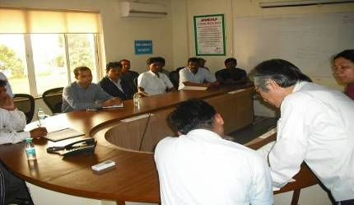
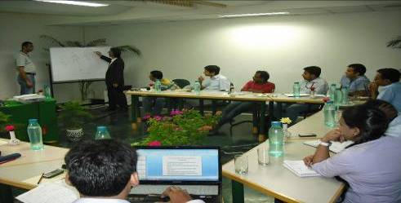
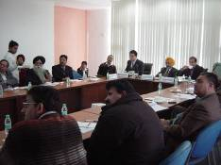
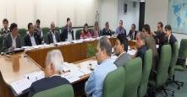
B2B Matching: Awareness creation and capacity building
On site trainings for plant engineers
In house trainings for energy auditors (TOT)
Awareness creation and capacity buildings for businesses managers and/or owners
Notes:
11

Slide 12
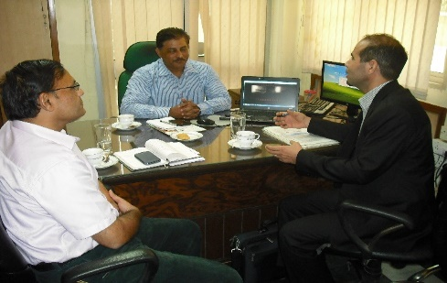
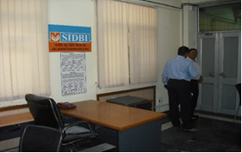
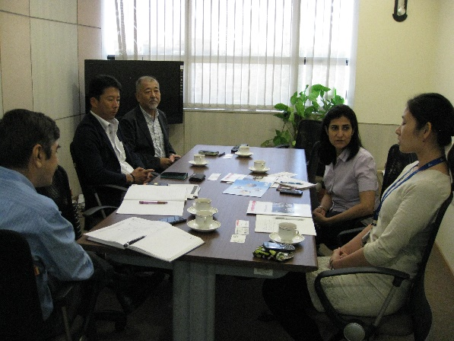
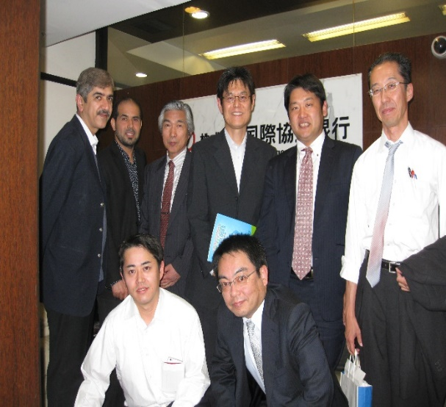
B2F Matching: Explore potential financing options
Mtg. with Small Industries development bank in India (SIDBI)
Mtg. with JICA (India)
Mtg. with JBIC (India)

Slide 13
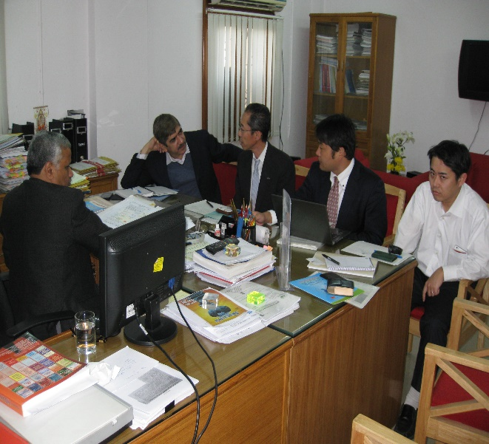
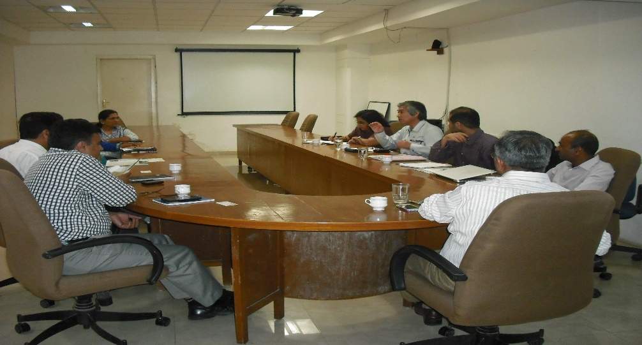
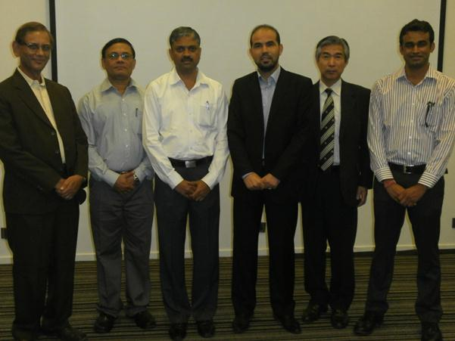
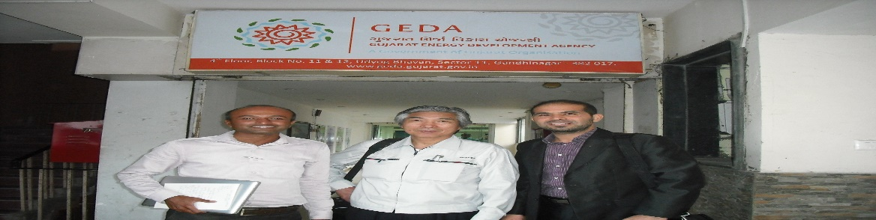
B2P Matching: Explore supporting policy/programme options
e.g. mtg. with Central Boiler Inspectors regarding IBR
e.g. Mtg. with Gujarat Energy Development Agency (GEDA)
e.g. mtg. with MCCIA

Slide 14
Example of IGES activities
3) Case study on Electric Heat Pump (EHP)

Slide 15
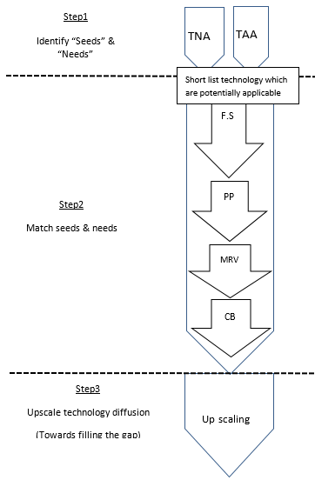
Overall process of deploying EHP
Technology Need Assessment (TNA)
Technology Availability Assessment (TAA)
JICA/JST Funding)
(2010-2013)
Feasibility Study
Demonstration projects
MOEJ Funding
(2014, 2015,2016, 2017)
Evaluation
Capacity Building
JBIC, EESL funding?

Slide 16
Timeframe, from identification to implementation
Invitation from TERI
11/
2011
Feasibility study (FS)
01/
2012
FS report submission
02/
2012
Detailed Study
04/
2012
Board resolution
07/
2012
MOU with TERI
08/
2012
Drawing approvals
03/
2013
Electric Heat Pump received
06/
2013
Electric Heat Pump started
07/
2013

Slide 17

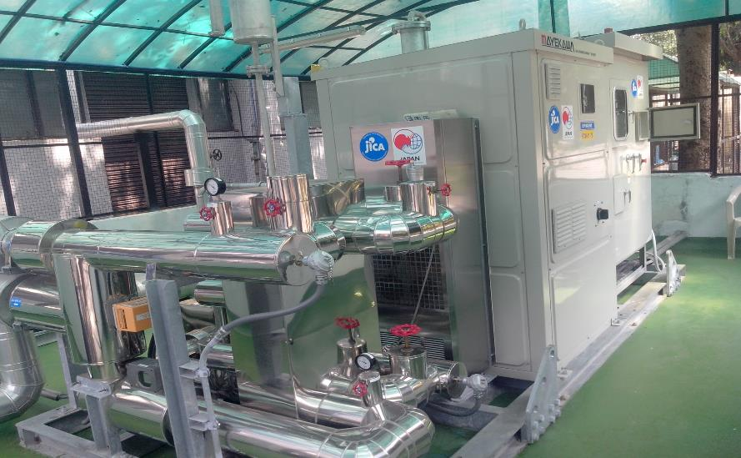
ELECTRIC HEAT PUMP INSTALLED
AT FOOD COMPLEX, MOGAR

Slide 18

YEARLY CO2 REDUCTION
Notes:
Average CO2 reduction is 180 ton/year
Note: In Year 2013, EHP started operation in 23 Jul.
Year 2015, EHP was under breakdown for 4 months
Year 2017, the data was just until Mid July.

Slide 19
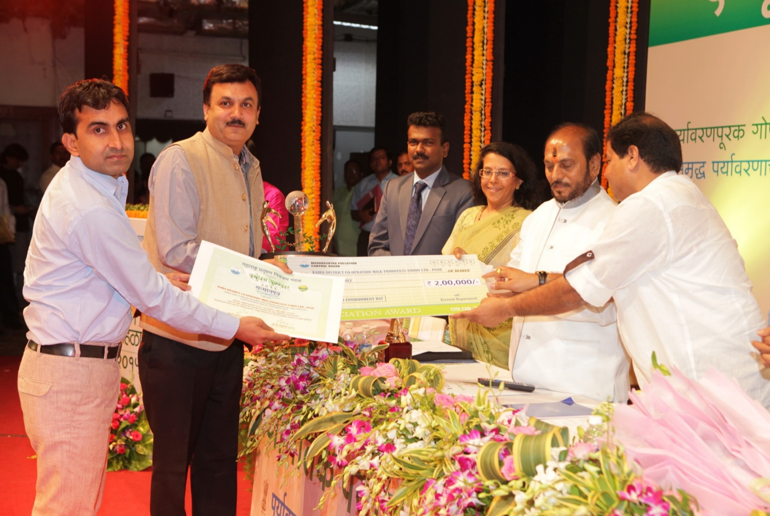
Recognitions from Energy and Environmental Savings
Vasundhara Award -2015

Slide 20
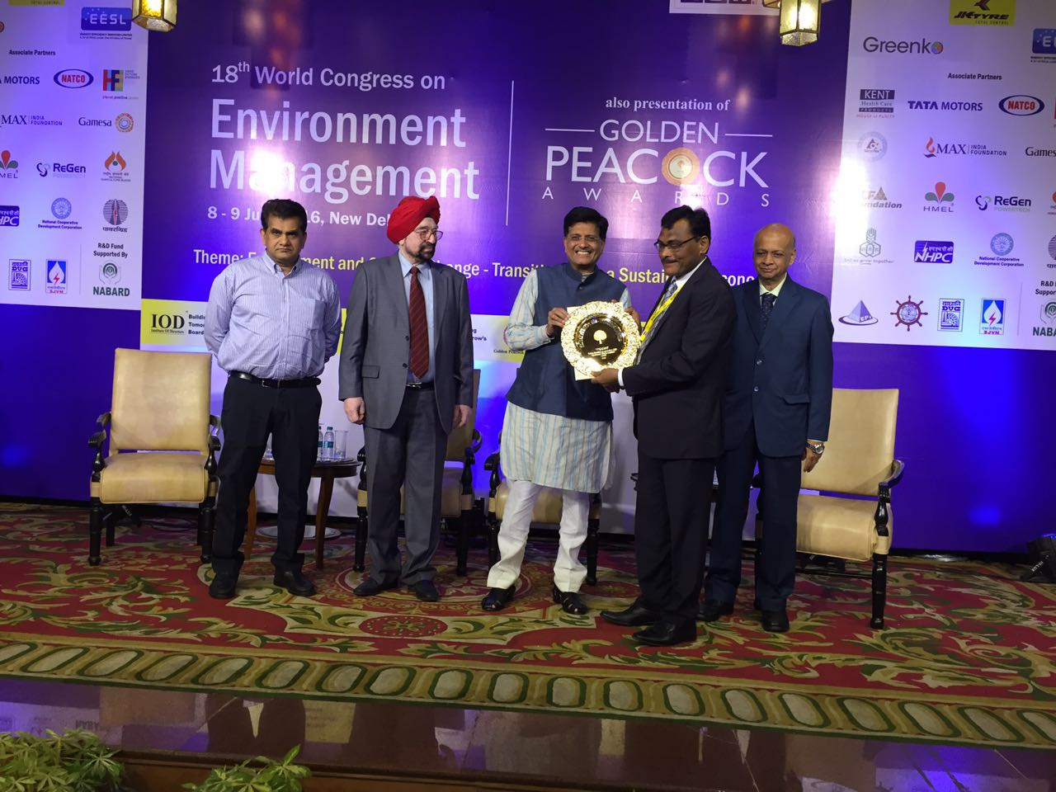
Recognitions from Energy Savings
and Innovations
Golden Peacock Award- 2016
(National Level)

Slide 21
In addition
1) In FY 2014, EHP was added to SIDBI list of technologies eligible for financing under JICA-SIDBI 2 step loan;
2) In FY2014, IGES-TERI developed a draft of request for assistance to CTCN to replicate EHP at wider level (submitted to MOEJ rather than to CTCN as commissioned work)
3) In FY2015-2017 Conduct studies on the replication of the case in other countries, namely Thailand and Vietnam

Slide 22
Key insights based on the EHP case study
All stage/phases of technology transfer should be addressed in systematic/programmatic approach;
No single programme can/should cover the financing of all stages of a project;
Capacity building is necessary before, during, and after project implementation for the appropriate recipients;
Cutting edge technology are not always the best solution;
Mapping; Matching, Follow-up are key components.

Slide 23
Example of IGES activities
4) Case study on compressed air system

Slide 24
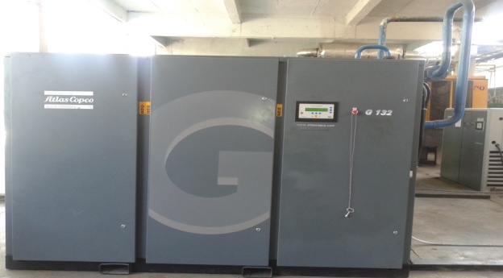
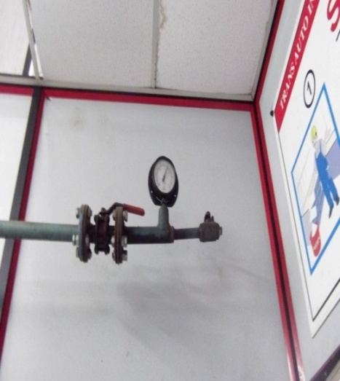
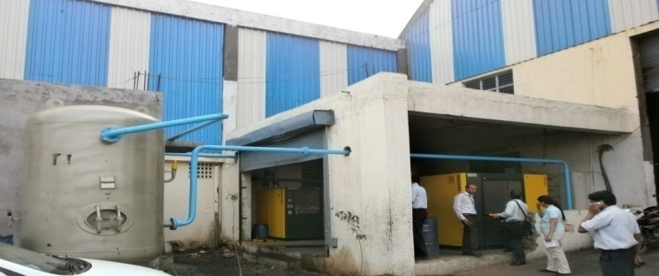
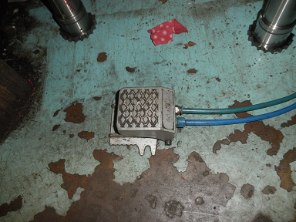
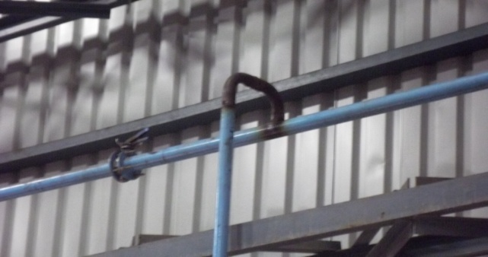
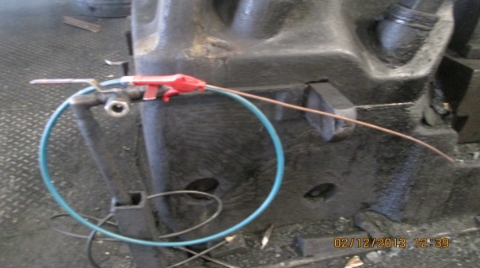
    Expected benefits of improving compressed air system: Energy saving: 20% -30%
Installation of new receiver and new air compressors (not inverter type)
Adjusting pressure setting
Reduce air leakage through installing foot switch
Reconsider pipe size and design
Start the use of efficient air gun

Slide 25
Example of identified potentials

Slide 26
Key insight based on compressed air case study
What kind of support is really required?
Who has to provide such support?
Mapping; Matching, Follow-up are key components.

Slide 27
Key insight based on compressed air case study
Financial capacity
Matching B2F is also required
Matching B2F and B2F is also required
Required project funding
e.g.: 1000 KW 2 stages compressor
e.g.: 1000 KW Turbo compressor
Maximum Own Capacity
e.g.: 100 KW Inverter compressor
e.g.: 100 KW Screw compressor
Matching B2B is sufficient
Matching B2P is also required
Technical capacity
Note:
B= Business
F= Finance
P= Policy/programme
Maximum Own Capacity
Required capacity through training programme

Slide 28
Exercise: Map where GCF should stands?
Financial capacity
Project financing is also required
Combined financial support and capacity building is required
Required GCF project funding
Project D
Project C
Maximum Own Capacity
Project B
Project A
Project identification is sufficient
Capacity building is also required
Maximum Own Capacity
Required Capacity through GCF country programming
Technical capacity

Slide 29
Example of IGES activities
4) Capacity building related to developing GCF concept notes/project proposals

Slide 30
List of events
Date | Type Event | Targeted countries | Objective | Organizers
08-12 Feb. 2015 (Tokyo, Japan) | Training Programme | 10 island nations (Cook Islands, Maldives, Marshall Islands, Palau, Papua New Guinea, Samoa, Solomon Islands, Tonga, Tuvalu, and Vanuatu) | Exchanging knowledge and information on policy, regulatory, institutional and financial aspects for enabling the energy transition to renewable energy in Small Island Developing States (SIDS) | MOEJ/IRENA as part of TA project. Commissioned to IGES
01-03 Dec. 2016 (Nadi, Fiji) | Financing workshop | Samoa, Cook Island, Fiji, Micronesia, Kiribati, Nauru, Palau, Papua New Guinea, Samoa, Solomon Island, Tonga, Tuvalu and Vanuatu | Exchanging knowledge and information on financial aspects for enabling the energy transition to renewable energy in Small Island Developing States (SIDS) | MOEJ/IRENA/SPC/US Department of State, as part of TA project. Commissioned to IGES which outsourced it to AIT/RRC.AP
12-16 Dec. 2016 (Bangkok, Thailand) | Training Programme | 24 trainees from Bangladesh, India, Indonesia, Philippines, Thailand, and Vietnam | Training Programme on Developing Project Proposals on Climate Change Mitigation | MOEJ, as part of TA project. Commissioned to IGES which outsourced it to AIT/RRC.AP
23-27 Oct. 2017 (Tokyo & Kobe, Japan) | Training Program | 11 participants from Fiji, Maldives, Mozambique, Palau, and Samoa | Training Program to Support Renewable Energy Deployment through Developing Project Proposals to Access GCF | MOEJ/IRENA as part of TA project. Commissioned to IGES
Scheduled on 12-15 Dec. 2017 (Suva, Fiji) | Follow Up workshop in Fiji | Fiji, Maldives, Palau, Samoa, Federal State of Micronesia, Marshall Island, Tonga, Vanuatu and Wallis and Futuna participants from SIDS | Training and follow up on developing project proposals to Access GCF | MOEJ/IRENA/SPC/US Department of State, as part of TA project. Commissioned to IGES which outsourced it to AIT/RRC.AP

Slide 31
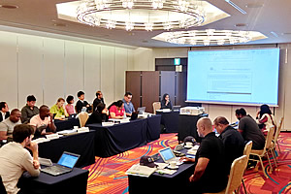
Approaches and Methods
Pre-training assignments
Working with actual templates i.e. GCF Concept Note
in-door training sessions
Group work using actual project ideas prepared prior to the course
Out-door training/visit

Slide 32
Insights based on the capacity building activities
Mapping for matching
Information collection, management and assessment
=>Develop database on “Seeds” and “Needs” (project idea/technologies, stimulating policies & regulations, stimulating financing schemes, etc.)
“On the ground” matchmaking
Stakeholders matching
(B2B, B2F and B2P)
Feasibility studies, project proposals, bankable proposals, project implementation, follow-up activities, etc
Stakeholders’ awareness creation and capacity building
Technical and financial assistances, Workshops, Trainings, joint planning for replication at wider level, etc.
“Online” Information and knowledge sharing
“Online” Information and knowledge sharing
“Outputs
Databases, directories, case studies, proposals (projects/strategies/roadmaps), training materials, etc.

Slide 33
Insights based on the capacity building activities
1) Numerous are the activities/programmes related to GCF activities;
2) Mapping; Matching, Follow-up are key components;
3) Information/knowledge sharing is not enough, consider information/knowledge development too;
4) IGES accumulated certain experience and stands ready to partnership (Co-design, Co-develop, Co-produce) with any institutes/organizations to promote GCF related activities.

Slide 34
Thank you for your attention

