Slide 1



International Cooperation on Resource Efficiency in Asia-Pacific
Matthew Hengesbaugh, Policy Researcher
IGES Sustainable Consumption and Production Area
11th Policy Forum of Seoul Initiative Network on Green Growth
7-9 September 2016

Slide 2
Presentation Outline
Background on Resource Efficiency Concepts and Challenges
International Cooperation on Resource Efficiency
Opportunities in Asia and the Pacific
Future Directions for Promoting the Resource Efficiency Agenda
Key Lessons
IGES-UNEP Collaborating Centre on Environmental Technologies (CCET)

Slide 3

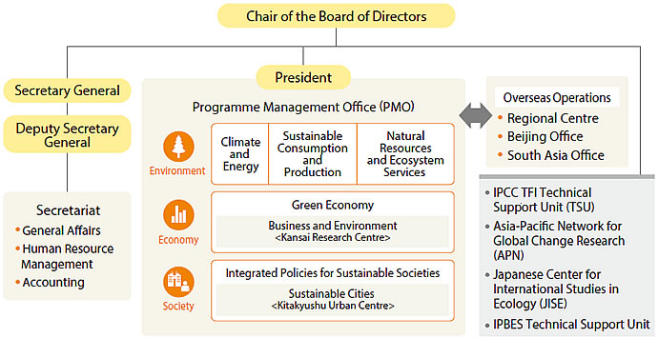
Institute of Global Environmental Strategies
Founded in 1998 under the initiative of Japanese government and with the support of Kanagawa Prefecture.
Purpose: To conduct innovative policy development and strategic research for environmental measures, reflecting the results of research into political decisions for realizing sustainable development both in the Asia-Pacific region and globally.
HQ：Hayama, Kanagawa Pref.
Employees: 175
> Researchers 100
> Foreign Researchers 42%
(As of March 2013)
Ranked as 38th out of 6,500
research institutions across the globe.
(2014, Univ. Pennsylvania)
15/210 in Climate Change Research（2013）

Slide 4
Resource Efficiency:
Key Concepts, Approaches and Issues

Slide 5
Policy Tools and Instruments for Resource Efficiency and the 3Rs
Resource extraction
Product design
Production
Consumption
Usage
Waste management
Material stewardship
Mineral resource extraction charge
Tax on raw materials
Aggregates(stone, rocks and gravel) levy
Natural resource taxation
EPR
Material stewardship
Training / consultancy on Lean manufacturing (KAIZEN) / Resource efficient process
Eco-label/Eco-Design /EPEAT/Certification /Standards/ top-runner
EMS(EMAS/ISO14001)
R&D support
Voluntary agreement
Awareness / Awards
For citizens
EPR / Deposit-refund, Take-back
Eco-label / Certification
Differenciated VAT
Awareness campaigns
For companies
Eco-label / Certification
Green Procurement
Voluntary agreement
Awareness / Awards
For citizens
Plastic bag tax
Pay as you throw (PAYT)
Municipal waste charge / Pay for MSW collection bag
Awareness campaigns / training / trainer
For companies
Plastic bag tax
Land fill tax
Landfill allowance trade
Incineration tax
Recycling Policy
Remanufacturing
Reuse, Repair, Refurbish
Material Resource Circulation
Source: Aoki-Suzuki (2015)

Slide 6
Resource Efficiency Challenges for Asia & the Pacific
UNEP’s GEO-6 Report: Regional Assessment for Asia & the Pacific (2016) indicated that the region’s material consumption accounted for more than 50 percent of global consumption in 2015.
Further, UNEP’s REEO report (2011) confirmed that material resource consumption would increase 3 times in 2050 compared to 2005 in Asia-Pacific region.
Even if resource and energy efficiency increase by 50%, resource consumption continues to expand with supply demands.
Therefore, developing economies need to increase its resource efficiency on the one hand; developed economies need to shift policy and investment for systems innovation towards decreasing resource consumption.
Source：Figure 7.5, UNEP(2011), Resource Efficiency: Economy and Outlook and the Pacific, P. 171.

Slide 7
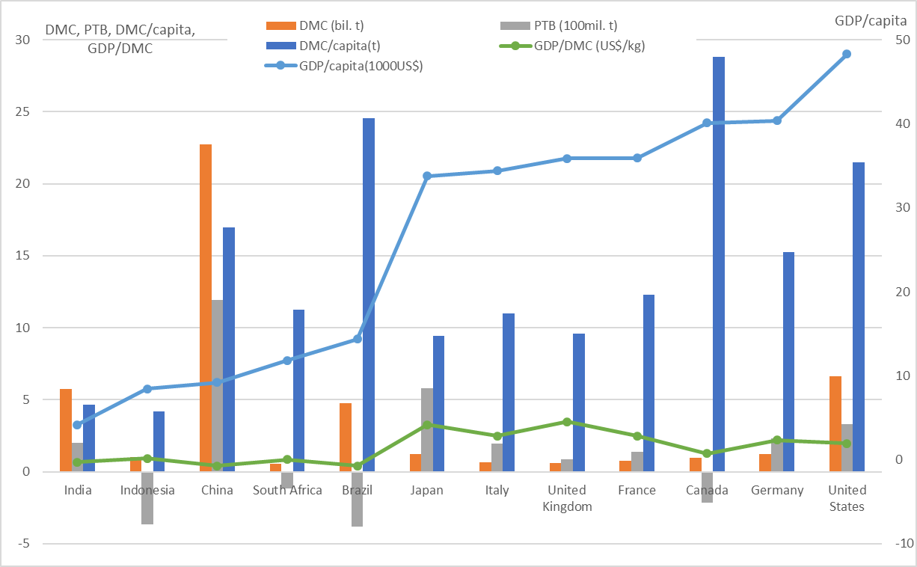
Need collaboration with non-G7 for RE as global agenda
Per capita consumption of some of BRIICS is higher
BRIICS
G7
Source: Aoki-Suzuki based on OECD stat
Notes:
日本GDPG7最下位

Slide 8
Rationale of international collaboration for sustainable resource management
To realize global resource efficient economy, developed countries need to show a bold and clear direction towards absolute decoupling of economic development and material consumption as a next model for other economies to follow
However, to avoid negative transboundary consequences/unintended effects from strong domestic incentive policies, new models of international collaboration emphasizing mutual collaborative approaches are needed

Slide 9
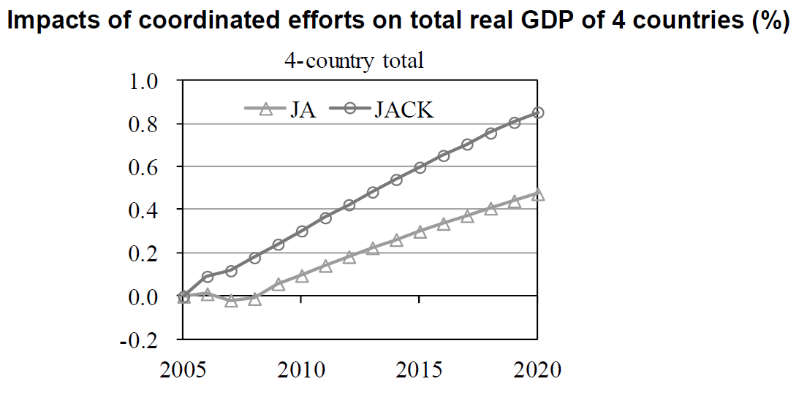
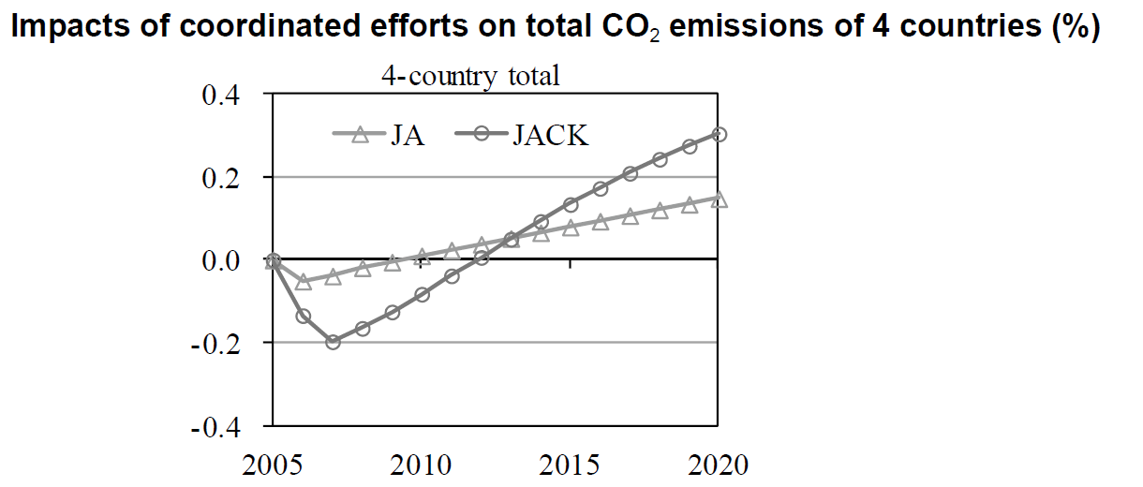
Quantitative study on regional policy: evidence of potential
IGES conducted a comparative analysis of effectiveness of policy coordination to reduce consumption of iron ore in 2015 10% less than BAU. In this simulation, countries introduce waste disposal charges and natural resource tax to reduce resource consumption.
The analysis demonstrates that coordinated efforts, particularly by four countries, can generate tangible economic benefits without significantly increasing total CO2 emissions during the simulation period.

Slide 10
Priority challenges for developing and emerging economies: increasing resource efficiency and policy implementation
Government capacity and interagency collaboration
  Giving high policy priority to resource efficiency and circulation in the national developmental strategy
  Involvement of relevant stakeholders from initial planning stages to the final review stage for various policies and strategies
  Cooperation and coordination among line-ministries to mainstream resource circulation and efficiency policy
Industrial infrastructure and technology transfer
  Linking development of legislation and systematic development of industrial sector (facilities and technologies) for treatment and recycling of collected recyclables
A well-organized recycling market
  Recycling mechanisms that use economic instruments such as EPR for specific end-of-life products would help shift from informal dirty recycling to a well-organized market with stable job opportunities.

Slide 11
International Dialogue on Resource Efficiency

Slide 12
G7/8 Agreement on Resource Efficiency/Productivity, the 3Rs
G8 Evian Summit 2003, France
Science and Technology for Sustainable Development:
A G8 Action Plan
We will enhance our understanding of resource material flows and continue work on resources productivity indices, notably in the Organisation for Economic Co-operation and Development.

Slide 13
G7/8 Agreement on
Resource Efficiency/Productivity, the 3Rs
G8 Sea Island Summit 2004, USA
Science and Technology for Sustainable Development:"3R" Action Plan and Progress on Implementation
Reduce, Reuse and Recycle Initiative
We will launch the Reduce, Reuse, and Recycle ("3R") Initiative at a Ministerial Conference in spring 2005 hosted by the Government of Japan. In cooperation with relevant international organizations such as the OECD, we will seek through this initiative to:
Reduce waste, Reuse and Recycle resources and products to the extent economically feasible;
Reduce barriers to the international flow of goods and materials for recycling and remanufacturing, recycled and remanufactured products, and cleaner, more efficient technologies, consistent with existing environmental and trade obligations and frameworks;
Encourage cooperation among various stakeholders (central governments, local governments, the private sector, NGOs and communities), including voluntary and market-based activities;
Promote science and technology suitable for 3Rs; and
Cooperate with developing countries in such areas as capacity building, raising public awareness, human resource development and implementation of recycling projects.
Resource Material Flows
Helped to create a new OECD material flows and resource productivity work plan.
Work ongoing through the WTO Doha Development Agenda to reduce or, as appropriate, eliminate trade barriers to environmental goods and services.

Slide 14
G7/8 Agreement on
Resource Efficiency/Productivity, the 3Rs
G8 Saint Petersburg 2006, Russia
Global Energy Security
  19. As part of an integrated approach to the entire resource cycle we reaffirm our commitment to comprehensive measures to optimize the resource cycle within the 3Rs Initiative (Reduce, Reuse, Recycle). In furthering these efforts, we will set targets as appropriate taking account of resource productivity. We will also raise awareness of the importance of energy efficiency and environmental protection through national as well as international efforts.

Slide 15
G7/8 Agreement on
Resource Efficiency/Productivity, the 3Rs
G8 Hokkaido/Toyako 2008
G8 Kobe EMM, Japan
Kobe 3R Action Plan
Goal 1: Prioritize 3Rs Policies and Improve Resource Productivity
Incl. Set targets taking account of resource productivity in furthering efforts to optimize resource cycles.
Goal 2: Establishment of an International Sound Material-Cycle Society
Goal 3: Collaborate for 3Rs Capacity Development in Developing Countries

Slide 16
G7/8 Agreement on
Resource Efficiency/Productivity, the 3Rs
G8 Deauville Summit 2011, France
G8 DECLARATION RENEWED COMMITMENT FOR FREEDOM AND DEMOCRACY, GREEN GROWTH
  37.We believe that it is also crucial to employ a range of measures to encourage efficient and sustainable resource use, including renewable energy, by national and other actors. We reaffirm our support to the Kobe 3R ("Reduce, Reuse, Recycle") Action Plan and welcome the OECD report on its implementation on resource productivity, and invite the OECD to continue to work on this issue.

Slide 17
G7 Agreement on
Resource Efficiency/Productivity, the 3Rs
G7 Elmau Summit 2015, Germany
1. Commitment to ambitious action to protect natural resources and use them efficiently
2. G7 Alliance on Resource Efficiency: Forum to exchange best practices in G7 and with stakeholders
3. Mandate to International Resource Panel to prepare synthesis report on potentials and promising solutions
4. Mandate to OECD to provide policy guidance for G7

Slide 18
G7 Agreement on
Resource Efficiency/Productivity, the 3Rs
G7 Toyama Summit 2016, Japan
3 Main Objectives:
Leading Domestic Policies for Resource Efficiency and the 3Rs
Promote Global Resource Efficiency and the 3Rs
Steady and Transparent Follow-Up Processes

Slide 19
G7/8 Agreement on Resource Efficiency/Productivity, the 3Rs
Evian
France
2003
Sea Island
USA
2004
Saint
Petersburg
Russia 2006
Hokkaido
Kobe EMM
Japan, 2008
Deauville
France
2011
Elmau
Germany
2015
Toyama
Japan
2016
 | 3R Initiative |  | Kobe 3R Action Plan | reaffirm Kobe 3R Action Plan | G7 Alliance on RE Toyama Framework on Material Cycles
 |  | Targets taking account of RP | Targets taking account of RP
 | Reduce waste, Reuse and Recycle resources and products | optimize the resource cycle within the 3Rs Initiative | Prioritize 3Rs Policies and Improve RP Reduce waste |  | Commitment to ambitious action for RE
 | Trade barrier: recycling and remanufacturing |  | Establishment of an International Sound Material-Cycle Society
 | cooperation among various stakeholders |  |  |  | G7 Alliance on RE Toyama Framework on Material Cycles
 | Cooperate with developing countries |  | 3Rs Capacity Development in Developing Countries |  | Toyama Framework on Material Cycles
 | OECD work on MFA and RP |  |  |  | IRP synthesis OECD policy guidance
Collaborative action
RP target
Mainstreaming 3R/RE policy
International resource circulation
Multi-stakeholder collaboration
Cooperation with developing countries
OECD/IRP

Slide 20
Opportunities in Asia and the Pacific

Slide 21
Timeline of International Cooperation
2004
G8 Sea Island Summit: 3R Initiative was agreed upon
2005
Ministerial Meeting on the 3R Initiative (Tokyo)
National 3R Strategy Development Programme (MOEJ, UNCRD, AIT.UNEP/RRCAP): Indonesia, Philippines, Thailand, Viet Nam, Bangladesh, Cambodia) until 2009
2006
Senior Officials Meeting on the 3R Initiative (Tokyo)
Asia 3R Conference (Tokyo)
2007
2nd Senior Officials Meeting on the 3R Initiative (Bonn, Germany)
2nd Asia 3R Conference (Tokyo)
2008
G8 Environmental Ministers Meeting(Kobe, Japan)
Kobe 3R Action Plan
East Asia Summit Environmental Ministers Meeting (Hanoi) : Proposal of Regional 3R Forum was acknowledged.
G8 Toyako Summit (Japan)
Kobe 3R Action Plan was endorsed
Asia 3R High-level Seminar(Tokyo)
2009
Inaugural meeting of the Regional 3R Forum in Asia(Tokyo): Tokyo 3R Statement was agreed upon.
United Nations CSD Inter-sessional Meeting “International Experts Meeting on Extension of Waste Management Service to Developing Countries”(Tokyo)
2010
2nd Regional 3R Forum in Asia (KL, Malaysia)
CSD (UN Commission on Sustainable Development) Intersessional Conference on Building Partnerships for Moving towards Zero Waste (Tokyo)
2011
3rd Regional 3R Forum in Asia (Singapore): “Recommendations of the Singapore Forum on the 3Rs in Achieving a Resource Efficient Society in Asia” was endorsed and submitted to RIO+20 Process as an input from Singaporean Government
G8 Deuville Summit (France)
Kobe 3R Action Plan reaffirmed
2012
2013
4th Regional 3R Forum in Asia (Hanoi, Viet Nam)
2014
5th Regional 3R Forum in Asia (Surabaya, Indonesia)
2015
G7 Elmau Summit (Germany)
Establishment of G7 Alliance on RE
6th Regional 3R Forum in Asia (Male, Maldives)
2016
G7 Toyama Summit (Japan)
Endorsed Toyoma Framework on Material Cycles
7th Regional 3R Forum in Asia (Adelaide, Australia)

Slide 22
Progress of Policy Development on the 3Rs and Resource Circulation in Asia
China | Circular Economy Promotion Law (enacted in January 2009) ^{i)} Advancement of a circular economy has been established as a major policy task of the People’s Republic of China
 | Rules on the Administration of the Recovery and Disposal of Discarded Electronic and Electrical Products (promulgated in 2009, effective in 2011) ^{ii)} The management of waste electronic products was tightened
 | Eco-Areas ^{iii)} Around 50 areas (provinces, cities, towns) have been designated as model Eco-Areas. And 20 model cities have been designated for the promotion of a local level circular economy (as of February 2011)
Malaysia | 2007 Solid Waste and Public Cleaning Management Act (2007) ^{iv)} Responsibility for solid waste management was transferred from local governments to the central government. The 3R principles were introduced. The privatization of waste management is encouraged.
 | The Five-year Plan “ 2011 - 2015” ^{v)} calls for raising the rate of resources recovery from household waste from 15% to 25% by 2015.
Philippines | Ecological Solid Waste Management Act (2001) ^{vi)} The 3R principles were introduced. All municipalities are required to achieve 25% diversion of solid waste (recycling and reduction) by 2006. Recycling rate in was 33% in 2010.^{vii)}
 | National Solid Waste Management Commission ^{viii)} Body to coordinate at the national level the ministries and other related parties in improving solid waste management (inaugurated in 2001).
 | National Framework Plan for the Informal Waste Sector in Solid Waste Management in the (2009) ^{ix)} Established as a result of support for the formulation of a 3R national strategy. Action plan to improve the conditions of the informal sector engaged in solid waste management.

Slide 23
Korea ^{x)} | Reduction and recycling of food waste Increase recycling rate: 1997 = 9.8%, 2000 = 45.1%, 2007 = 92.2% Prolong the remaining useful life of landfill sites: from 7 years to 11 years
 | Volume-based municipal waste charges Per capita solid waste generation declined 26% in the 13 years from 1994 to 2007.
 | Extended producer responsibility system Raise the recycling rate of used products (waste home appliances, end-of-life vehicles) covered by the EPR system.
Thailand | Take-back program for used products Take-back started for containers and packaging, used lead-acid batteries, mobile phones and batteries for them, in cooperation with the manufacturers and retailers. ^{xi)} Take-back of fluorescent lamps also in place through cooperation from Japan’s JETRO. ^{xii)}
 | Initiation of a recycling-oriented society ^{xiii)} 3R implemented in more than 200 communities. In some communities, a 30 - 50% reduction or more in waste generation was achieved.
 | Industries Waste Exchange Program ^{xiii)} Over 450 firms registered by 2005.
Viet Nam | 3R-related laws and policies Under the 2005 Law on Environmental Protection, 14 decisions were newly taken related to 3R and solid waste management. ^{xvi)} Decree No. 57 on integrated solid waste management in 2007 and Decision No. 1440 on the planning of solid waste management in three central economic regions until 2020 in 2008. ^{xv)}
 | 3R National Strategy (approved by the Prime Minister) ^{xvi)} Targets for the year 2020: 30% recycling of collected waste; separation-at-source rates = 30% for households and 70% for firms
Taiwan | Resource Recycling Fund ^{xvii)} Currently, ad valorem fees are collected from firms for 14 kinds of recyclable products and are pooled in the Fund. Recycling operators and treatment contractors become entitled to a subsidy from the Fund if they conform to the environmental and quality standards. The Fund is also used to adjust for any volatility in the recycling market.

Slide 24
Progress of EPR Legislations in Asia
Countries | Specific legislation or draft legislations
China | Rules on the Administration of the Recovery and Disposal of Discarded Electronic and Electrical Products (promulgated in 2009, effective in 2011)
India | E-waste Management and Handling Rules (promulgated in 2010, effective in 2012)
Indonesia | specific article on EPR is under preparation under Solid Waste Management Act 2008.
Malaysia | specific article on take-back and deposit refund in Solid Waste and Public Cleansing Management Act 2007. Draft Regulation on Recycling and Disposal of End-of-life Electrical and Electronic Equipment.
Thailand | WEEE Strategic Plan in 2007 and Draft Act on Economic Instruments for Environmental Management (under development)
Viet Nam | Draft regulations on the reclamation and treatment processes for disposal products (under planning: draft was released in 2010

Slide 25
Selected International Collaborative Programmes
Programmes | Overview
Regional 3R Forum in Asia | Inaugurated in November 2009. Periodical policy dialogue meetings, promotion of 3R projects in collaboration with donor organizations, cooperation with 3R research networks, etc.
TEMM and policy dialogues on the 3R/circular economy | Following an agreement at the Tripartite Environment Ministers Meeting among Korea, China and Japan, working-level officials of the three countries meet every year to exchange information at seminars and from time to time conduct bilateral policy dialogues.
Asian Network for Prevention of Illegal Transboundary Movement of Hazardous Wastes | Officials of Asian countries in charge of the Basel Convention meet and form a network for information sharing among countries. Active since 2004.
Asia Pacific E-Waste Project | The pivotal role played by the Basel Convention Secretariat is to build up an E-Waste inventory, offer training and hold local workshops in Asian countries.
Thematic Working Group on Solid and Hazardous Waste of the Regional Forum on Environment and Health in South-East and East Asian Countries | WHO and UNEP serve as the secretariat of the Regional Forum on Environment and Health in South-East and East Asian Countries. Under its umbrella, government officials and experts gather and analyze the best practices and challenges concerning urban waste and medical waste.
ERIA 3R Working | Economic Research Institute for ASEAN and East Asia, international research institute serving for ASEAN, has a thematic working group of researchers and experts on 3R policy development and implementation in ASEAN countries.
UNEP International Panel for Sustainable Resource Management | UNEP launched an international panel in November 2007, inviting world-renowned scientists and experts. Collects up-to-date information and is building a knowledge base on the use of natural resources and environmental impacts. Also makes policy recommendations.

Slide 26
Developing 3R Programmes
Assisting MOEJ for bi-lateral collaboration with Malaysia and Viet Nam
“Collaborative Project for the Development of
National Strategic Plan for Food Waste Management in Malaysia”
Agreement for
the collaborative project
JPSPN, MHLG,
Malaysia
MOEJ, Japan
Commissioned
(FY2010)
Supporting institutions
・JGPSSI
・PPSPPA
・PEMANDU
・Municipalities
・Universities etc.
Collaborative partner
National
Coordinator
IGES
partly re-commissioned (FY2010)
<Project Contents>
1. Legal framework
Develop the food waste management regulation
2. Large-scale organic waste treatment plant (financed by Malaysian government)
Analyze cost-sharing mechanism
3. Scaling-up and expansion of successful cases
Composting pilot projects at local levels (municipalities, universities, etc.)

Slide 27
Future Directions for Promoting the Resource Efficiency Agenda

Slide 28
Phased Approach for International Cooperation

Slide 29
Possible topics for the future research activities
  Developing guideline and capacity development for 3R policy indicators for developing countries.
  How to develop environmentally-sound recycling industries in developing countries.
  How to improve reflection of “reduction”, “reuse”, and “recycling” to current climate-related multi-lateral/global funds and financial schemes.
  Addressing policy challenges associated with Sustainable Resource Management/ Sustainable Materials Management (especially related to decoupling/reduction).
  How to achieve absolute decoupling.
  Examination of possible international financial mechanism for sustainable resource management and resource circulation

Slide 30
International fund for sustainable resource management
It is important to initiate discussions in pursuit of a multilateral funding mechanism for sustainable resource circulation and management, since the existing multilateral funding mechanisms related to the international cooperation in the field of environmental protection, such as GEF and CDM are heavily oriented toward the issues of climate change and biodiversity.
It is worthwhile for developed countries exploring the possibility of directing a certain portion of the recycling fees or other materials management tax income to finance bilateral and multilateral cooperation programs as a stimulus for sustainable materials circulation and management
Examples of Policy Tools and Concepts
Multi-lateral financial mechanism for sustainable materials management and materials circulation Policy collaboration on resource reduction International collaborative scheme for contributing part of national recycling funds

Slide 31
Key Lessons

Slide 32
Towards the improvement of Resource Efficiency and the 3Rs at the global level
Systematic approach over the entire resource cycle is crucial
Resource Efficiency as Global Agenda: SDGs, 2030 Development Agenda
Needs to elaborate global collaborative action, simultaneously develop RE/3Rs strategy suitable for each country’s situation (industrial structure etc..)
  Developing / Emerging / Developed
  Resource importing / Resource exporting
  Goods Producing / Goods Consuming

Slide 33
Governance Reform at National and International Level
Levels
Domestic level at emerging and developing economies | Involvement of relevant stakeholders from initial planning stages to the final review stage National resource recycling fund based on EPR principle Systematic development of facilities and technologies for sound resource circulation A recycling economy with an effective supply/demand balancing function Combination of certification of sound recycling operators and resource recycling fund
International | Adapting a Phased Approach Developing International Guideline for Resource Efficient Products and Services Reflecting consideration of resource efficiency and productivity with pollution prevention to appraisal of developmental project Showcasing true green economy model led by developed economies International fund for sustainable resource management

Slide 34
IGES-UNEP Collaborating Centre on Environmental Technologies (CCET)

Slide 35
IGES Centre Collaborating with UNEP on Environmental Technologies (CCET)
Founded in March 2014 based on the Agreement between UNEP and IGES on the Establishment of the Centre Collaborating with UNEP on Environmental Technologies.
Purpose: To support UNEP-IETC (International Environmental Technology Centre)
1) By providing additional scientific, technological and policy relevant knowledge and
information through its existing resources and
2) By enabling additional networking and collaboration with other domestic / international
partners.
Location：IGES HQ (Hayama, Kanagawa Pref.)
Employees:
Director, 2 IGES researchers
Sustainable Consumption and Production Research
3R and Resource Efficiency Policy Research
CCET

Slide 36

UNEP International Environmental Technology Centre (IETC)
IETC is a branch of UNEP / Division of Technology, Industry and Economy (DTIE), and is responsible for works relevant to waste management.
Its main function is to promote the application of Environmentally Sound Technologies (ESTs) in developing countries and countries in transition, with a focus on waste management related issues.
It is located in Tsurumi Park, Osaka

Slide 37
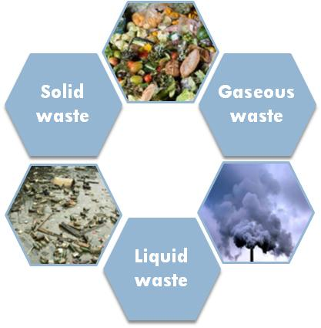
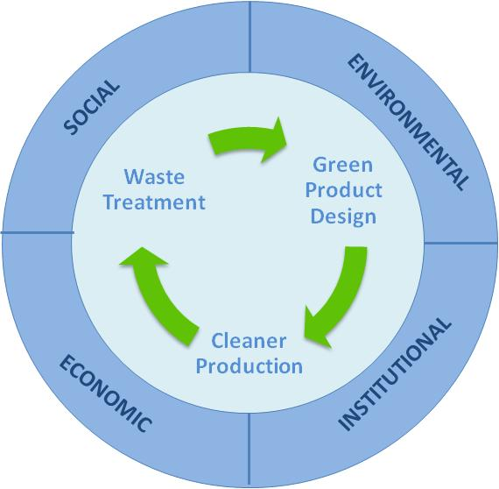
IETC’s Approach to Waste Management
    Holistic Approach to Waste Management
    Waste-to-Resource:
    From Linear Flow to Closed-loop of Resource Circulation
    Promotion of Preventive Policy and 3R
Sustainability
  Waste to Resource
Knowledge, Expertise, Technology, Policies

Slide 38
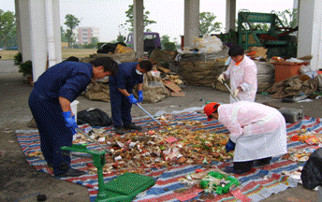
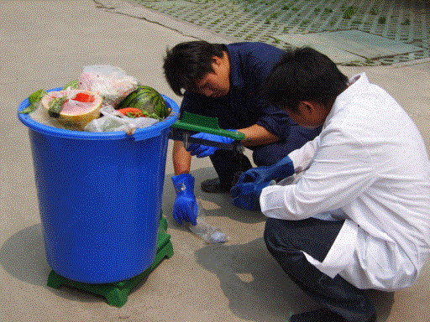
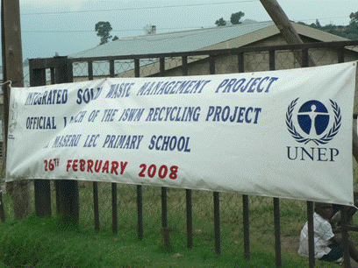
Experience of IETC:
Integrated Waste Management
Wuxi City, China – 2008
Pune City, India – 2008
Maseru City, Lesotho – 2009
Matale City, Sri Lanka – 2009
Novo Humburgo City, Brazil – 2009
Nairobi City, Kenya – 2010
Bahir Dar City, Ethiopia – 2010
Pathum Thani Province, Thailand – 2011
Addis Ababa City, Ethiopia – 2011
Da Nang City, Vietnam - 2012
Kampot City, Cambodia - 2012
Bangkok City, Thailand - 2012
Honduras - 2013

Slide 39

Collaborating Centre: Work Plan
１．Supporting Development / Implementation of
National & City Level Waste Management Strategies and Action Plans
Supporting Cambodia, Myanmar and their target cities (Phnom Penh and Mandalay respectively) for the development of national as well as city-level Holistic Waste Management Strategies and Action Plans, and for implementation of pilot projects.
Additional target countries to be considered in future upon requests from stakeholders. Outreach activities for other cities in the selected countries and expansion of the project to other countries will also be explored.
Data Collection
Assessment of current solid waste management system
Strategy and Action Plan
1st National / City Level Workshop
2nd National / City Level Workshop
Pilot Project
Jun. – Jul. 2016
Oct. – Nov. 2016
Oct. – . 2017
Notes:
The first component of our activities here at CCET is to assist the governments of selected countries and cities to do just that.
Currently, we are supporting the government of Myanmar and Cambodia as well as their target cities (Mandalay and Phnom Penh) to develop their own National & City-level WM Strategies and Action Plans.

Slide 40
Collaborating Centre: Work Plan
２．Contribution to development of Knowledge-hub and Curriculum for Waste Management
Collected data, policy information and technical knowledge gained through above activities will be provided to IETC as the contribution to its Waste Management Knowledge-hub. Centre will provide case study materials for the curriculum IECT plan to develop in collaboration with Kyoto University, Asian Institute of Technology (Thailand), Tongji University (China), TERI University (India), and University of New South Wales (Australia). The Centre will also conduct workshops.

Slide 41
Collaborating Centre: Work Plan
３．Supporting IETC’s Outreach
In order to support IETC’s outreach effort to relevant stakeholders in Japan, the Centre will provide assistance through organizing its own event(s) in Japan, setting-up exhibition booth in relevant events, engage in publicity, organizing websites, and providing Japanese contents.
The Agreement between UNEP and IGES stipulates that CCET can also engage in projects partly or entirely financed by external funding, in addition to the projects mandated by the above Project Cooperation Agreement (PCA). The Center will also seek the possibility of conducting projects financed by government agencies, development assistance institutions, international organizations and private parties.

Slide 42
Thank You very much!
References
1. UNEP (2016), Global Environmental Outlook (GEO-6): Regional Assessment for Asia and the Pacific
http://uneplive.unep.org/media/docs/assessments/GEO_ASSESSMENT_REPORT_ASIA_Wam.pdf
2. Hotta, Y. and Kojima, S. (2012), “Policy Framework for International Collaboration Towards Sustainable Resource Circulation and Management in Asia” in IGES White Paper IV 2012 Greening Governance in Asia-Pacific.
http://www.iges.or.jp/en/pub/whitepaper4.html
3. Hotta, Y. (2012), “Global Resource Crisis or Sustainable Resource Management? Proposals towards Resource-efficient Global Economy” IGES Rio+20 Issue Brief Vol. http://www.iges.or.jp/en/rio20/pub.html
4. UNEP(2011), Resource Efficiency: Economy and Outlook and the Pacific
http://www.unep.org/dewa/Portals/67/pdf/Resource_Efficiency_EOAP_web.pdf
E-mail: hengesbaugh@iges.or.jp

