Slide 1

Making Low Carbon Development Locally Relevant:
Cases from Indonesia and Japan
Eric Zusman, Ryoko Nakano, Sudarmanto Budi Nugroho, Junichi Fujino, Nguyen Thi Kim Oanh, Lai Nguyen Huy, Didin Permadi Augustian, Asep Sofyan, Puji Lestari, Alvin Mejia, Pia Agatep, Heru Sugiarto, Tsuyoshi Fujita, Kei Gomi, Fairz Syam, Muchamad Muchtar, Regan Leonardus Kaswanto, Deddy Hadi Susilo Arifin, Agus Dwi Harianto,
International Workshop on Clean Energy Development in Asian Cities (Learning From Real Cases),
Kyoto University, February 22, 2017

Slide 2

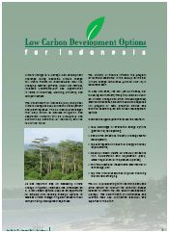


Low Carbon Development has become a “buzzword” in Asia

Slide 3
Environmental Kuznets Curve (EKC)
“though there is no guarantee that environmental quality is inevitable with rising incomes, there is sufficient evidence around the world to give us hope.”*
Pollution Levels
Level of Development
Early Kuznets literature is from Grossman and Krueger, 1994; and World Bank, 1992
*Anderson, 1993
Notes:
Gene M. Grossman and Alan B. Krueger, “Economic Growth and the Environment,” The Quarterly
Journal of Economics, 1994, pp. 353-377.
Corrupt governments might be more willing to negotiate with polluting industries.
See Ramon Lopez and Siddhartha Mitra, “Corruption, Pollution, and the Kuznets Environment Curve,”
Journal of Environmental and Economics Management, August 2000, pp. 137-150. See also Beata K.
Samrzynska and Shang Jin-Wei, “Pollution Havens and Foreign Direct Investment: Dirty Secret or Popular
Myth?” World Bank Working Paper, September 2001.

Slide 4
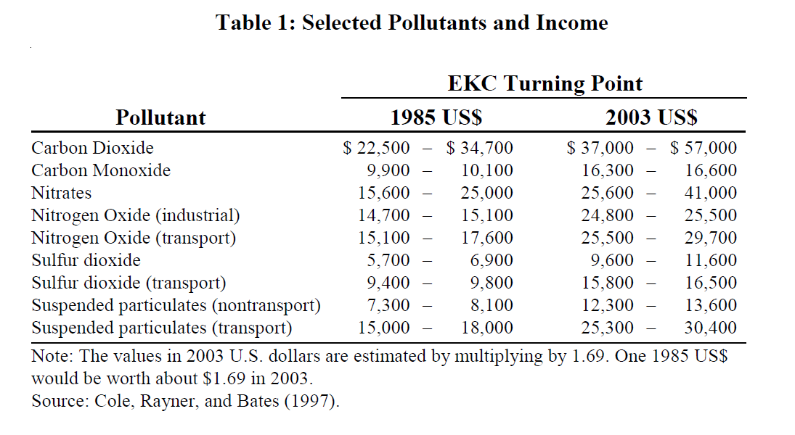
The EKC Turning Points

Slide 5
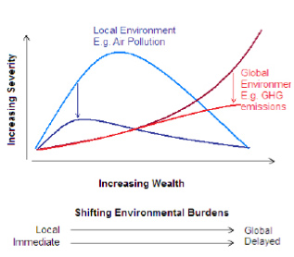
Co-benefits Can Help Drive Low Carbon Development
Source: UNU-IAS, 2013

Slide 6
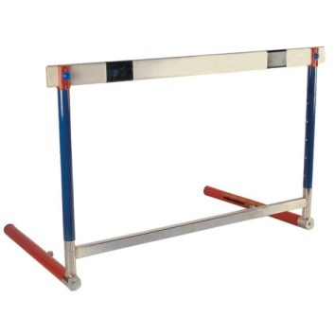
Need to overcome barriers to achieve turning point for GHGs
GHGs
This will require greater emphasis on sectoral integration and social inclusion
Social
Level of Development
Institutional

Slide 7

Sectoral integration and social inclusion also feature prominently in the SDGs

Slide 8
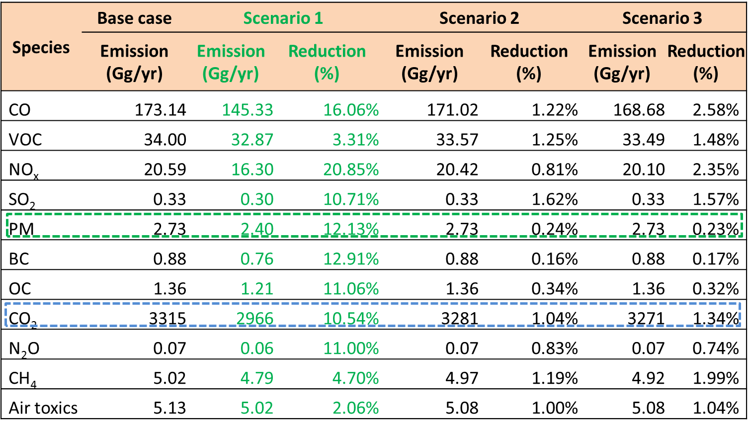
Quantifying Co-benefits in Bandung
Eco-driving
Pedestrian Walkways

Slide 9
Piloting Results from
Bandung Co-benefits Analysis
In terms of fuel savings, the data points included in the analysis pointed to a total savings of 112 liters of fuel (combined diesel and gasoline) during the post-training period. This was computed by dividing the kilometers driven during the post-training period with the efficiencies that were observed during the pre-training period.

Slide 10
Bandung Pilot Results

Slide 11
Co-benefits from the BRT in Semarang
Implication of modal shifting
Mode shifting to BRT: 4 corridors expansion (5, 6, 7 and 8)
Based on Ernst (2006), 20% of BRT users in Jakarta were private vehicle users (14% PC, 6% MC)
Total km travelled (VKT): 2.3 mill. Km, total reported passengers (P, based on Dishubkominfo and survey): 3.8 million (2013) → ratio P/VKT: 1.6 pass./km
Total km served by new 4 corridors: 979 km/day (Dishubkominfo, 2015)
Total passengers served by new 4 corridors: 979 x 1.6 x 365= 0.6 mill./yr
Assuming 20% of those will be shifted from PC and MC
  PC: 81,000 pass. /yr or 20,330 PCs
  MC: 34,800 pass. /yr or 17,400 MCs
Veh. Type | Number of unit in 2015 | Number of unit shifted to BRT (4 new corridors) | Remaining driven
PC | 131,276 | 20,330 | 110,946
MC | 813,812 | 17,400 | 796,412
Taxi | 2,024 | - | 2,024
Bus | 1,806 | - | 1,806
Paratransit | 3,049 | - | 3,049
Emission reduction: 3 – 14%

Slide 12
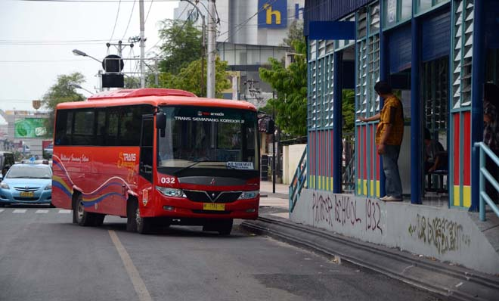
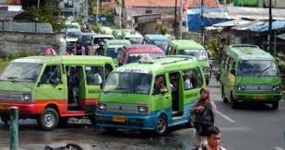
Next Steps for Semarang: Analyze Potential Integration between BRT and Paratransit

Slide 13
Theory of Planned Behavior
Introduced by Icek Ajzen in 1985, the theory of planned behavior argues that peoples’ intentions are central to behavioral achievements and they are usually influenced by whether or not the person is confident of having the ability to conduct the behavior, the level and nature of their belief in performing the behavior, and whether they are subject to social pressure (i.e. subjective norms)
Ability to solve the problem
Social Pressure (Subjective norm)
Intention
Behavior
Perceived behavioral control

Slide 14
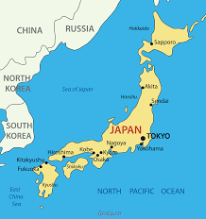
Data collected in Post Fukushima Japan
Respondent
Breakdown
N=4000
conducted Oct 2013
Category |  | Number | age
Gender | Male | 2000 | 50%
 | Female | 2000 | 50%
Age* | 20s | 536 | 13.4%
 | 30s | 915 | 22.9%
 | 40s | 908 | 22.7%
 | 50s | 870 | 21.8%
 | 60s + | 771 | 19.3%
Location | Yokohama (total population) | 1000 (3,703,998) | 25.0%
 | Kawasaki (total population) | 1000 (1,448,196) | 25.0%
 | Kitakyushu (total population) | 1000 (982,388) | 25.0%
 | Nagoya (total population) | 1000 (1,034,154) | 25.0%
Education level | Up to high school degree | 2011 | 50.3%
 | Undergraduate degree and over | 1989 | 49.7%
Household Income | Under 3 million | 794 | 19.2%
 | 3 million ~ under 5 million | 1088 | 27.2%
 | 5 million ~ under 7 million | 928 | 23.2%
 | 7 million ~ under 10million | 706 | 17.1%
 | Over 10 million | 484 | 12.1%
Working Status | Unemployed or part-time worker | 1482 | 37.1%
 | Working on a full time basis | 2518 | 63.0%
Home ownership | Renting a home | 1376 | 34.4%
 | Own a home | 2624 | 65.6%

Slide 15
Attitude toward the behavior
Willingness to Pay for Renewable Energy
Marginal Effects
Total Left-censored (0% renewable) Uncensored Right-censored (100% renewable) | 1690 316 1272 102
Gender (female) (standard error) | -0.03 (0.14) | -0.07 (0.14) | 0.02 (0.15)
Education (standard error) | -0.26’ (0.13) | -0.25’ (0.13) | 0.03 (0.15)
Age (standard error) | 0.03*** (0.005) | 0.03*** (0.006) | 0.02*** (0.006)
Household income (standard error) | 0.18*** (0.05) | 0.19*** (0.05) | 0.15** (0.05)
Working status (standard error) |  | -0.10 (0.15) | -0.09 (0.15)
House structure (standard error) |  | 0.05 (0.03) | 0.06’ (0.03)
Participation in local community chamber (standard error) |  |  | 0.26’ (0.15)
Knowledge of energy policies |  |  | 0.27*** (0.06)
Coefficient Log-likelihood | -3814 | -3813 | -3800
Degree of freedom | 6 | 8 | 11
Results:
1) Willingness to pay for renewable energy correlated positively seniority and affluence.
2) Knowledge of energy policies are strongly and positively correlated with Willingness to pay

Slide 16
Attitude toward the behavior
Higher WTP correlates with knowledge levels
Knowledge | None | Low | Moderate | High | Highest
WTP= 0-999 yen/month | 56% | 52% | 49% | 45% | 41%
WTP=1000-1999 yen/month | 23% | 24% | 25% | 26% | 26%
WTP=2000-4000 yen/month | 21% | 23% | 26% | 29% | 33%

Slide 17
Category |  | Number | percentage
Gender | Male | 300 | 50%
 | Female | 300 | 50%
Age | Below 19 | 2 | 0.33%
 | 20s | 91 | 15.17%
 | 30s | 154 | 25.67%
 | 40s | 132 | 22.00%
 | 50s | 96 | 16.00%
 | 60s + | 51 | 9.00%
Location | Bogor Tengah (Central Bogor) (Total population) | 66 (103,719) | 10.27%
 | Bogor Barat (West) (Total population) | 131 (224,963) | 22.27%
 | Tanah Sareal (Total population) | 118 (209,737) | 20.77%
 | Bogor Utara (North) (Total population) | 110 (179,615 ) | 17.78%
 | Bogor Timur (East) (Total population) | 59 (100,517) | 9.95%
 | Bogor Selatan (South) (Total population) | 116 (191,468) | 18.96%
Education level | College graduate or above | 95 | 15.8%
 | High school graduate or above | 155 | 25.8%
 | Entered high school but have not graduated | 229 | 38.2%
 | Did not reach high school | 117 | 19.5%
 | Other________________ | 4 | 0.7%
Household Income | Less than 1 million rupiah | 66 | 11.0%
 | 1-2.5 million rupiah | 196 | 32.7%
 | 2.6-5 million rupiah | 206 | 34.3%
 | 5.1-7.5 million rupiah | 27 | 4.5%
 | 7.6-10 million rupiah | 15 | 2.5%
 | 10.1-15 million rupiah | 12 | 2.0%
 | 15.1-20 million rupiah | 1 | 0.2%
 | Greater than 20 million rupiah | 4 | 0.7%
 | Do not want to answer | 73 | 12.2%
Home ownership | Renting a home | 514 | 85.7%
 | Own a home | 79 | 13.2%
 | Others | 7 | 1.2%
Bogor City
Respondent
Breakdown
N=600

Slide 18
Attitude toward the behavior
 |  | Model 1.a | Model 2.a | Model 3.a | Model 4 a
 | Intercept No | Not sure | 0.66 | 2.69 *** | 2.67 *** | 3.4
 | Intercept Not sure | Yes | 1.19 ** | 3.31*** | 3.3 *** | 4.0
Individual attributes | Age | -0.007 (0.007) | -0.02 ** (0.008) | -0.02 ** (0.008) | -0.02** (0.008)
 | bs(age, df = 5)1 (standard error)
 | bs(age, df = 5)2 (standard error)
 | bs(age, df = 5)3 (standard error)
 | bs(age, df = 5)4 (standard error)
 | bs(age, df = 5)5 (standard error)
 | Gender (standard error) | 0.03 (0.18) | 0.03 (0.19) | 0.12 (0.19) | 0.18 (0.19)
 | Education (standard error) | 0.28 *** (0.1) | -0.09 (0.12) | -0.1 (0.12) | -0.08 (0.12)
 | Monthly income (standard error) | 0.12 (0.12) | 0.099 (0.13) | 0.10 (0.13) | 0.12 (0.13)
 | Ownership of appliances (standard error) | 0.22 *** (0.06) | 0.14 ** (0.06) | 0.13 ** (0.06) | 0.12 * (0.07)
Knowledge | Knowledge of policies (standard error) |  | 0.28 *** (0.03) | 0.29 *** (0.03) | 0.35 *** (0.05)
 | Information from Energy Bills (standard error) |  | 0.25 ** (0.12) | 0.26 ** (0.12) | 0.28 ** (0.11)
Participation | Environmental Campaign (standard error) |  |  | 0.34 ** (0.15) | 1.31 *** (0.48)
 | Social activities (neighborhood, social, sports related) (standard error) |  |  | -0.13 ** (0.07) | -0.13 * (0.07)
Interactions | Knowledge on policies x Environmental Attitudes |  |  |  | -0.08 ** (0.03)
 | Residual deviance | 956 | 858 | 852 | 847
 | AIC | 970 | 876 | 874 | 871
 | N | 600 | 600 | 600 | 600
Probability to switch to LED lighting
Results:
1) Willingness to purchase technologies were positively correlated with some measures of youth and education.
2) Effects of education disappear when information and participation variables are added into the models.

Slide 19
Attitude toward the behavior
Knowledge - Policy Awareness
3) Information of both relevant policies and energy bills are more likely to purchase energy saving lightings relative to those with less information.

Slide 20
Subjective norm
Knowledge x Participation
4) A lack of information could to some degree be compensated by engaging in environmentally-related activities

Slide 21
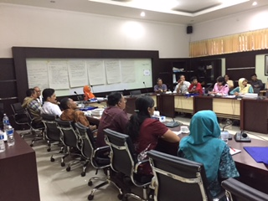
Social norms - FGD
Subjective norm
This was suggested by conducting small group discussions. Discussions after a given professional lecture generally enhance people’s willingness to favor a policy
Time schedule for each session:
(15 min) Pretest survey
(30 min) Expert speaker’s presentation
(30 min) Separate into two groups
(15 min) Post-test survey
 | Pre-FGD | Post-FGD
Knowledge on Policy
Bus Rapid Transport | 53% | 100%
Green Buildings | 41% | 91%
Willingness to switch to BRT when going to work | 36% | 63%
Willingness to Personally Support green buildings | 50% | 100%
Willingness to increase community participation to support this cause
Bus Rapid Transport | 27% | 100%
Green Buildings | 0% | 100%
Willingness to increase Calls to government to support this cause
Bus Rapid Transport | 36% | 90%
Green Buildings | 8% | 83%
Participants: approx 10-20 for each theme/2 groups
Affiliation: Academia, Government, Business, Communities
Small group discussions

Slide 22
Communication methods
Images would be effective in changing people’s behavior in new unfamiliar policies people. (In this example, green buildings is a new unfamiliar policy. Bus rapid transport is well known)
Social media is unanimously preferred over other information channels.
Percentage of respondents who think The methods have Significant impact
Diagrams
Bus Rapid Transport | 63%
Green Buildings | 58%
Image of Children
Bus Rapid Transport | 18%
Green Buildings | 75%
Image of Mayor
Bus Rapid Transport | 36%
Green Buildings | 50%
Figures on Climate Change Mitigation
Bus Rapid Transport | 36%
Green Buildings | 41%
Figures on impact protected
Bus Rapid Transport | 72%
Green Buildings | 50%
Preferred channels of Information
1st choice
TV programs | 40%
Official Government bulletin | 22%
Internet and social media | 22%
Others | 16%
2nd choice
Internet and Social media | 42%
Newspaper | 13%
Official Government Bulletin | 13%
Others | 32%
3rd choice
internet and social media | 24%
School | 20%
Neighbors and aquaintences | 20%
Others | 56%

Slide 23
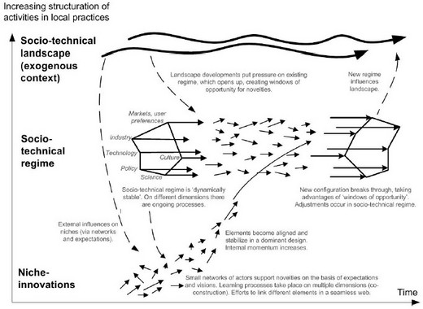
Sectoral Integration and Social Inclusion Can Help Align Interests Within and Across Multiple Levels
Geels, 2005

Slide 24
Controlling global pollutants
GHGs
_{(local pollution)}
Social
GDP
Institutional

