Slide 1
Necessary arrangements for participating in Article 6.2 cooperative approaches
Temuulen Murun
Researcher, Climate and Energy Area
Workshop on COP 27 Article 6 update and its implication on JCM implementation
December 23, 2022

Slide 2
Outline
1
Necessary arrangements for participating in Article 6.2 cooperative approaches
Domestic arrangements for authorization
Corresponding adjustments (CAs)
Reporting under Article 6.2
2
IGES activity related to Article 6.2 reporting
Mutual learning program for enhanced transparency (MLP)

Slide 3
What are ITMOs?
ITMOs: Internationally Transferred Mitigation Outcomes
Real,
verified,
additional
Emission reductions and removals when internationally transferred
Measured in tCO2 eq. or non-GHG
Generated from 2021 onwards
Authorized for use towards nationally determined contribution (NDC)
Authorized for use towards international mitigation purposes
Authorized for other purposes
Article 6.4 emission reductions when authorized for use towards NDC and/or other international mitigation purposes
e.g. CORSIA (Carbon Offsetting and Reduction Scheme for International Aviation)
e.g. private sector’s voluntary emission reduction target
Reference: Decision 2/CMA.3 Guidance on cooperative approaches referred to in Article 6, paragraph 2, of the Paris Agreement, Annex I. Internationally transferred mitigation outcomes, paragraph 1
https://unfccc.int/sites/default/files/resource/cma2021_10_add1_adv.pdf#page=11

Slide 4
Participation responsibilities
(a) To be a Party to the Paris Agreement (PA)
(b) To prepare, communicate and maintain a NDC as per Article 4.2
(c) To have arrangements for authorizing the use of ITMOs towards achievement of NDCs
(d) To have arrangements for tracking ITMOs
(e) To provide the most recent national inventory report as per decision 18/CMA.1
(f) Its participation contributes to its NDC, LT-LEDS (long-term low-emission development strategy) and the long-term goals of the PA
These participation responsibilities (a-f) should be reported in the Initial Report
Reference: Decision 2/CMA.3 Guidance on cooperative approaches referred to in Article 6, paragraph 2, of the Paris Agreement, Annex II. Participation,
https://unfccc.int/sites/default/files/resource/cma2021_10_add1_adv.pdf#page=11

Slide 5
What to do?
Participating Parties have to do the following actions under Article 6.2:
Establish domestic arrangements for authorizing the use of ITMOs
Application of corresponding adjustment (CAs)
Development of a registry system for ITMOs recording and tracking
Reporting under Article 6.2 (Initial Report, Annual Information and Regular information as a part of Biennial Transparency Report)
The review by Article 6 technical experts
Reference: Decision 2/CMA.3 Guidance on cooperative approaches referred to in Article 6, paragraph 2, of the Paris Agreement,
https://unfccc.int/sites/default/files/resource/cma2021_10_add1_adv.pdf#page=11

Slide 6
1. Domestic arrangements for authorization
Decision 2/CMA.3 Para 18 (g): Provide, for each cooperative approach, a copy of the authorization by the participating Party, a description of the approach, its duration, the expected mitigation for each year of its duration, and the participating Parties involved and authorized entities; (in the Initial report)
Authorization for the use of ITMOs means that participating Parties will apply CAs to avoid double counting and report the information of ITMOs
Each Party should prepare domestic arrangements for authorization the use of ITMOs
How to arrange the authorization in the countries? How to govern it?
Mongolia
Japan
1. Decision on credit issuance by the Joint Committee
2. Authorization of the use of internationally transferred mitigation outcomes by each government (JCM credits issued in the JCM registry of Japan)
Reference: Decision 2/CMA.3 Guidance on cooperative approaches referred to in Article 6, paragraph 2, of the Paris Agreement, https://unfccc.int/sites/default/files/resource/cma2021_10_add1_adv.pdf#page=11

Slide 7
2. Methods of corresponding adjustments (CAs)
Actual emissions and removals
Emissions balance for assessment of NDC achievement
CAs
2021 2030
Transfer
2021 ……. 2030
ITMOs
Acquire
Average method of CAs: Amount of ITMOs/elapsed years in NDC implementation
CAs
2021 2030
2021 ……. 2030
Assumption:
Both Parties have single year NDC target in 2030 with implementation period between 2021-2030 and use average method for CAs.
Reference: Decision 2/CMA.3 Guidance on cooperative approaches referred to in Article 6, paragraph 2, of the Paris Agreement, https://unfccc.int/sites/default/files/resource/cma2021_10_add1_adv.pdf#page=11

Slide 8
3. Reporting under Article 6
As part of BTR*
Regular
Information (RI)
Annual Information (AI) Agreed Electronic format (AEF)
Initial Report (IR)
Every year
- Participation responsibilities
- Description of NDC
- Methods for applying CAs
- Cooperative approaches
First transfer
Corresponding Adjustments
Corresponding Adjustments
Acquisition
Use of ITMOs
*BTR: Biennial Transparency Report
Initial report: No later than authorization of ITMOs (i.e. 2023) or In conjunction with next the BTR (i.e. 2024)
Reference: Decision 2/CMA.3 Guidance on cooperative approaches referred to in Article 6, paragraph 2, of the Paris Agreement, https://unfccc.int/sites/default/files/resource/cma2021_10_add1_adv.pdf#page=11

Slide 9
Possible reporting schedule
Submission year | 2023 | 2024 | 2025 | 2026 | 2027 | 2028 | 2029 | 2030 | 2031 | 2032
IR (Initial report) | ✓ | ?
AI (Annual information) |  |  | ✓ | ✓ | ✓ | ✓ | ✓ | ✓ | ✓ | ✓
RI (Regular information ) |  | ? |  | ✓ |  | ✓ |  | ✓ |  | ✓
BTR1
BTR2
BTR3
BTR4
BTR5
Assumptions:
Initial first transfer is made in 2023.
When submission year is X, information on ITMOs from X-2 years are reported in AI and RI.
Information on ITMOs can be included only from the second BTR.
The fifth BTR is used for assessing the achievement of its NDC.
Author’s understanding based on the discussions from the Mutual Learning for Enhanced Transparency using the JCM as an example

Slide 10
Outline
1
Necessary arrangements for participating in Article 6.2 cooperative approaches
Domestic arrangements for authorization
Corresponding adjustments (CAs)
Reporting under Article 6.2
2
IGES activity related to Article 6.2 reporting
Mutual learning program for enhanced transparency (MLP)

Slide 11
Mutual Learning Program for Enhanced Transparency (MLP)
Purpose:
Participants and topics in 2020-2022:
Understand how to apply the reporting guidance under Article 6.2 and 13
Explore improvement areas of next reporting
Strengthen a network working on Article 6.2 and 13 reporting
Article 6.2 reporting pair
1. Thailand (TGO) – IGES
3. Indonesia (CMEA, MOEF) – Mongolia (MET)
2. Chile – Thailand (TGO) – IGES
Activity:
4. Bangladesh (DOE) – IGES
7 months duration
3 meetings and 2 reporting exercises
TGO: Thailand Greenhouse Gas Management Organization
CMEA: Coordinating Ministry for Economic Affairs of Indonesia
MET: Ministry of Environment and Tourism of Mongolia
MOEF: Ministry of Environment and Forestry of Indonesia
DOE: Department of Environment of Bangladesh
Output:
Draft reporting on Article 6.2 and 13

Slide 12
MLP overview
01
Invitation
Kick-off meeting
(Online)
Introduction of participants
Introduction of Mutual Learning
Explanation of schedule and a first assignment
Draft Art. 6.2 reporting using the JCM as example
Ask questions to each other’s deliverable
02
First Exercise
Main meeting
(Online)
Presentation of the first exercise
Explanation of answers to questions
Exchange views and free discussion
03
Refinement of deliverable from first exercise
Written answers to questions asked
Second Exercise
Follow-up meeting
(Online)
Presentation of the second exercise
Review of the program
Discussion for the next step
04

Slide 13
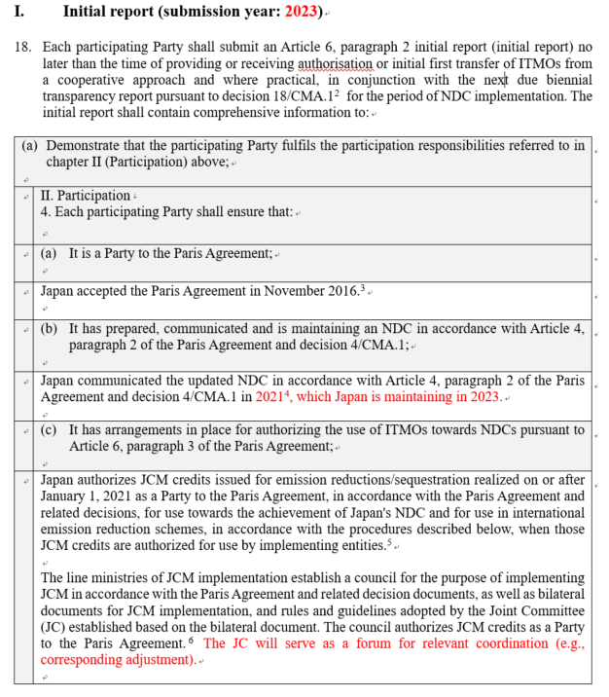
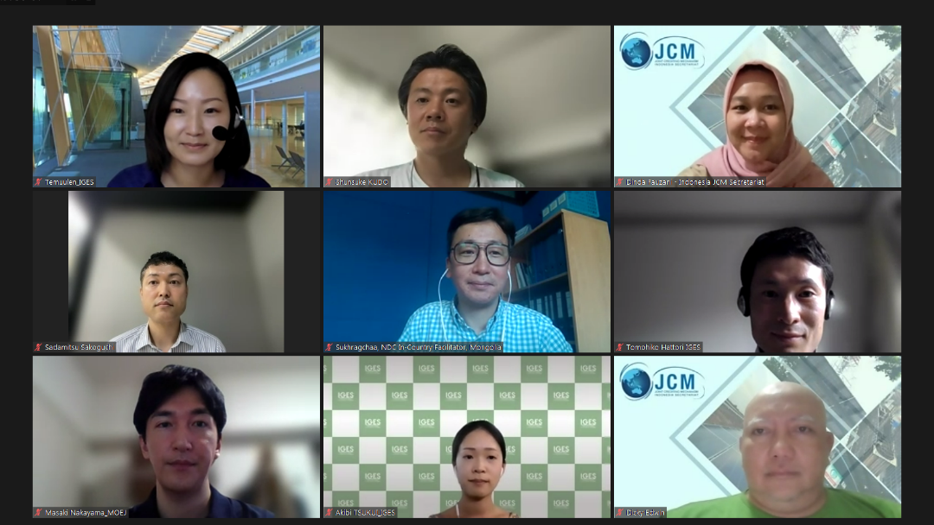
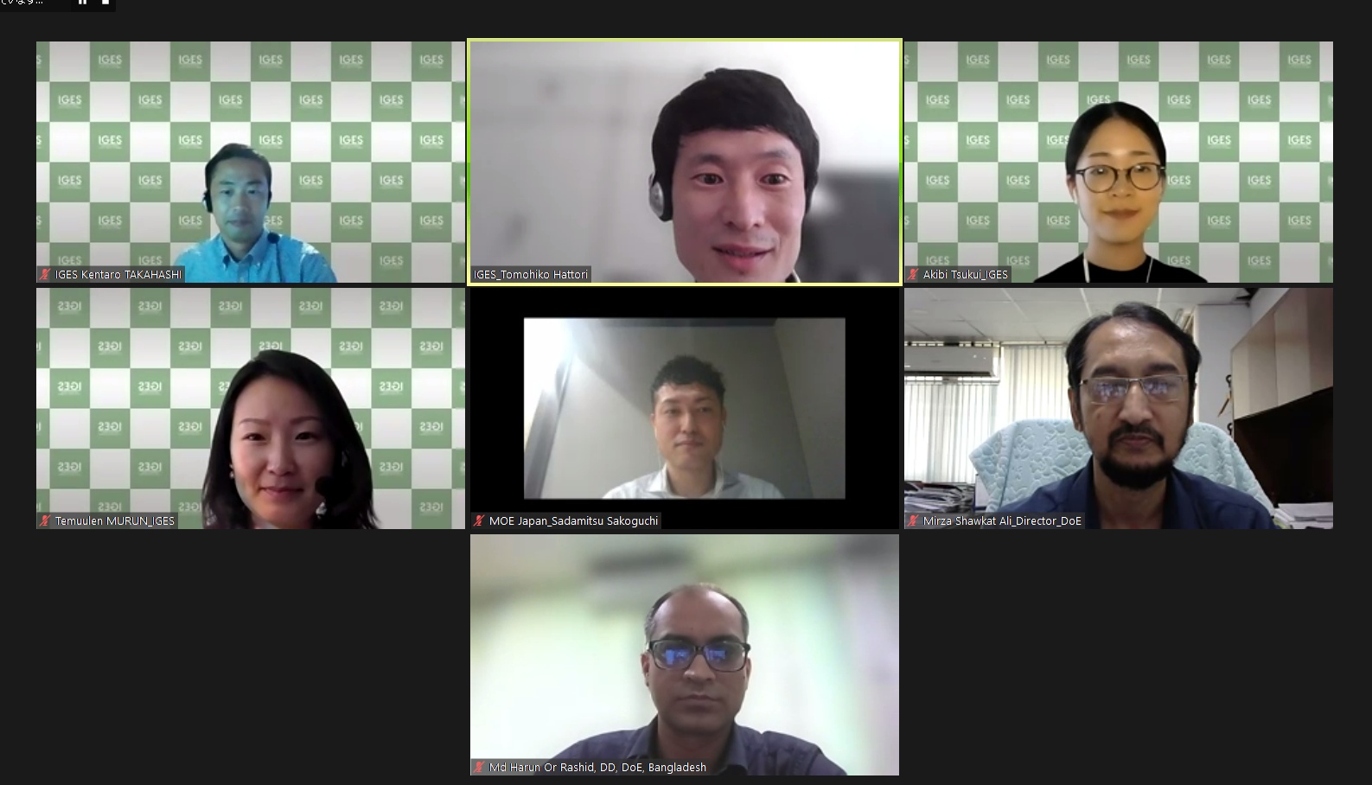
MLP exercise and discussion

Slide 14
Thank you for your attention.
Mutual Learning Program for Enhanced Transparency (MLP)
https://www.iges.or.jp/en/projects/transparency
©2022 Institute for Global Environmental Strategies. All rights reserved.

Slide 15
Annex

Slide 16
What is first transfer?
(a) For a mitigation outcome authorized by a participating Party for use towards the achievement of an NDC or for the first international transfer of the mitigation outcome;
(b) For a mitigation outcome authorized by a participating Party for use for other international mitigation purposes, either the authorization, the issuance or the use or cancellation of the mitigation outcome, as specified by the participating Party.
Reference: Decision 2/CMA.3 Guidance on cooperative approaches referred to in Article 6, paragraph 2, of the Paris Agreement, https://unfccc.int/sites/default/files/resource/cma2021_10_add1_adv.pdf#page=11

Slide 17
Reporting items
Reporting items |  | IR | AI | RI
1 | Fulfilment of participation requirements (e.g. NDC, arrangements for authorization, tracking ITMOs, NIR, LT-LEDS) | ✓ |  | ✓
2 | NDC information pursuant to para 64 of the annex to 18/CMA. 1, if BTR has not been submitted | ✓
3 | ITMO metrics and method for corresponding adjustments (CA) | ✓
4 | Mitigation information in NDC in tCO2 eq., including sectors, sources, GHGs and time periods covered by NDC; or methodology for the quantification of the NDC in tCO2 eq. | ✓
5 | Information on each cooperative approach including a copy of authorization, expected mitigation for each year | ✓
6 | How the cooperative approach ensures environmental integrity, net increase in global emissions within and between NDC implementation through robust, transparent governance and the quality of mitigation outcomes | ✓ |  | ✓
7 | How the cooperative approach is minimizing the risk of non-permanence of mitigation across several NDC periods | ✓ |  | ✓
8 | How the cooperative approach minimizes and, where possible, avoids negative environmental, economic and social impacts | ✓ |  | ✓
9 | How the cooperative approach reflects, respects, promotes and considers human rights, the right to health, the rights of indigenous peoples, local communities, migrants, children, persons with disabilities and people in vulnerable situations and the right to development, as well as gender equality, empowerment of women and intergenerational equity | ✓ |  | ✓
Reference: Decision -/CMA.4 Matters relating to cooperative approaches referred to in Article 6, paragraph 2, of the Paris Agreement, https://unfccc.int/sites/default/files/resource/cma4_auv_cma13_PA6.2.pdf

Slide 18
Reporting items (continues)
 | Reporting items | IR | AI | RI
10 | Description of how the cooperative approach is consistent with sustainable development objectives of the Party, noting national prerogatives | ✓ |  | ✓
11 | Where a mitigation outcome is measured and transferred in t CO2 eq, description of how the cooperative approach provides for the measurement of mitigation outcomes in accordance with the methodologies and metrics assessed by IPCC and adopted by the CMA |  |  | ✓
12 | Information on authorizations and information on its authorization(s) of use of ITMOs towards achievement of NDCs and authorization for use for other international mitigation purposes, including any changes to earlier authorizations |  |  | ✓
13 | How CA are representative of progress towards NDC and ensure participation does not lead to a net increase in emissions |  |  | ✓
14 | How the Party has ensured that ITMOs that have been used towards achievement of its NDC will not be further transferred, further cancelled or otherwise used |  |  | ✓
15 | Annual information on authorization of ITMOs for use towards achievement of NDCs, authorization of ITMOs for use towards other international mitigation purposes, first transfer, transfer, acquisition, holdings, cancellation, voluntary cancellation, voluntary cancellation of mitigation outcomes or ITMOs towards overall mitigation in global emissions, and use towards NDCs |  | ✓
16 | The cooperative approach, the other international mitigation purpose authorized by the Party, the first transferring participating Party, the using participating Party or authorized entity or entities, as soon as known, the year in which the mitigation occurred, the sector(s) and activity type(s), and the unique identifiers. |  | ✓
17 | Annual emissions balance consistent with application of CA |  |  | ✓
18 | Application of the necessary CA and assessment of achievement of the NDC in BTR that contains the end year of the NDC period |  |  | ✓
Reference: Decision -/CMA.4 Matters relating to cooperative approaches referred to in Article 6, paragraph 2, of the Paris Agreement, https://unfccc.int/sites/default/files/resource/cma4_auv_cma13_PA6.2.pdf

Slide 19
Draft version of the Agreed Electronic Format (AEF) - 1
Table 2: Actions
Article 6 database record ID | Cooperative approach | ITMO
 |  | Unique identifier |  |  |  |  |  |  |  | Metric and quantity | Metric and quantity |  |  |  |  |  | ITMO details | ITMO details
 |  | First unique identifier | Last unique identifier | Underlying unit block start ID | Underlying unit block start ID | Underlying unit last block end | Underlying unit last block end |  |  | Metric^{f} | Metric | Quantity (expressed in metric) | Quantity (t CO₂ eq) | Conversion factor (reporting Party) |  |  | First transferring participating Party | First transferring participating Party^{i} | Vintage | Sector(s) | Sector(s)^{k} | Activity type(s)
 | Cooperative approach Article 6.4 mechanism |  |  |  |  |  |  |  |  |  |  |  |  |  |  |  |  |  |  | Energy IPPU AFOLU Waste
(Table 2: Actions continues)
 |  |  |  | First transfer definition |  | Actions
Authorization |  |  |  |  |  | Action details
Date of authorization | Authorization ID | Purposes for authorization | OIMP authorized by the Partyº |  |  | Action date | Action type | Transferring participating Party | Acquiring participating Party | Purposes for cancellation | Using participating Party or authorized entity or entities | First transfer
 |  | NDC |  | Authorization
 |  | OIMP |  | Issuance
 |  | NDC and OIMP |  | Use or cancellation
Reference: Draft version of the agreed electronic format is available digitally at https://unfccc.int/documents/624366

Slide 20
Draft version of the Agreed Electronic Format (AEF) - 2
Table 3: Holdings
Article 6 database record ID | Cooperative approach | ITMO
 |  | Unique identifier |  |  |  |  |  |  |  |  | Metric and quantity |  |  |  |  | ITMO details | ITMO details
 |  | First unique identifier | Last unique identifier | Last unique identifier | Underlying unit block start ID | Underlying unit block start ID | Underlying unit last block end^{e} | Underlying unit last block end |  |  | Metric | Quantity (expressed in metric) | Quantity (t CO₂ eq) | Conversion factor (reporting Party) |  | First transferring participating Party | First transferring participating Party^{i} | Vintage | Vintage^{j} | Sector(s) | Sector(s) | Activity type(s)
 | Cooperative approach Article 6.4 mechanism |  |  |  |  |  |  |  |  |  |  |  |  |  |  |  |  |  |  | Energy IPPU AFOLU Waste | Energy
(Table 3: Holdings continues)
Authorization
Date of authorization | Authorization ID | Purposes for authorization | OIMP authorized by the Party
 |  | NDC |  | Authorization
 |  | OIMP |  | Issuance
 |  | NDC and OIMP |  | Use or cancellation
Reference: Draft version of the agreed electronic format is available digitally at https://unfccc.int/documents/624366

