Slide 1
Sharing experiences from Mutual Learning Program for Enhanced Transparency (MLP) Capacity building activity for Article 6.2 reporting
Temuulen Murun, Researcher, IGES
COP 27 side event: Sharing best practices and lessons learned from capacity building for implementation of Article 6
November 15, 2022

Slide 2
Mutual Learning Program for Enhanced Transparency (MLP)
Purpose:
Participants and topics in 2020-2022:
Understand how to apply the reporting guidance under Art. 6 and 13
Explore improvement areas of next reporting
Strengthen a network working on Art. 6 and 13 reporting
Article 6.2 reporting pair
1. Thailand (TGO) – IGES
3. Indonesia (CMEA, MOEF) – Mongolia (MET)
2. Chile – Thailand (TGO) – IGES
Activity:
4. Bangladesh (DOE) – IGES
7 months duration
3 meetings and 2 reporting exercises
TGO: Thailand Greenhouse Gas Management Organization
CMEA: Coordinating Ministry for Economic Affairs of Indonesia
MET: Ministry of Environment and Tourism of Mongolia
MOEF: Ministry of Environment and Forestry of Indonesia
DOE: Department of Environment of Bangladesh
Output:
Draft reporting on Art. 6 and 13

Slide 3
MLP overview
01
Invitation
Kick-off meeting
(Online)
Introduction of participants
Introduction of Mutual Learning
Explanation of schedule and a first assignment
Draft Art. 6.2 reporting using the JCM* as example
Ask questions to each other’s deliverable
02
First Exercise
Main meeting
(Online)
Presentation of the first exercise
Explanation of answers to questions
Exchange views and free discussion
03
Refinement of deliverable from first exercise
Written answers to questions asked
Second Exercise
Follow-up meeting
(Online)
Presentation of the second exercise
Review of the program
Discussion for the next step
04
*JCM: Joint crediting mechanism

Slide 4
Key discussion points and lessons learned
Key discussion points:
Understanding terminologies for Article 6 reporting for the JCM
Sharing information on how to establish institutional arrangements for authorization
Deepening the understanding of corresponding adjustments (CA)
Lessons learned:
Requirement of strong and long-term commitment
Lack of basic understanding of Article 6 reporting (e.g. ITMOs etc.)
Practical exercise is helpful to understand the Article 6 guidance and identify gaps
Flexibility is important (e.g. program schedule, exercise topics, informal discussion)
Learning by doing and valuing the process of learning
ITMOs: Internationally transferred mitigation outcomes

Slide 5
Thank you for your attention.
Mutual Learning Program for Enhanced Transparency (MLP)
https://www.iges.or.jp/en/projects/transparency
Temuulen Murun, Researcher, murun@iges.or.jp

Slide 6
Annex

Slide 7
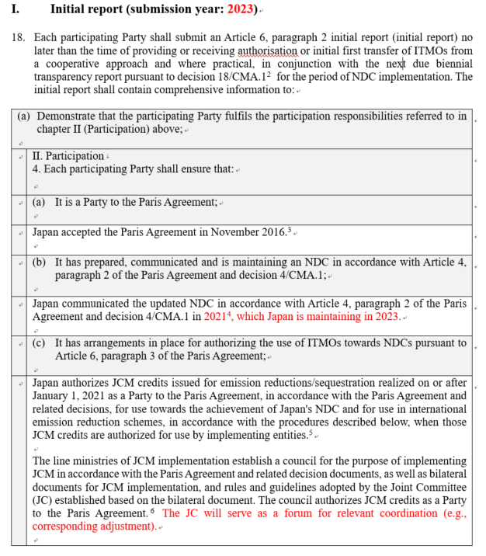
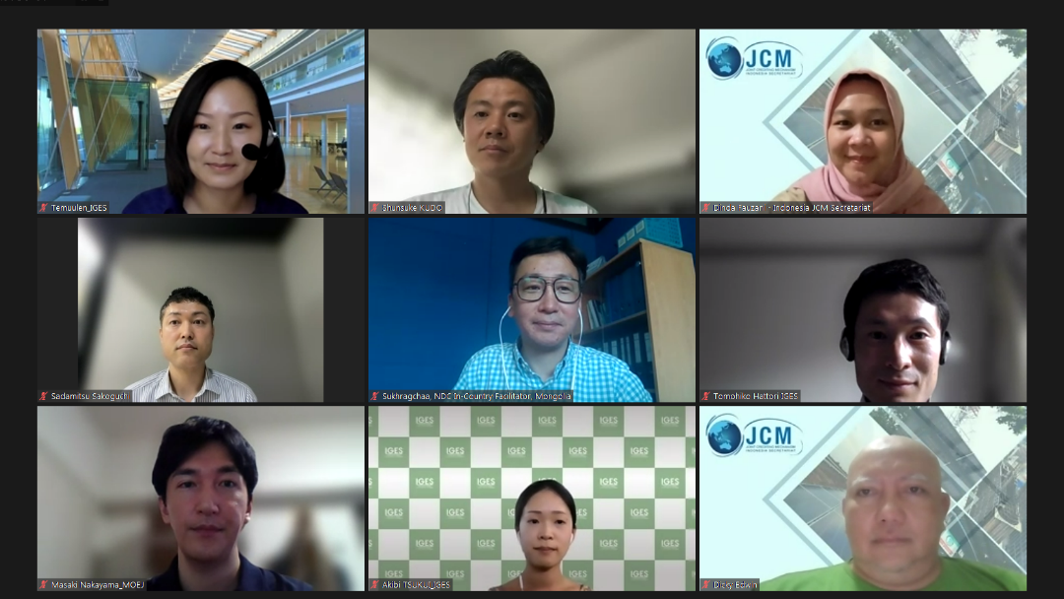
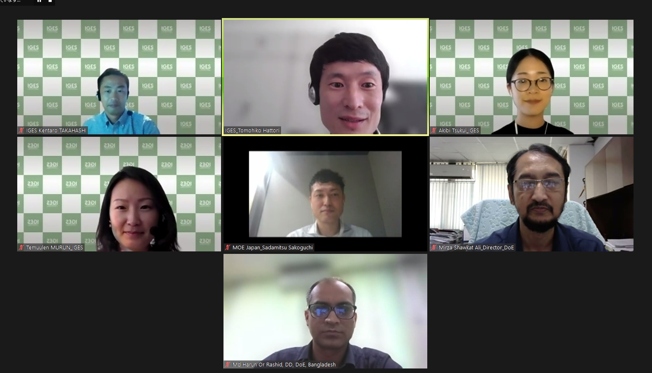
1st Exercise : Draft hypothetical Art. 6.2 reporting using the JCM

Slide 8
1. Understanding of Art. 6 terminologies for the JCM
ITMOs | JCM credits issued for Japan which are authorized by Governments of a partner country and Japan. JCM credits issued for a partner country are not considered as ITMOs unless they are subsequently transferred internationally or used for international mitigation purposes (e.g. CORSIA) or other purposes determined by the partner country.
Corresponding adjustment (CA) | Adding the quantity of ITMOs (authorized and) first transferred to the emissions and removals covered by the NDC¹ (partner countries). Subtracting the quantity of ITMOs used to the emissions and removals covered by the NDC² (Japan).
(ITMOs use for) other purposes | Purposes other than NDC achievement or international mitigation purposes such as private sectors’ mitigation commitments as determined by the partner country.
(ITMOs) use (ITMOs) holdings | By “use”, Japan subtracts the amount of ITMOs used from its emissions and removals. By “holding”, Japan maintains ITMOs without using.
1,2: UNFCCC (2021). Para 8 (a), (b), Annex to Decision -/CMA.3 Guidance on cooperative approaches referred to in Article 6, paragraph 2, of the Paris Agreement. (hereinafter referred to as Article 6.2 guidance)

Slide 9
2. Institutional arrangements for authorization
Domestic discussion | Framework law for climate change which is relevant to institutional arrangements for Art. 6 has been established. (Chile) The line ministries of JCM implementation has established “JCM Promotion and Utilization Committee” for relevant decisions. (Japan)
JCM Joint Committee (JC) | The JC could serve as a bilateral coordination body between two countries when a formal process for authorization is domestically arranged

Slide 10
3. Hypothetical reporting exercise on ITMOs (Annual information)
<Participant A from a Transferring Party>
Year | ITMO authorization | First transfer | Subsequent transfer | Acquisition | Holdings | Cancellation | Use towards the NDC | Authorization for other international mitigation purposes
2016 2017 2018 2019 | 157 8947 9206 1 | 125 7158 7364 0 | 0 0 0 0 | 0 0 0 0 | 32 1789 1842 1 | 0 0 0 0 | 32 1789 1842 1 | 0 0 0 0
(Unit: tCO₂eq)
ITMOs: Internationally transferred mitigation outcomes

Slide 11
3. Hypothetical reporting exercise on CAs (Regular information)
<Participant C from a Transferring Party >
 | Unit | Reporting year |  |  | Cumulative
 |  | 2016 | 2018 | 2020
A) Emissions and removals from sectors and GHGs covered by the NDC {e.g., use past data from GHG inventories} | tCO₂eq | XXX | XXX | XXX
B) ITMOs first transferred {e.g., credits issued for Japan} | tCO₂eq | 73 | 141 | 24,468 | 24,682
C) Mitigation outcomes authorized for other international mitigation purposes | tCO₂eq | - | - | -
D) ITMOs used towards the NDC | tCO₂eq | - | - | -
E) Corresponding adjustments as per the method referred to in paragraph 8 {to choose 8.(a)(i), (ii) or 8.(b)} | tCO₂eq | 8,227.33 | 8,227.33 | 8,227.33 | 24,682
F) Annual emissions balance | tCO₂eq | XXX + 73 | XXX + 141 | XXX + 24,468
ITMOs: Internationally transferred mitigation outcomes

