Slide 1
Training workshop
Blended practical solutions for sustainable lifestyle/sustainable foundries
-22 Feb. 2022-
Green Loans and Sustainability Linked Loans: Why? How?
Abdessalem RABHI, PhD.
Senior Programme Coordinator, IGES

Slide 2
Overall Content
Why and how businesses are embracing sustainability?
What are the key differences between Green Loans and Sustainability-linked loans?
What are the key challenges to embracing sustainability and applying for these types of loans?
Example of available scheme to overcome those challenges.
Conclusion and key messages.

Slide 3
MSMEs loan in India: Quick Overview
63 million MSMEs (Nov.2021)
Multiple lenders in India offer MSME loans:
Interest Rate | 7.65% p.a. onwards
Loan Amount | Rs.50,000 onwards
Loan Tenure | Up to 15 years
Processing Fee | Subject to the lender
Examples of top Banks offering MSMEs loans in 2022
Example of top NBFCs offering MSMEs loan in 2022
Bank Name | Interest rate
State Bank of India (SBI) | 7.65% p.a. onwards
UCO Bank | 8.85% p.a. onwards
Indian Bank | 9.75% p.a. onwards
United Bank of India | 10.25% - 16.25% p.a.
Oriental Bank of Commerce | 10.70% p.a. onwards
Central Bank of India | 11.25% p.a. onwards
ICICI Bank | 13% p.a. onwards
Fullerton Business Loan
Interest Rate | 17% p.a. to 21% p.a.
Processing Fee | Up to 6.5% of the loan amount
Loan Amount | Up to Rs.50 lakh
Loan Repayment Tenure | Depending on the scheme
Source: Author based on information available at: https://www.bankbazaar.com/personal-loan/msme-loan.html

Slide 4
MSMEs Credit Gap
Ongoing policy focus and years of mandated lending have not produced enough progress*.
5% of MSMEs have access to formal finance*.
94% of MSMEs have credit requirement below Rs.10, 00,000* (JPY1,500,000).
Banks are hesitant to lend to enterprises below the Rs.10, 00,000 threshold*.
31% of MSMEs name access to finance as top challenges*.
* source: https://www.devalt.org/newsletter/jan20/of_1.htm
MSMEs Credit Demand | Formal Credit Supply | Overall Credit Gap
Rs. 37 trillion | Rs. 14.5 trillion. | Rs. 20 – 25 trillion.

Slide 5
It’s all about credit rating/score
High credit rating/score: Key to loan approval
High credit rating/score: Key to lower borrowing cost
High sustainability (Environmental, Social, and Governance (ESG)) performance: key to higher credit rating, especially for MSMEs (Sonali Bhattacharya and Dipasha Sharma 2019).
Borrower fills a loan applicant form
Hand it over to the bank/lender
Bank check with credit rating agency for credit score/rating and report
High credit score/rating leads to eligibility check basis documentation

Slide 6
Scope of sustainable finance
Environmental, Social, and Governance (ESG) Factors | Environmental Factors | A. Climate change | Climate change mitigation
 |  |  | Climate change adaptation and resilience
 |  | B. Pressures on natural resources | Over-consumption of natural resources -Water -Biodiversity -Land use and forestry -Marine resources
 |  | C. Pollution, waste and a circular economy | Air pollution Water pollution Waste and waste management Circular economy
 | Social Factors | Impacting Internal Stakeholders | Human capital development
 |  |  | Health and safety
 |  |  | Human rights
 |  |  | Labor rights
 |  | Impacting external stakeholders | Stakeholder opposition and controversial sourcing
 |  |  | Product liability and consumer protection
 |  |  | Social opportunities
 |  |  | Animal welfare and antimicrobial resistance
 | Governance Factors | Corporate Accountability | Board structure, diversity, effectiveness, independence
 |  |  | Reporting and transparency
 |  |  | Financial integrity and capital allocation
 |  | Corporate Alignment | Executive remuneration
Climate Finance
Environmental
/Green finance
Sustainable/
ESG finance

Slide 7
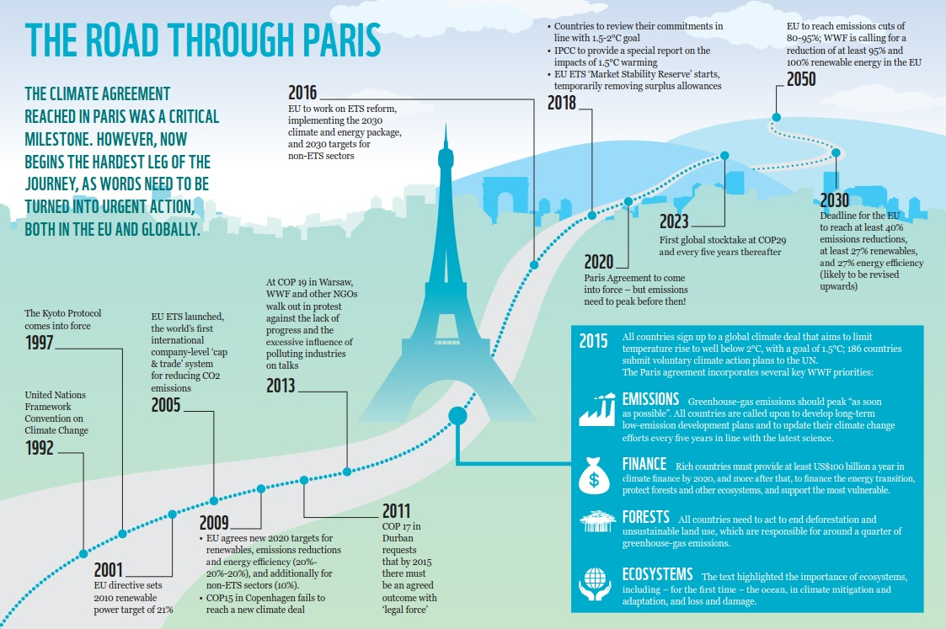
Green finance: The Paris Agreement (PA)
Source: https://wwf.panda.org/wwf_news/?264013/100%2Ddays%2Dsince%2DParis%2D3%2Dmissed%2DEU%2Dclimate%2Dopportunities

Slide 8
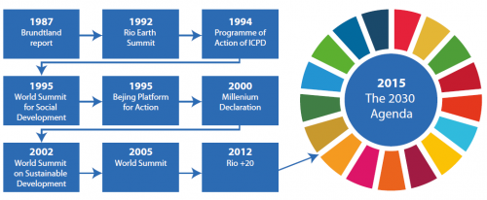
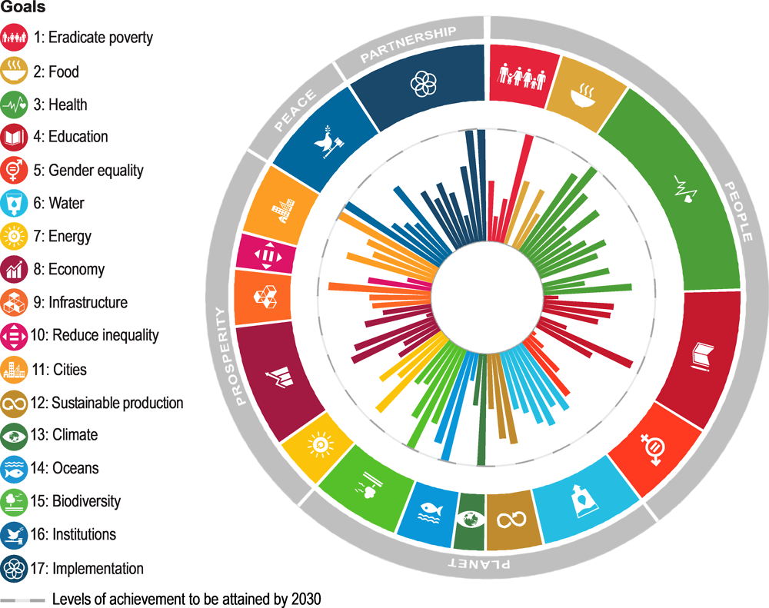
Sustainable finance: The SDGs
2015
The 2030 Agenda (17 SDGs)
Source: https://ec.europa.eu/eurostat/statistics-explained/index.php?title=SDG_-_Introduction

Slide 9
Sustainable finance: Example of debt finance instruments
Green loans (GLs) and Sustainability-Linked Loans (SLLs) are among the debt finance instruments meant to finance/support environmentally sustainable economic activity
Debt finance | Purpose | e.g.: Bonds | e.g. Loans
Sustainable finance / ESG Finance | Proceed-based | -Green bonds -Social bonds -Sustainability bonds | -Green Loan -Sustainability loan
 | Corporate general-purpose | Sustainability Linked Bonds | Sustainability-Linked Loans

Slide 10
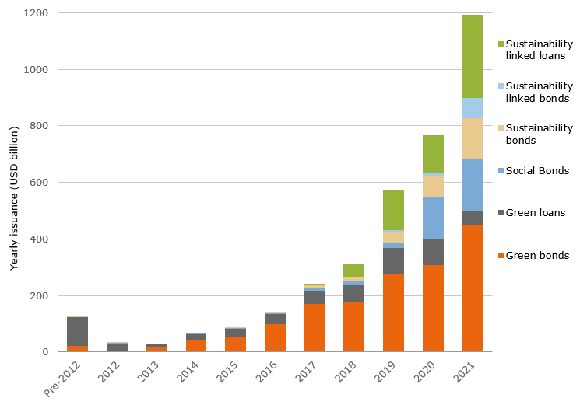
Sustainable finance trend: Mainstreamed
Source: Source: NN Investment Partners, Bloomberg. Data include issuance up to 22 October 2021.

Slide 11
Examples of supporting initiatives/alliances for sustainable finance
The Glasgow Financial Alliance for Net Zero (GFANZ) was launched in April 2021, bringing together existing and new net-zero finance initiatives in one sector-wide coalition that provides a forum for leading financial institutions to accelerate the transition to a net-zero global economy.
Glasgow Financial Alliance for NetZero (GFANZ)
Net-Zero Banking Alliance (NZBA) | Net Zero Asset Managers initiative (NZAM) | Net-Zero Asset Owner Alliance | Net-Zero Insurance Alliance (NZIA) | The Net Zero Financial Service Providers Alliance (NZFSPA) | The Net Zero Investment Consultants Initiative (NZICI)
The Net-Zero Banking Alliance (NZBA) was launched by 43 Founding Members on 21 April 2021 and has since grown. Unfortunately, still, no representative from India has joined.
NZBA Latest Membership Stats
103 Banks | 40 Countries | US$ 68trn Total Assets | 44% of global banking assets

Slide 12
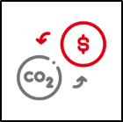
Why embracing sustainability and sustainable finance?
Lower borrowing cost (interest rate, processing fee, cash rebate, etc.).
Positive impact on the environment (responsible business).
Positive impact on reputation and credibility (public opinion).
Values-based relationships and recognition as a potentially less risky company (investors/lenders).
Long-term growth via internal leverage for overall performance (Business leaders/employees).
New investment opportunities.
Resilience to physical and transition risks (accident, constrained liquidity, regulations, etc.).
Access to sustainability-related training and technical assistance.

Slide 13
Green Loans vs. Sustainability Linked Loans: Which one?
From a financial perspective, GLs and SLLs may appear similar to a traditional business loan where a borrower pays back the amount borrowed along with interest.
GLs and SLLs have to be structured using different principles and guidance.
 | Green Loans (GLs) | Sustainability Linked Loans (SLLs)
Use of proceed | Exclusively to Green Projects (proceed based instrument) | Corporates general purpose eligible sustainability linked projects, as defined by
Principles (Guidance) | Green Loan Principles (GLPs)* (Guidance on GLPs)* | Sustainability-Linked Loan Principles (SLLPs)* (Guidance on SLLPs)*
* Developed by an experienced working party, consisting of representatives from leading financial institutions active in the global syndicated loan markets and published by Loan Market Association (LMA), Asia Pacific Loan Market Association (APLMA), and Loan Syndication and Trade Association (LSTA)
Notes:
-The GLPs and SLLPs have been developed by an experienced working party, consisting of representatives from leading financial institutions active in the global syndicated loan markets, with a view to promoting the development and integrity of the green loan product. They have been published by LMA, APLMA, and LSTA. (Loan syndication and trading Association). Latest version in Feb.2021 and May 2021 respectively.
-The GLP build on and refer to the Green Bond Principles (GBP) administered by the International Capital Market Association (ICMA), with a view to promoting consistency across financial markets.

Slide 14
Green Loan Principles (GLPs)
Borrower is required to align the GLs to four components according to GLPs (updated Feb. 2021)
Components | Further explanation
1. Use of proceeds | Should be utilised solely for projects that have clear environmental benefits
2. Project evaluation and selection | Clearly communicate the environmental objectives of the projects, how the projects fit within eligible categories of use, and any related eligibility criteria. Also explains how it will manage environmental and social risks of the project.
3. Management of proceeds | Green loan funds should be put into a dedicated account, or otherwise tracked by the borrower to maintain transparency in the usage of proceeds.
4. Reporting | Should keep up-to-date information about the use of proceeds until the amount borrowed is fully drawn, including a description of the green projects funded, the amount allocated, and the expected green impacts from them.
Review: When appropriate, an external review is recommended. Self-certification to confirm alignment of the green loan with the key features of the GLP, may be also sufficient.

Slide 15
Sustainability-Linked Loan Principles (SLLPs)
Borrower is required to align the SLL to five core components according to SLLPs (May 2021).
Component | Brief explanation
1. Selection of KPIs | Relevant, core, and material to the borrower’s overall business. Measurable or quantifiable and able to be benchmarked.
2. Calibration of SPTs | Should be ambitious and based on recent performance levels. Should be based on a combination of benchmarking approaches.
3. Loan Characteristics | The margin under the relevant loan agreement may be adjusted based on whether the borrower meet, or fail to meet, the pre-determined SPT.
4. Reporting | Where possible and at least once per annum, provide a Sustainability Compliance Certificate/Report to monitor the performance of the SPTs and to determine that the SPTs remain ambitious and relevant to the borrower’s business.
5. Verification | Borrowers must obtain independent and external verification of the performance level of each SPT for each KPI. Such mandatory post-signing verification is a necessary element of the SLLP.
Source: https://www.lma.eu.com/application/files/8416/2210/4806/Sustainability_Linked_Loan_Principles.pdf

Slide 16
Illustrative example of SLL
A Borrower (X) wishes to enter into a 5-year MSME loan (general corporate purposes) of Rs 10 lakh from Bank (Y). He aligned the loan framework to the five core components according to SLLPs (2021) and agreed with the lender on the following KPIs/SPTs.
KPIs | Baseline | KPI Cumulative Reduction from Baseline
 |  | 2022 | 2023 | 2024 | 2025 | 2026
1. CO2 emissions | 4,000,000 tonnes CO2e | 3.00% | 6.00% | 9.00% | 12.00% | 13.00%
2. Water consumption | 1,000,000 cubic metres | 0.25% | 0.50% | 0.60% | 1.00% | 1.35%
They also agreed on interest margin and the structure adjustment in case SPTs are met as follow:
Credit Rating | Interest rate(% p.a.)
AA or AAA | 10.50
BBB or A | 11.50
C, B, or BB | 12.50
D | 14.00
Number of SPTs achieved | Applicable Margin adjustment in %
2 | 1.00 decrease
1 | Unchanged
0 | 0.50 increase
Assuming, in Jan. 2023, X has a credit rating of BBB.
-> If he provides a “Sustainability Compliance Certificate” certifying that he has met both SPTs:
Interest rate will be: 11.50% - 1.00% = 10.50%
-> if he provides a sustainability Compliance Certificate” certifying he fail to meet any of the SPTs:
Interest rate will be: 11.50 + 0.50% = 12:00%

Slide 17
Challenges to access sustainable finance
Examples of challenges to apply for GLs or SLLs
Information gap/asymmetry: | Many MSMEs borrowers, and some lender relationship directors, may not know that this type of product exists.
Mind-set: | Not convinced about the cost vs. benefits
Lack of sustainability strategy: | Most MSMEs do not have a sustainability strategy/framework in place
Limited capacities | Limited financial and technical capacities to develop the frameworks and to align with the principles, to self-monitor, report, and disclose
Reputational risk: | Risk and consequences of breach, especially in case of public disclosure

Slide 18
Example for supporting Initiatives/Stakeholders for sustainable finance (Singapore) (May 2020)

Slide 19
Examples for supporting schemes/stakeholders for sustainable finance (India)
 | Scheme | Purpose
Public-Private Financing | JICA-SMBC-Tata Cleantech Capital Limited (TCCL) | Renewable energy generation, electric vehicles (EV), energy efficiency (proposals following the Green Loan Principles (GLPs).
Japanese Bank in India | MUFG Bank Ltd. (5) Mizuho Bank Ltd.(5) SMBC (3) | All the three banks are members of NetZero Banking Alliance (NZBA); so they are keen to provide Green Loans and Sustainability Linked Loans (proposals following the GLPs and SLLPs)
Indian Banks | SIDBI (Dev. Bank) | -4E financing scheme (bilateral credit line) -Cluster development fund (bilateral credit line) -Sustainable Finance Scheme (Energy efficiency and cleaner production projects not covered under bilateral lines of credit.)
Global finance coaching and investment facilitation | Private Financing Advisory Network (PFAN) (hosted by UNIDO and REEEP) | Free business coaching and investment facilitation to develop climate and clean energy projects in emerging markets, including India.

Slide 20
Potential Synergetic Approach to access Green Loans

Slide 21
Conclusion and key messages
More businesses are embracing sustainability and shifting towards sustainable finance, such as green loan and sustainability linked loan.
->Why?: To seize several financial and non-financial benefits (see slide11).
MSMEs can explore the possibility of turning MSMEs loans into green loans or sustainability-linked loans.
-> How?: Align the loan framework with the green loan principles (slide13) or the sustainability linked loan principles (slide14).
MSMEs require substantial support to embrace sustainability and access to sustainable finance.
-> How?: A multistakeholder approach is needed to leverage the existing supports in a synergetic manner and mutual learning, starting with more awareness creation and capacity building activities.

Slide 22
Thank you for your kind attention

