Slide 1
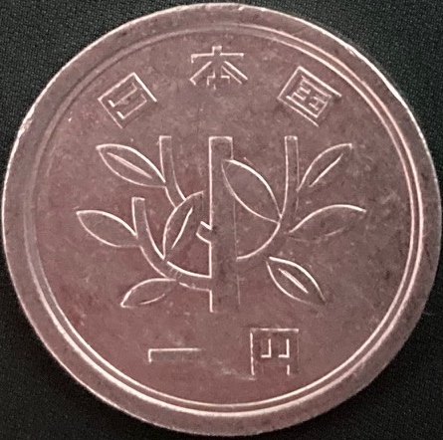
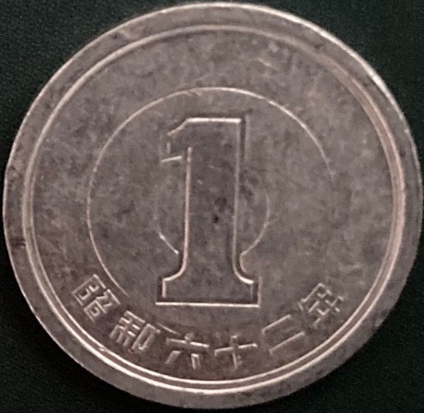
Innovation nature
from
for
Notes:
Short overview on the topic, expandig on what’s been said and focusing a bit on this familiar but perhaps musunderstood word, “innovation”
We are talking about two complementary topics – two sides of the same coin (ANIMATE), as they say in English
Innovation for nature – the ways in which human ingenuity is helping us to conserve better
And innoovation from nature – the ways in which nature informs and inspires technology - in various fields from nedicine to engineering
Neither of these positive messages receive the attention they deserve, and I have never seen them dealt with together

Slide 2
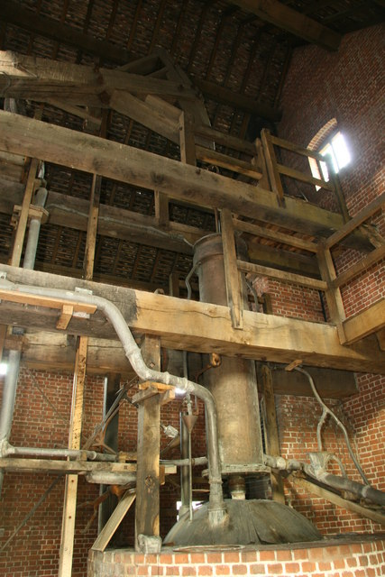
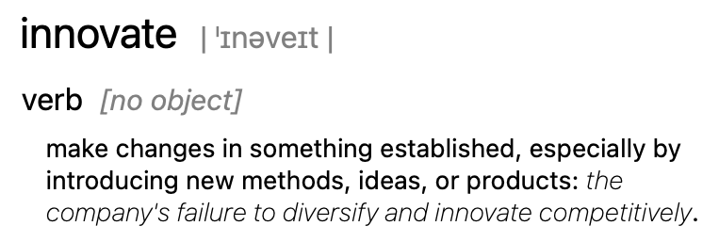
Innovation
To innovate…
≠ invention
Gradual, iterative processes
geograph.org.uk
Notes:
Let’s start with the word “innovation”. We all know the word but what is it really?
Not invention because it builds on something else, and because it is applied. And it is generally a gradual, iterative process with lots of mistakes and dead-ends and lost opportunities along the way. No “Eureka moment”, as Matt Ridley puts it, but when an innoavtion catehs on, it can tarsnform the way we do thinsg – for better or for worse
If you trace back almost any of the tools we use today, you will find they go back way beyond the prototype that made them famous.
The three people (newcommen, Papan and Savoury) who are regarded centrally responsoble for the first conversion of heat to work may never have met
…toys used in ancient Greece and Rome used this principle, and later to create water fountains
But Papan started to think about how to harness the power of heat for practical purposes
Savoury turned it into a machine that turned out to be imprtcical
Newcomen made a practical machine that actually made a difference
And of course thischain of innovations, which I am oversimplifying terribly here, led the development of the steam locomotive, and humankind’s adventures into self-propelled transport, which truly changed the world

Slide 3
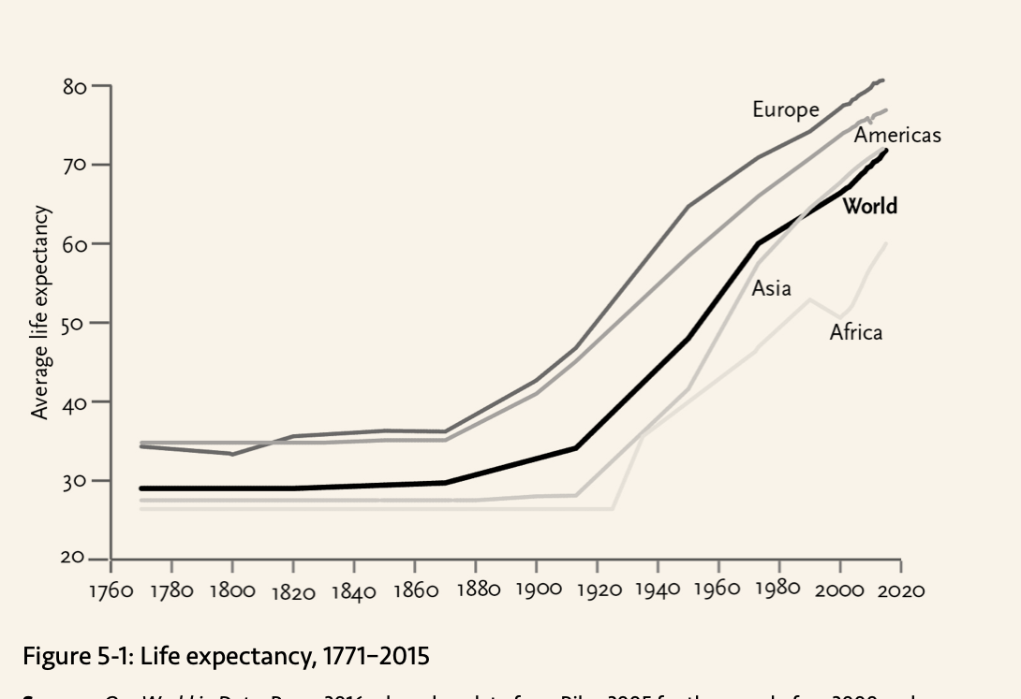
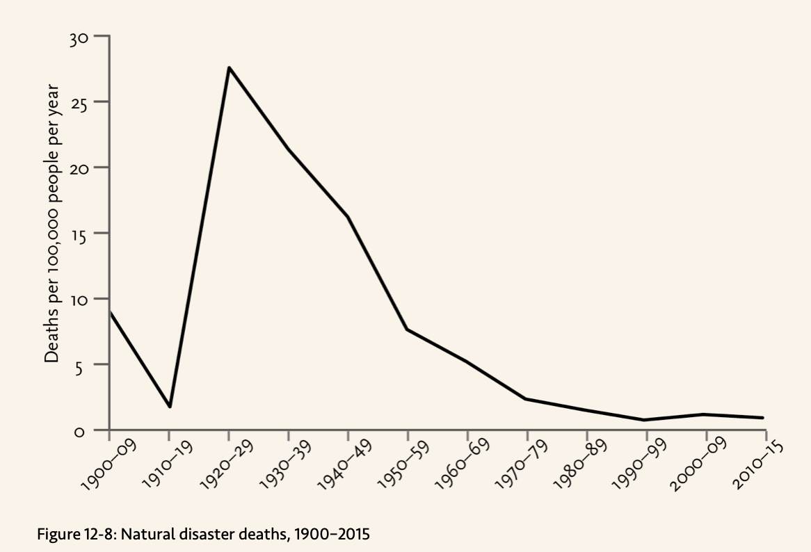
What has innovation done for us?
Sources: ”Enlightenment Now”, Steven Pinker and “Our World in Data”
Notes:
I’ve only recently begin to approach a full understanding of how lucky we are to live in the worls we live in today
We have enough free time to spend days purely on leusure and enjoying the company of others
We can expect to live into our 70s or 80s
We can have life-saving surgery without feeling a thing
We can visit stay in contact with our loved ones, at virtually no cost, anwhere in the world
These are all things that we take for granted and we might be well adviosed to consider the stoic practe of imagining what it wuld be like not to have these things, in oreder to enjoy them more
I acknowledge that we also have civilization-threatening problems on a global scale that we did not have before, and technology is partly responsible for them
But innovation has done incredible things in the past and we can continue to get better at it if we maintain the conditions necessary for that

Slide 4
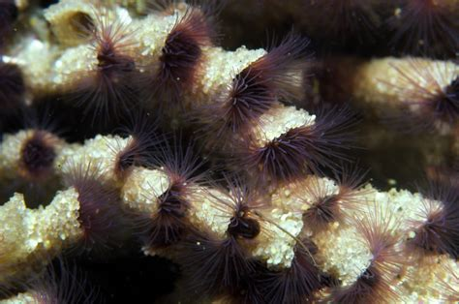
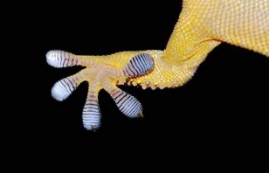
uniprot.org
Innovation from nature
Natural selection is nature’s innovation engine
Thousands of papers
Thousands of patents
…infinite possibilities
news.cnrs.fr
Notes:
So the sophistication and acceleration of human innovation is staggering
And that level of innovation is uniquely human.
Animals can do some amazing things inluding tools but this pales in comarison
However, if you take nature as a whole, and in partilcualr evolution by natural selection, that’s where you see some incredible innovation
Each species is uniquely adapted to its environemnt and has developed a toolkit of adaptations to help it hunt, hide, flee, fight etc.
In the spirit of human innovation, many of these adaptations have been observed and adapted and applied to solving design and material challenges faced by humankind – from medicine to engoneering
Sandcatsle worms
Gecko Gripper from OnRobot has micro‑scaled fibrillar stalks that use Van der Waals forces to pick up objects
The shape of the kingfisher’s beak helped to sole a problem with the aerodynamics of the Japanese bullet train
The high-voltage discharges of electric eels was the design basis for a biocompatible power source for implanted devices such as pacemakers and prostheticsiv;
a low-pressure water purification membrane was inspired by the roots of mangrove trees;
nanostructures mimicking the surface of butterfly wings have been embedded into currency, credit cards, and pharmaceuticals to prevent counterfeiting
And the list goes on and on and on…

Slide 5
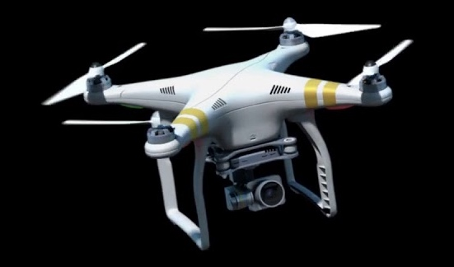
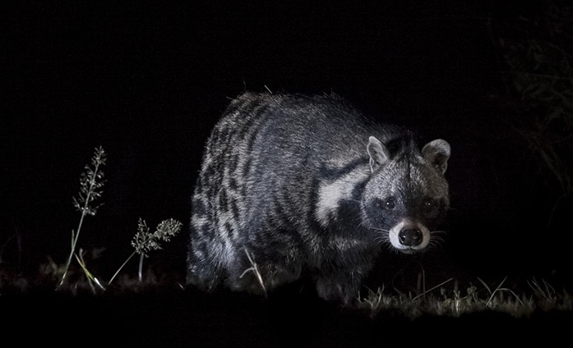
youtube.com
Innovation for nature
Rapid advances built on incremental, gradual change
conservationjournalism.com
Notes:
And then thetre’s innovation for nature.
Artificial Intelligence to detect deforestation
Drones (PIC)
Cameras (traps, live feeds, etc.) (PIC)
Tracking (STORY)
DNA analysis
Citizen science

Slide 6
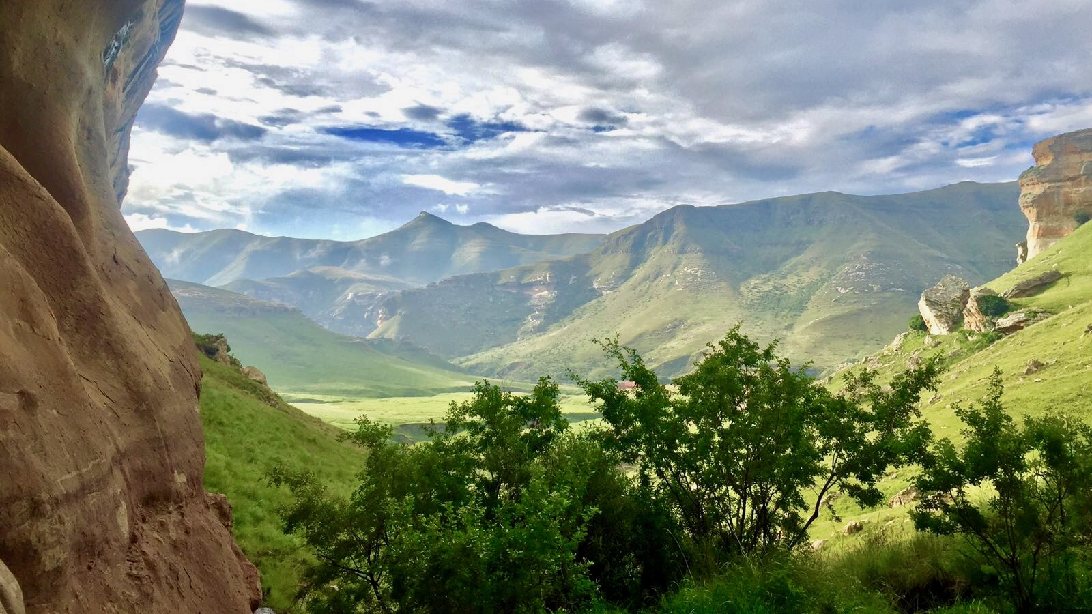
Focusing on innovation
Positive messages from two directions
Not an alternative but a proven part of the solution
Nature offers infinite potential if we concerve it effectively
Photo: Felize van der Plaat
Notes:
We hear a lot of doom and gloom messaging but important to keep one eye on the positive
Tech is not an alternative to lightening out footprint on the planet, but so far it has been the best solution – albeit a the same time as it has accelarated our impact and created the problems in the first place
Although there are good cases for regulation in some instances, we cannot stop technology and the innovation that produces it.
But we can focus more on how to use it to our best advantage
US govt 200 billion on innovation (though non-regulated apparently better)
I think that nature is a key component there, and one that is, in my opinion, under-explored. Every species has

