Slide 1
The role of governments in the transition towards the long term sustainability
15th Asia Pacific Roundtable for Sustainable Consumption and Production
“Green Recovery and Beyond in Asia Pacific through SCP”
Webisode 4
11 May 2021
Caixia Mao
Policy Researcher, Sustainable Consumption and Production Area

Slide 2
Vietnam’s National Action Plan on Sustainable Consumption and Production 2021 – 2030
The changing role of governments in the future – Expert survey result
Discussion: The role of governments in the transition towards the long term sustainability

Slide 3
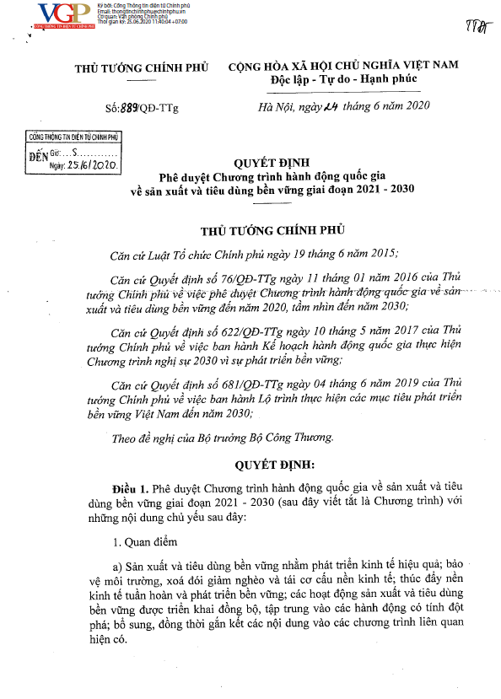
1. Vietnam’s National Action Plan on Sustainable Consumption and Production 2021 – 2030 Development Process
Approved by the Prime Minister of Vietnam June 2020
Participation of 6 ministries in the inter-ministerial drafting committee:
The Government Office, Ministry of Industry and Trade, Ministry of Natural Resources and Environment, Ministry of Agriculture and Rural Development, Ministry of Education and Training, Ministry of Finance, Ministry of Justice; and IGES Team
Ministry of Industry and Trade,
The Socialist Republic of Vietnam

Slide 4
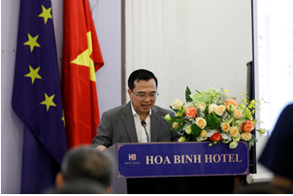
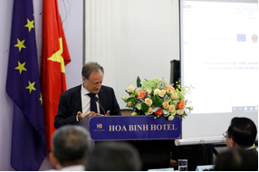
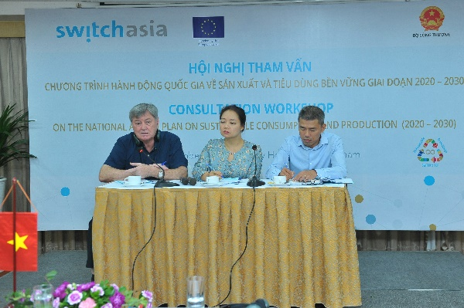
Multi-stakeholder Consultative and Co-creation Process for Consensus Building
Inter-ministerial Drafting Committee
1st Inter-ministerial Review
2nd Inter-ministerial Review
Submission to the Prime Minister Office
Approval by the Prime Minister
Jun – Aug
Jun
2020
Apr
Jun
Sep
Oct
Oct
Nov
Dec
MSC on SCP priorities in Vietnam
Assessment on SCP
2016 – 2020 and Development of New NAP SCP 2021-2030
1st Consultation Workshop
2nd Consultation Workshop
Kick-off
Workshop
Revisions and Reflections
2019
IGES provided technical assistance in the assessment and drafting of the NAP, and supported MoIT in facilitating the consultation process with other ministries.

Slide 5
1. Vietnam’s National Action Plan on Sustainable Consumption and Production 2021 – 2030 Development Process
1. Improve legal policies on promoting sustainable consumption and production
9. Build capacity, enhance education and implement sustainable lifestyles
13. Develop science and technology to promote sustainable consumption and production.
14. Promote access to and support of green finance.
15. Promote international cooperation on sustainable consumption and production
2. Sustainably manage, exploit and use resources, develop renewable, recyclable materials, and fuel
3. Sustainable design, ecological design, reuse, recycle-oriented design
4. Promote Cleaner Production, eco-friendly products, following product life cycles.
5. Develop system of sustainable distribution, and sustainable import/export
6. Promote labeling of products and certification of ecolabels
7. Promote development of sustainable marketing, provide information for consumers
8. Promote sustainable procurement
10. Promote application of circular economy for waste
11. Promote communication on sustainable consumption and production
12. Develop a database system on sustainable consumption and production

Slide 6
1. Vietnam’s National Action Plan on Sustainable Consumption and Production 2021 – 2030 – Implication on sustainable lifestyles
Social and hard infrastructure for sustainable lifestyles
Promote research and data system development
Education and awareness raising on sustainable lifestyles
Incentivize / regulate (un)sustainable products / services provision
Ministry of Industry and Trade (MoIT) as the focal point ministry to incorporate SCP as an opportunity to upgrade Vietnam’s industry to innovate and compete in the global economy (incorporating trade aspect), as a comprehensive sustainable development instrument.
Figure 1: How NAP on SCP could facilitate the transition towards sustainable lifestyles?

Slide 7
2. The changing roles of governments in the future – Expert survey result
Figure 2. Respondents’ projected changes to stakeholders’ strength. Notes: the share of the strengths of stakeholders described in the responses of changes in stakeholders’ roles in the Global Foresight Survey of Potential Changes in Society by 2050: Perspectives of Research Institutes and NGOs. The unit of analysis is reported changes in stakeholders’ roles. N = 124. (Source: Mao et al., 2020a)

Slide 8
2. The changing roles of governments in the future – Expert survey result
Figure 3: Positiveness of the foresighted future related to stakeholders’ changing roles. Notes: the share of the positiveness of future. The unit of analysis is reported changes in stakeholders’ roles. N = 124. (Source: Mao et al., 2020a)

Slide 9
2. The changing roles of governments in the future – Expert survey result
Stronger + Positive
“The governance structure will become more optimal. The social planner will take close part in social networking design and activities. The economic development and environmental protection need more efforts from all the stakeholders. The government will establish an effective and efficient management system to manage the social activities.”
Weaker + Negative
“The profound and far-reaching impacts of climate change, sea level rises, food-water-and-shelter issues, and associated refugee migrations, along with destruction of infrastructure must necessarily limit the role national governments can play in local social and economic activities. Rather than directing or controlling local communities, they will be scrambling to keep some semblance of a nation held together - if there are nations at all by that time.”
Examples of respondents’ views on the changing roles of government (Source: Mao et al., 2020a).

Slide 10
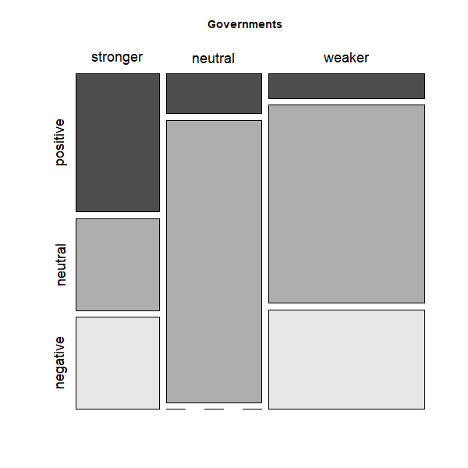
2. The changing roles of governments in the future – Expert survey result
Figure 4: Cross-analysis of the strength and positiveness of stakeholders’ changing roles. Notes: mosaic plots of the strengths of the stakeholder and the positiveness of the future described in the responses of changes in stakeholders’ roles. Horizontal axis refers to the strengths of stakeholders. Vertical axis refers to the positiveness of future. The size of boxes refers to the number of responses belongs to each combination of strength and positiveness. The unit of analysis is reported changes in stakeholders’ roles. N = 124. (Source: Mao et al., 2020a)

Slide 11
3. Discussion: The role of governments in the transition towards the long term sustainability
Government could take the leading role in the sustainability transition, but with strong support and in close cooperation with other stakeholders: research communities, private sector, local governments, the civil society.
When working with government ministries, instead of talking about lifestyles and consumption patterns directly, it’s important to understand ministries’ roles and interests to find the right entry points for policy intervention.
Social and hard infrastructure matters in sustainability transition, and government could make the sustainable options as the default ones, which is the key when considering the scale of changes needed toward the long term sustainability.

Slide 12
References
King, P., Mao, C., Pham, N., Nguyen, L., Nguyen, T., Zhou, X., & Moinuddin, M. (2020). “Development of the National Action Plan on Sustainable Consumption and Production (2021 – 2030) in Vietnam: An assessment of the progress in 2016-2020”. Bangkok: SWITCH Asia.
King, P., Mao, C., Pham, N., Nguyen, L., Nguyen, T., Zhou, X., & Moinuddin, M. (2020). Vietnam National Action Plan on SCP (2021 – 2030). Bangkok: SWITCH Asia.
Mao, C., Koide, R., & Akenji, L. (2019). Society and Lifestyles of 2050: Summary of Findings of the Global Survey of Foresight Experts, Hayama: IGES Publication in partnership with United Nations Environment Programme (UNEP).
Mao, C. Koide, R., & Akenji, L. (2020a). Applying Foresight to Policy Design for a Long-Term Transition to Sustainable Lifestyles. Sustainability, 12(15), 6200.
Mao, C., Koide, R., Brem, A., & Akenji, L. (2020b). Technology Foresight for Social Good: Social Implications of Technological Innovation by 2050 from a Global Expert Survey. Technological Forecasting and Social Change. 153.

Slide 13
2. The changing roles of governments in the future – Expert survey result
An online ad-hoc expert survey (co-implemented with UNEP)
Survey Targets: foresight studies experts published journal articles (i) Foresight Studies experts that are conducting researches on future in different fields and (ii) Experts that with expertise in particular fields and research on future only in the fields of their expertise.
Survey period: 25th January – 28th February 2018 (invitation by email)
Responses: 137 valid responses from a sample of over 1,500 experts
Figure 5: Research / project areas of survey respondents(Source: Mao et al., 2019)

Slide 14
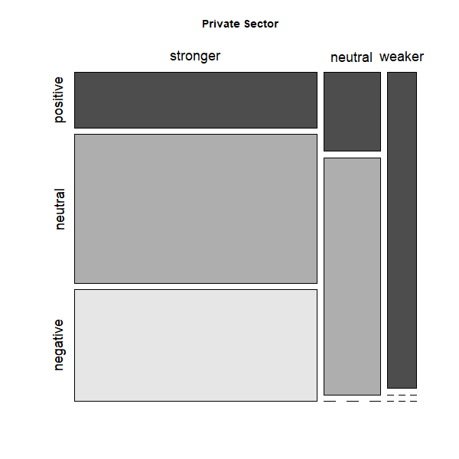
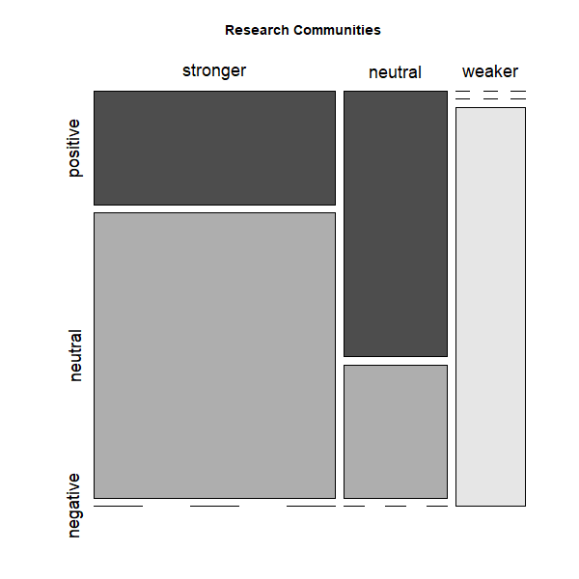
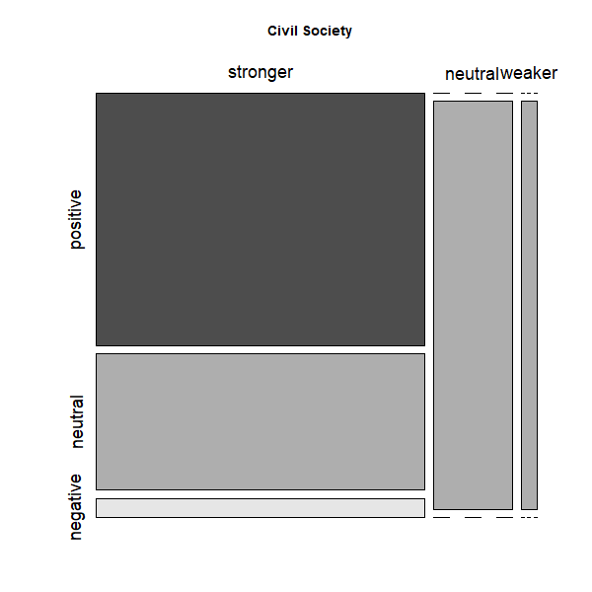
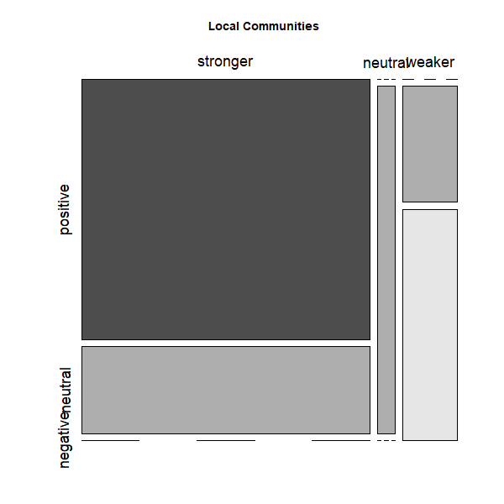
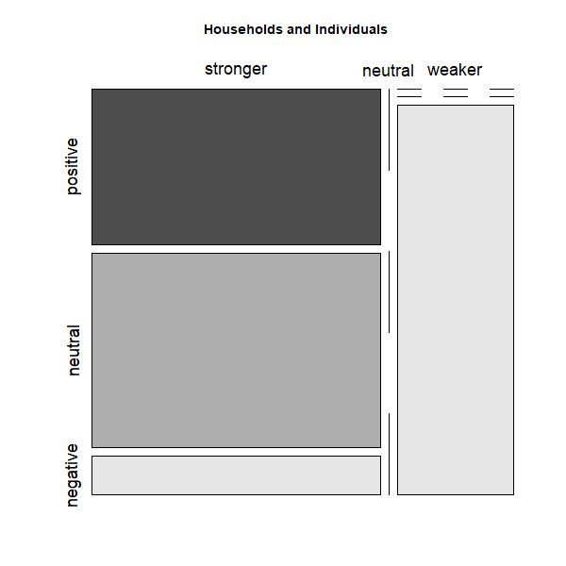
2. The changing roles of governments in the future – Expert survey result
Private Sector
Research Communities
Civil Society
Local Communities
Household & Individuals
Figure 6: Cross-analysis of the strength and positiveness of stakeholders’ changing roles. Notes: mosaic plots of the strengths of the stakeholder and the positiveness of the future described in the responses of changes in stakeholders’ roles. Horizontal axis refers to the strengths of stakeholders. Vertical axis refers to the positiveness of future. The size of boxes refers to the number of responses belongs to each combination of strength and positiveness. The unit of analysis is reported changes in stakeholders’ roles. N = 124. (Source: Mao et al., 2020a)

