Slide 1
Linkages between the JCM and SDGs
JCM Global Partnership Meeting, Session 3
(17-19 Feb 2021)
Temuulen Murun, Researcher, Climate and Energy area
Akibi Tsukui, Researcher, Climate and Energy area

Slide 2
Outline
SDGs in Article 6 and the JCM
Key findings from IGES analysis: “JCM contributions to SDGs”
JCM potentials for recovery plan from the COVID-19 pandemic
Summary

Slide 3
SDGs in Article 6 and JCM
SD in Article 6 of the PA¹
Parties shall, where engaging on a voluntary basis in cooperative approaches that involve the use of internationally transferred mitigation outcomes towards NDCs, promote sustainable development and ensure environmental integrity and transparency….
SD under the JCM²
To facilitate diffusion of leading low carbon technologies, products, systems, services, and infrastructure as well as implement mitigation actions, and contribute to sustainable development of the partner countries.
  Every project is required to conduct a local stakeholder consultation
  Assessing and reporting SD have been conducted in Mongolia³ and Indonesia⁴
  SD assessment: Project participants set out SD plan to prevent any negative impacts on the environment and submit SD report to address these impacts and to identify possible contributions to SD^{3,4}.
  1. Article 6 pf the Paris Agreement, https://unfccc.int/sites/default/files/English_paris_agreement.pdf
  2. JCM website, https://www.jcm.go.jp/about
  3. SD Guideline under the JCM in Mongolia, https://www.jcm.go.jp/opt/mn-jp/rules_and_guidelines/download/JCM_MN_GL_SDCP_CR_ver01.0.pdf
  4. SD Guideline under the JCM in Indonesia, https://www.jcm.go.jp/opt/id-jp/rules_and_guidelines/download/JCM_ID_GL_SDIP_IR_ver01.0.pdf

Slide 4
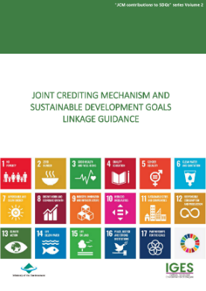

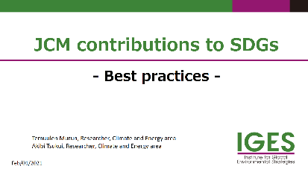
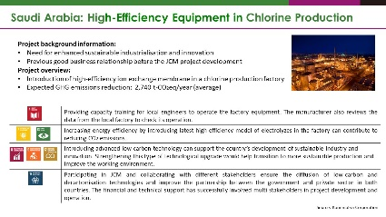
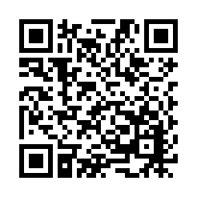
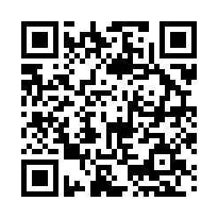
“JCM contributions to SDGs” series
First Volume
-Developed qualitative and quantitative indicators for JCM
-Analysed 57 registered projects
JCM-SDGs Best practices
- Included 8 case studies
- Future work: Update indicators and analyse new projects regularly
Mar 2020
Aug 2020
Feb 2021
Second Volume
-A tool for identifying the JCM project contributions to the SDGs
- Updated indicators and covered newly registered projects
IGES publication website: https://www.iges.or.jp/en/pub/list/series/4680

Slide 5
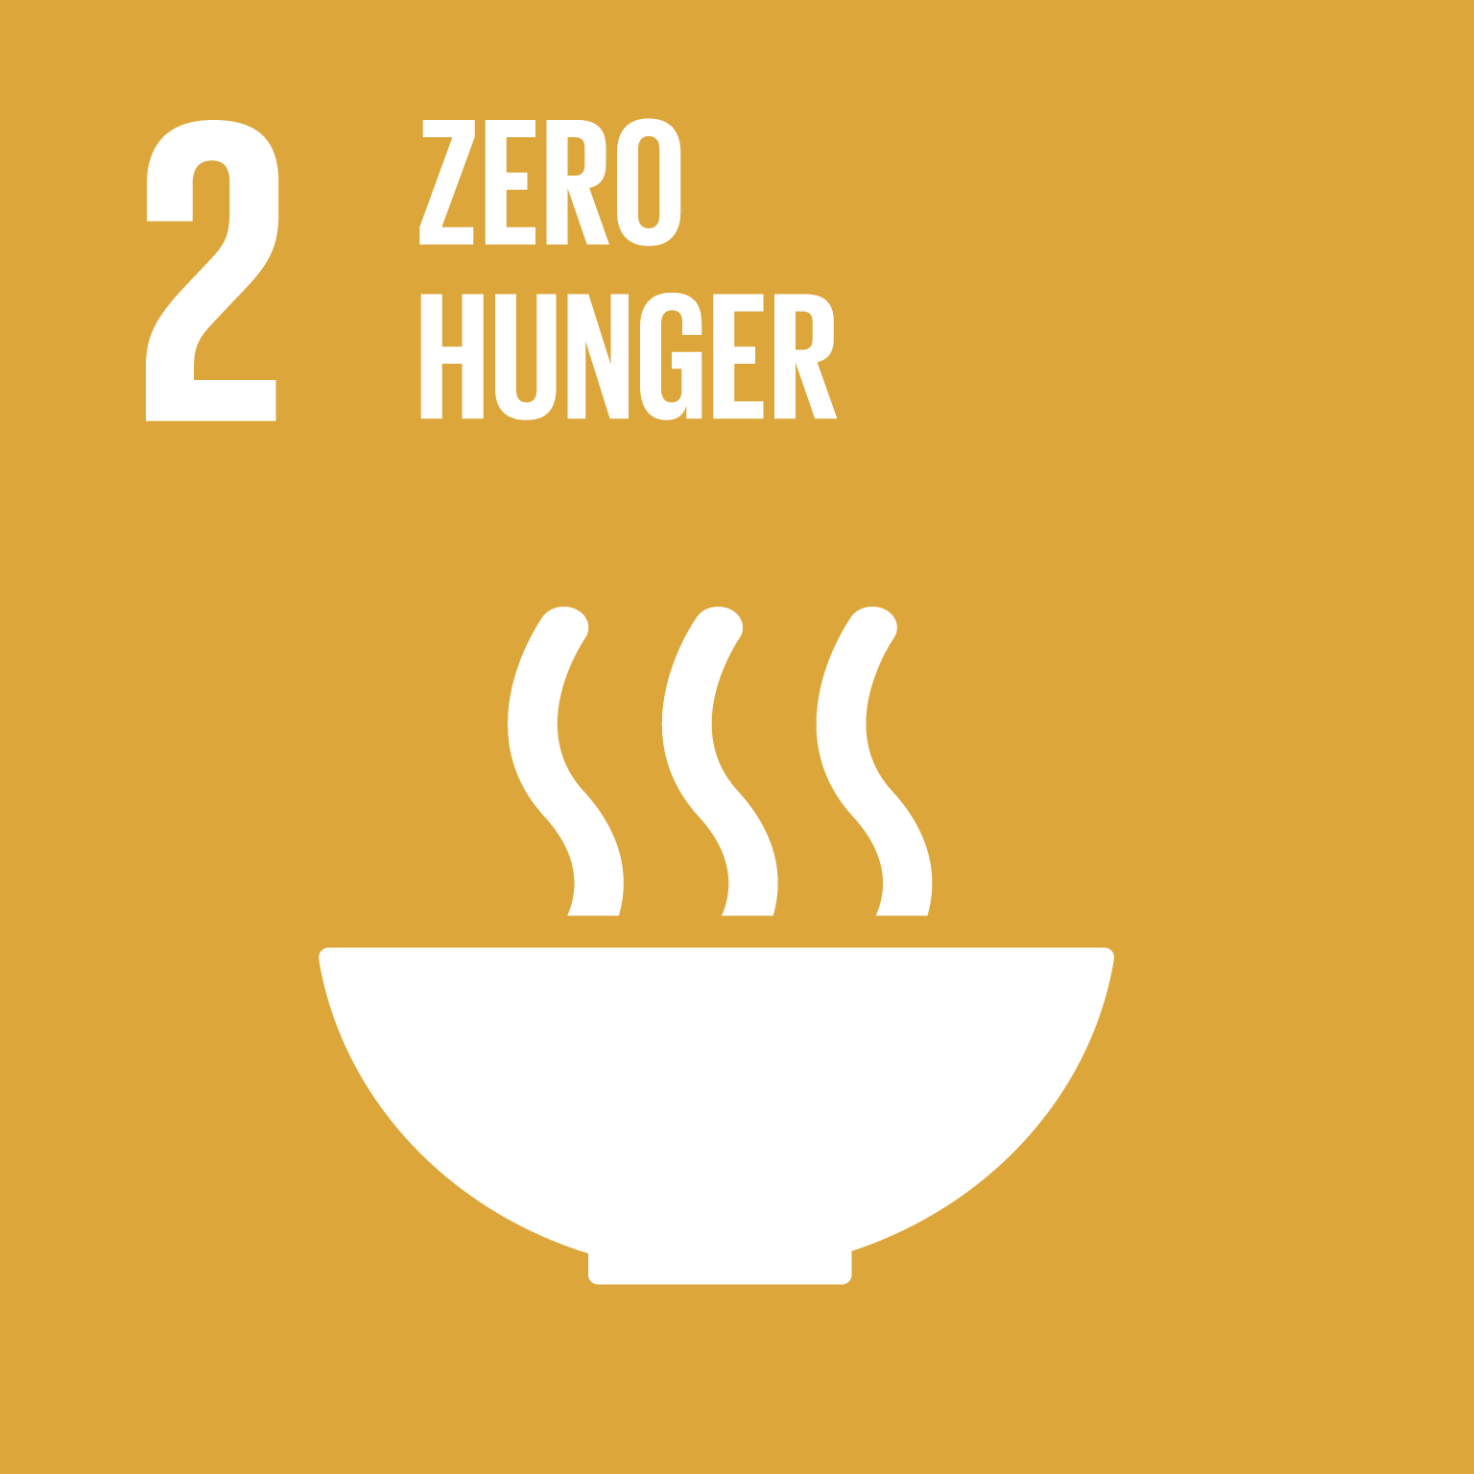



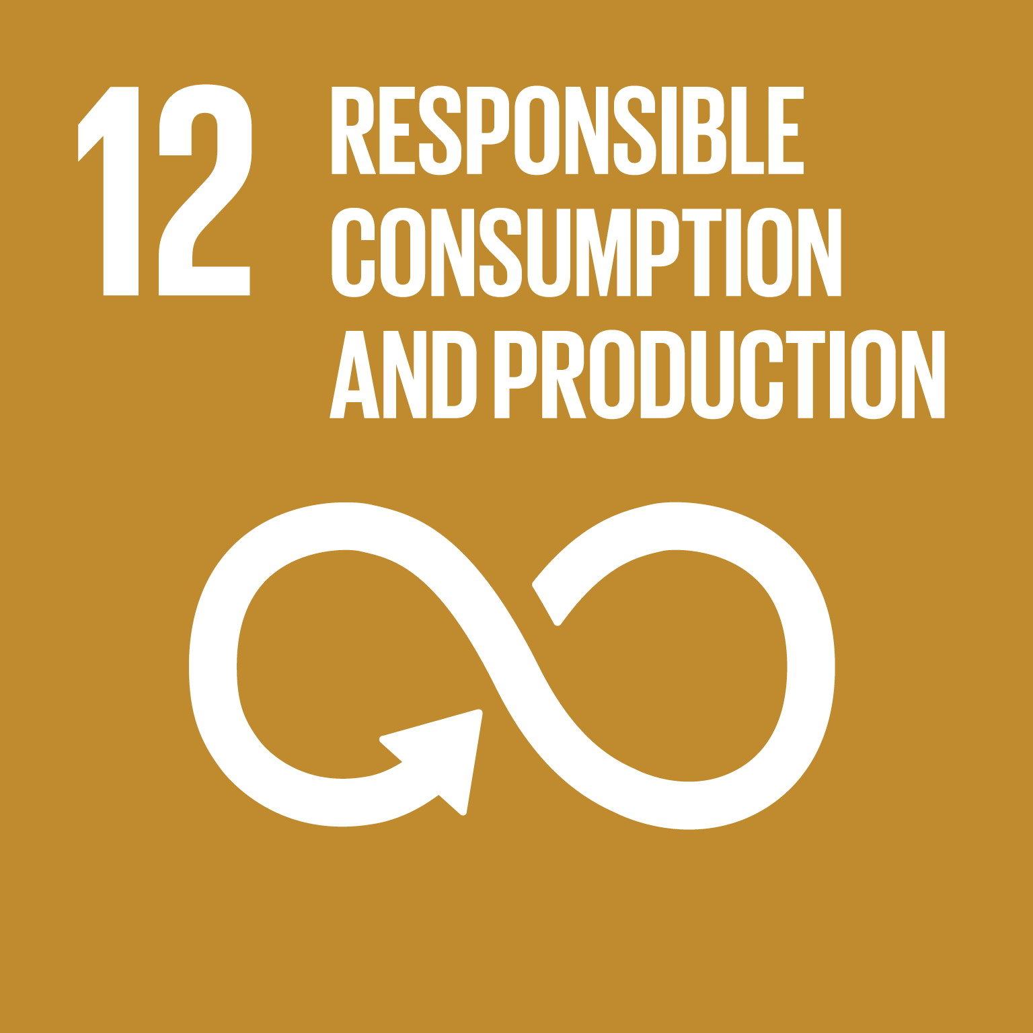




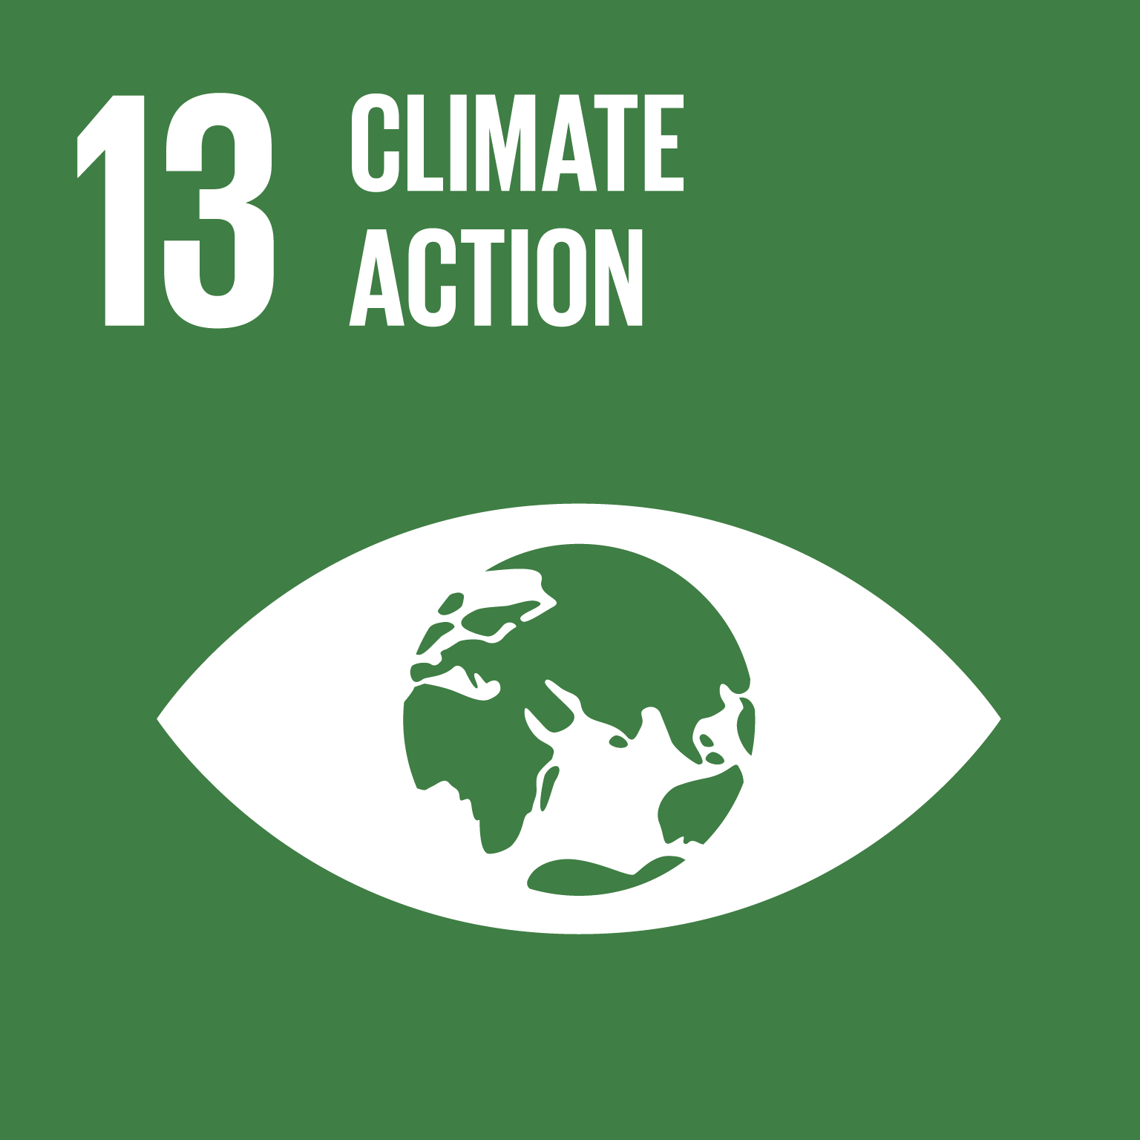

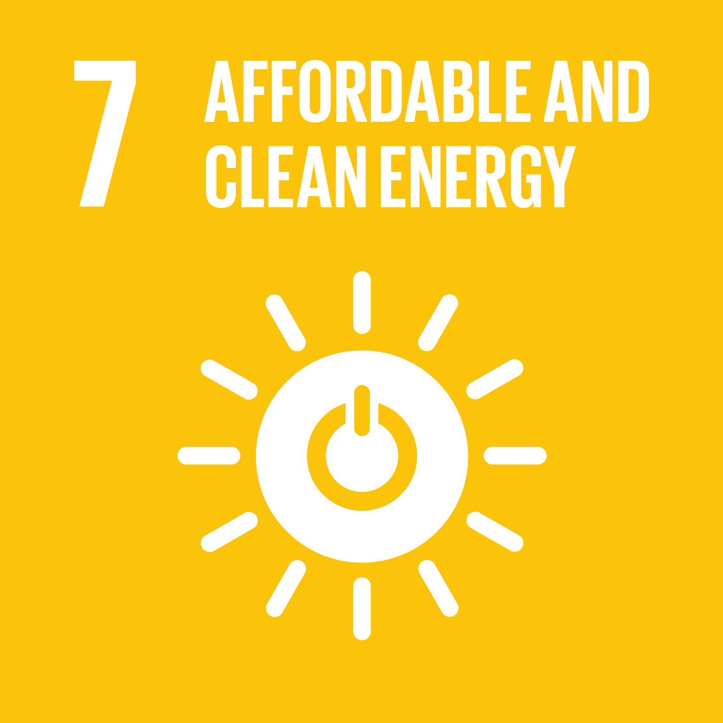
1. Contributions to multiple goals and targets
JCM contributes to not only energy, environmental and economic Goals but also social dimension of the SDGs
Social
Environmental
Economic
Source: “JCM contributions to SDGs”, “JCM-SDGs linkage guidance”

Slide 6
2. Implementing projects in different sectors
Common SDGs that JCM contributes to:
JCM contributions based on project types:
1. Introducing Waste Paper Processing System into a Packaging Paper Factory
4.4 Technical training
7.a International cooperation to increase clean energy
7.3 Reducing energy consumption
12.2 Recycling resources
12.5 Recycling waste
9.4 Sustainable industry
12.4 Responsible consumption and management of natural resource
2. Introducing high efficiency air-jet loom in a textile factory
13.3 Improve employees’ awareness of climate change
7.3 Reducing energy consumption
17.3 Mobilizing private capital to support SDGs
8.2 Industry innovation in developing countries
Source: “JCM contributions to SDGs”, “JCM-SDGs linkage guidance”

Slide 7
3. Expanding JCM contributions to the SDGs
Potential JCM projects:
Common SDGs that JCM contributes to:
1. Renewable energy in irrigation system
4.4 Technical training
7.a International cooperation to increase clean energy
To contribute sustainable agriculture and increase efficient water management
2. Waste water treatment
9.4 Sustainable industry
12.4 Responsible consumption and management of natural resource
To enhance public health and sanitation; and support sustainable cities
13.3 Improve employees’ awareness of climate change
3. Solid and plastic waste treatment
17.3 Mobilizing private capital to support SDGs
To enhance recycling waste and contribute to reduction of ocean plastics
Source: “JCM contributions to SDGs”, “JCM-SDGs linkage guidance”

Slide 8
Designing JCM projects from SDG perspective
Analyze JCM projects using JCM-SDGs linkage guidance
Benefits of analyzing projects
  Enhance understanding of the interlinkage between JCM and SDGs
  Design and plan projects from SDG perspective
  Increase projects’ potential to contribute to your country’s SDG achievement by encouraging private sectors to practice the JCM
IGES has developed a video how to analyze projects
IGES has conducted case study analysis based on the JCM-SDGs linkage guidance
https://www.iges.or.jp/en/pub/jcm-and-sdgs-linkage-guidance/en

Slide 9
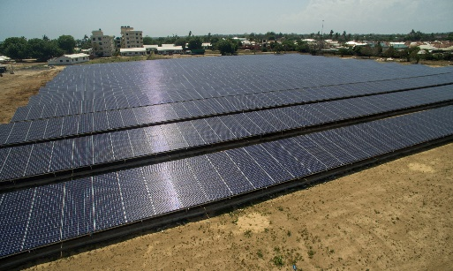
Kenya: Solar PV System at a Salt Factory
Project background information:
Electricity prices for manufacturing are high
Power outages often occur in rural areas
Project overview:
Installation of a high-quality 991.1kW solar PV system as an alternative power source
Expected GHG emissions reduction: 630 t-CO2eq/year (average)
 | The reduction in the amount of electricity purchased from electric power companies has led to a reduction in the cost of electricity usage in the factory. This makes it possible to manufacture and sell salt at a more affordable price.
 | Reducing fossil fuel consumption contributes to reduce air pollution. Reducing the environmental burden by improving air pollution can improve the per capita environmental impact of cities.
 | Vocational training on how to operate the solar PV power generation facilities was conducted for engineers at the salt factory. Pacific Consultant Co., Ltd developed and shared a monitoring manual for local employees.
 | 20%-30% of the total annual electricity consumption at the factory is covered by electricity generated from the solar PV power generation system. The project received the Best New Subscriber Award at the Energy Management Awards in Kenya in 2019.
 | The use of renewable energy reduces grid power consumption and supports Kenya’s transition to sustainable production while increasing sustainability of the production.
 | Participating in JCM and collaborating with different stakeholders ensure the diffusion of low-carbon and decarbonisation technologies and improve the partnership between the government and private sector in both countries. From project planning to implementation, project participants maintain close communication with local governments and communities.
Source: Pacific Consultants Co., Ltd.

Slide 10
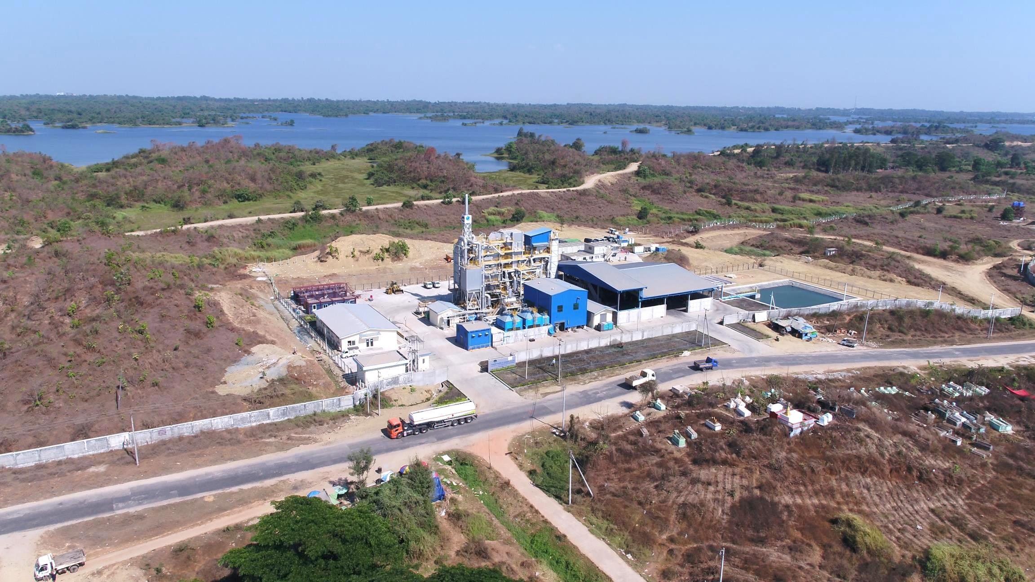
Myanmar: Waste-to-Energy Project
Project background information:
Landfill capacity at the current treatment site is decreasing
Negative impacts on environment (human health) due to poor waste management
Project overview:
Introduction of advanced solid waste treatment
Expected GHG emissions reduction: 4,067 t-CO2eq/year (average)
 | Generating electricity from solid waste leads to reduce fossil fuel consumption and contributes to air pollution reduction. Treating solid waste can contribute to soil contamination reduction in the surrounding area. Therefore, the project reduces negative environmental impacts by improving waste management.
 | Providing technical capacity training for local engineers and employees to operate the treatment plant.
 | Engaging in advanced waste management and reducing hazards from solid waste can prevent ground water pollution. The project can reduce the volume of solid waste by around 90%.
 | The project reduces GHG emissions by replacing electricity generated by fossil fuel and avoiding methane release from the solid waste. Over 60 % of generated electricity is used by the treatment plant itself, and the rest is sold to the grid system.
 | Introducing highly efficient technologies in solid waste treatment leads to enhance sustainable public infrastructure development. The plant treats about 60 tons of waste per day. It has a separate recycling process which collects recyclable materials such as bottles and plastics. These activities contribute to reducing the landfill waste. Strengthening this kind of technological upgrade would help Myanmar to move towards more sustainable production.
 | Contributing to marine pollution reduction through appropriate solid waste management
 | Participating in JCM and collaborating with different stakeholders ensure diffusion of low-carbon and decarbonisation technologies and improve the partnership between the government and private sector in both countries.
Source: JFE Engineering Corporation

Slide 11




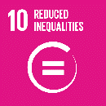
COVID-19 impacts on the SDGs
Reduced commitment to climate action; but less environmental footprints due to less production and transportation
Conflicts prevent effective measures for fighting COVID-19; those in conflict areas are most at risk of suffering devastating loss from COVID-19
Aggravate backlash against globalization; but also highlight the importance of international cooperation on public health
Population living in slums face higher risk of exposure to COVID-19 due to high population density and poor sanitation conditions
Loss of income, leading vulnerable segments of society and families to fall below poverty line
Economic activities suspended; lower income, less work time, unemployment for certain occupations
Food production and distribution could be disrupted
Supply disruptions and inadequate access to clean water hinder access to clean handwashing facilities, one of the most important COVID-19 prevention measures
Devastating effect on health outcomes
Supply and personnel shortages are leading to disrupted access to electricity, further weaking health system response and capacity
Women’s economic gains at risk and increased levels of violence against women. Women account for majority of health and social care workers who are more exposed to COVID-19.
School for many closed; remote learning less effective and not accessible for some
UNDESA report, https://www.un.org/sites/un2.un.org/files/sg_report_socio-economic_impact_of_covid19.pdf

Slide 12

JCM potentials for the COVID-19 recovery
Resource efficiency, Clean energy, Circular economy, Biodiversity
De-carbonization
Securing employment
Recovery plan:
Inclusive, Sustainable, Resilient society
Protecting human and health services
Multilateral collaboration, Solidarity
JCM projects:

Slide 13
Summary
SD contribution is an important aspect in the JCM as it is under Art 6
JCM projects contribute to multiple SDG Goals and Targets (12 Goals)
Developing JCM projects in different sectors would increase its contributions to more SDGs
By implementing JCM projects in essential sectors, which the country needs, can support the recovery from COVID-19

Slide 14
Thank you

Slide 15
Annex

Slide 16
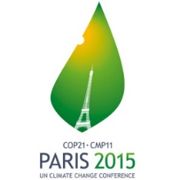
Paris Agreement and SDGs: JCM potentials
GHG emission reduction, Transition to low and
de-carbonization society
Clean energy (Goal 7), Sustainable industry (Goal 9), Sustainable consumption (Goal 12), etc. ⁵
The JCM supports the ambitious global frameworks
Agenda 2030, the universal blueprint for the sustainable society
Holding the increase in the global avg. temperature to below 2°C above pre-industrial levels
To support the achievement of the SDGs
If the global warming were limited to 1.5°C, SDGs can be easily achieved⁶

Slide 17
Responses to the COVID-19: Sustainable recovery plan
UNFCCC⁷: Ms. Patricia Espinosa, Executive Secretary
Recovery from COVID-19 should address climate change
Establish more inclusive and sustainable path for all; and make societies and people more resilient
UN Framework⁸:
Health first: Protecting health services and systems, Protecting people: Social protection and basic services, Economic responses and recovery: protecting jobs, small and medium sized enterprises, Macroeconomic response and multilateral collaboration, Social cohesion and community resilience
EU Green Deal⁹:
A roadmap for making the EU's economy sustainable by turning climate and environmental challenges into opportunities across all policy areas and making the transition just and inclusive for all.
Sectors: specifically transport, energy, agriculture, buildings, and industries (steel, cement, information, textiles, chemicals)
To boost the efficient use of resources by moving to a clean, circular economy; and To restore biodiversity and cut pollution
MOEJ Responses and Measures¹⁰:
Recovering economic activities by supporting to install energy efficient ventilating equipment to reduce risks; and securing employment in national parks and tourist areas
Building resilient economy by improving supply chain and production sites to transit decarbonisation

Slide 18
Reference list
5. IPCC 1.5 Summary for policymakers, https://www.ipcc.ch/site/assets/uploads/sites/2/2019/05/SR15_SPM_version_report_LR.pdf
6. Climate change and SDGs synergies, https://sustainabledevelopment.un.org/content/documents/22398Summary_document_Copenhagen_FINAL_for_website.pdf
7. UNFCCC June Momentum, https://unfccc.int/event/where-do-we-stand-with-ndcs-enhancing-action-on-climate-change-in-2020
8. A UN framework for the immediate socio-economic response to COVID-19, https://unsdg.un.org/sites/default/files/2020-04/UN-framework-for-the-immediate-socio-economic-response-to-COVID-19.pdf
9. EU Green Deal, https://eur-lex.europa.eu/legal-content/EN/TXT/?qid=1596443911913&uri=CELEX:52019DC0640#document2
10. MOEJ COVID-19 Responses and Measures, https://www.env.go.jp/guide/budget/r02/r0204-hos-gaiyo/full.pdf

