Slide 1

Greening the COVID-19 Response, Recovery, and Redesign
Kazuhiko Takeuchi
Earth League Annual Meeting, October 20, 2020
Presented by Eric Zusman on Behalf of IGES

Slide 2
Outline
The Case for Coherence
The Triple R Framework
Applications
Discussion Questions
Notes:
consistency, coherence, credibility or comprehensiveness (Foxon and Pearson, 2008, Howlett and Rayner, 2007, Kern and Howlett, 2009, Majone, 1997, Matthes, 2010).
Positive interactions or synergies

Slide 3
Triple R Framework: Policy and Institutional Coherence
Plans to manage COVID-19: fragmented and short-sighted
For example, often countries are allocating some funds to promote green industries while providing even more resources to fossil fuel and brown industries
Further, often there are not strong links between narrow interventions that address COVID-19 and structural changes to key systems and policymaking institutions
We argue that a sustainable and resilient future requires need for a coherent and forward-looking planning framework

Slide 4
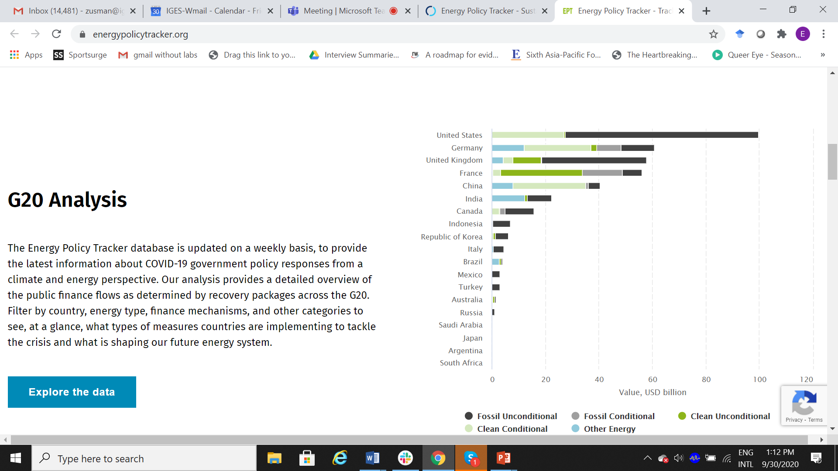
Energy Tracker: Evidence of Policy Incoherence
Source: https://www.energypolicytracker.org/, 2020

Slide 5
Incoherence: The United States CARES Act
Changes to tax restrictions/rebates that favour oil companies
COVID-19-related changes to royalties for use of public lands
COVID-19-related regulatory rollbacks and non-compliance reporting
Tax relief for renewable energy projects
Source: DeConcini and Neuberger, 2020, https://www.wri.org/blog/2020/06/coronavirus-stimulus-packages-clean-energy
Notes:
37 oil companies claimed more than $1.9 billion in CARES Act tax benefits.

Slide 6
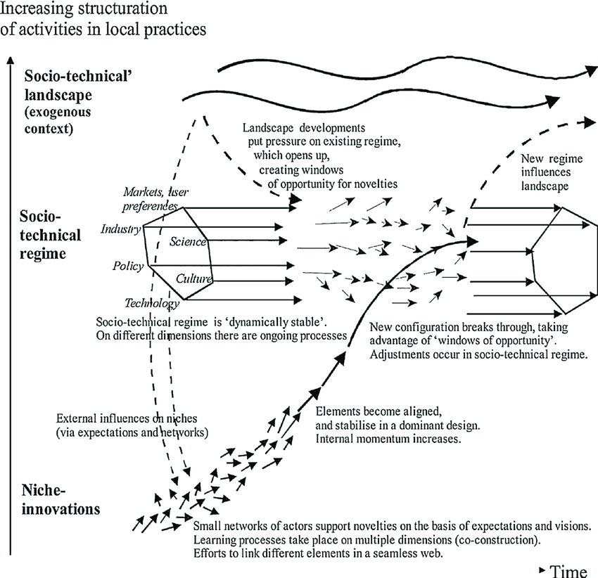
Motivation for the Triple R Framework
Lock-ins and inertia
Multilevel transitions
Sources: Unruh, 2002; Brown, et al, 2007
Sources: Geels, 2010
Notes:
Carbon lock-in arises through technological, organizational, social and institutional co-evolution, “culminating” in what was termed as techno-institutional complex (TIC). In order to resolve the climate problem, an escape from the lock-in condition is required. However, due to the self-referential nature of TIC, escape conditions are unlikely to be generated internally and it is argued here that exogenous forces are probably required.

Slide 7
Triple R Framework: Key Building Blocks
1. Respond-adopt targeted interventions to address direct pandemic health and livelihood impacts as well as possible underlying causes (including environmental causes)
2. Recover -reform broader policies and redirect fiscal stimulus to allocate resources to sustainable and resilient policies and investments
3. Redesign-transform energy, transport, and urban and socioeconomic systems as well as policymaking institutions to break unsustainable lock-ins
Notes:
Note that there is interactive and evolutionary dynamic between the multiple elements of the framework
Need to take into account

Slide 8

IGES Triple R Framework
RESPONSE
RECOVERY
Targeted interventions to address direct impacts
Sustainable policies and stimulus with an environmental focus
Sustainable & Resilient World
JUST TRANSITION
Transformation of socioeconomic systems and institutions
REDESIGN
Time
Horizons
Short-term
Medium-term
Long-term
© IGES

Slide 9
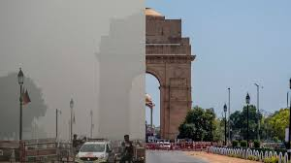
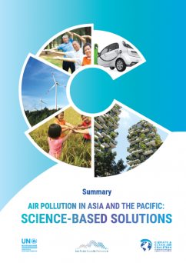
Case 1
Air Pollution and Climate Change
RESPONSE
RECOVERY
REDESIGN
Responding to the crisis
Target communities and populations with poor air quality
Promote teleworking
and non-motorized
transport
Recovery for low emissions future
Allocate stimulus to low emissions policies and programmes
Maintain air quality improvements and minimize rebounds with sustainable alternatives
Promote co-benefits to link health, air pollution and climate
Strengthen atmospheric governance
Enhance coordination to break down silos between health, air pollution and climate agencies
Reconsider urban, transport and spatial planning
Make institutions responsive to marginalized stakeholders
© IGES
9
9
Notes:
Waste management during the COVID-19 Pandemic
Countries with inadequate waste management systems (for municipal and medical waste) prior to the pandemic are more vulnerable to impacts.
Governance and sound policymaking are critical “throughout the emergency management cycle – from preparedness and readiness to response and eventual evidence-based recovery from COVID-19”
Survey results show that some governments were managing healthcare waste inadequately under normal circumstances → this was made worse during the pandemic
Key priority areas for governments (source segregation, discharge and collection, transportation, treatment, final disposal) have short-term and long-term actions necessary to respond, recover, and redesign the waste management system for greater resilience.
E.g. for transportation, one emergency response measure might be to adjust collection service schedules to meet the current demand, but in the recovery phase and beyond, it is prudent to improve collection service across the board, strengthen operations at transfer stations, and encourage greater involvement of the informal sector.
These longer-term measures may help redesign the waste management system to become more effective, resilient, and inclusive.

Slide 10
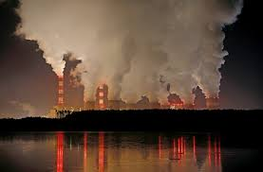
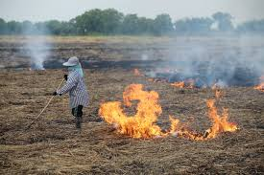
Response: Target Polluted Communities
Exposure air pollution can worsen COVID-19 impacts
Reduce pollution in heavily exposed communities
Provide opportunities for teleworking for non-essential workers
Do not forget rural pollution and secondary pollutants (notably tropospheric ozone)
Notes:
Response
The accumulation of single-use medical waste requires both immediate and, in some cases, reconfigured approaches to treatment and disposal (source segregation, storage, transport, treatment)
There have also been increases in other forms of waste and pollution—i.e. from packaging and residential energy-related emissions
COVID-lockdowns have led to reductions in some other forms of waste and pollution—i.e. from office buildings and the transport sector
As resources may be limited for these approaches in developing countries, create opportunities for cross-country learning on safe but affordable treatment and disposal methods for medical/healthcare waste and pollution control

Slide 11
Recovery: Allocate Resources to Sustainable/Low Emissions Energy, Mobility, Cooking, and Agriculture
Retain air quality improvements/ limit rebounds with policy tools and investments in
  Renewables and energy efficiency
  Clean cooking
  Electric vehicles, inspection and maintenance, and non-motorized transport
  Alternatives to open burning
Notes:
Response
The accumulation of single-use medical waste requires both immediate and, in some cases, reconfigured approaches to treatment and disposal (source segregation, storage, transport, treatment)
There have also been increases in other forms of waste and pollution—i.e. from packaging and residential energy-related emissions
COVID-lockdowns have led to reductions in some other forms of waste and pollution—i.e. from office buildings and the transport sector
As resources may be limited for these approaches in developing countries, create opportunities for cross-country learning on safe but affordable treatment and disposal methods for medical/healthcare waste and pollution control

Slide 12
Redesign: Transform Energy, Transport, Food Systems and Related Institutions
Create essential infrastructure for renewables and sustainable mobility and agriculture
Enhance cooperation between environmental and health ministries

Slide 13
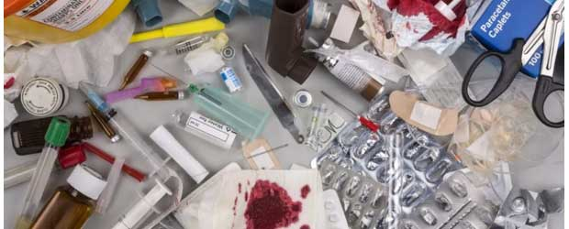
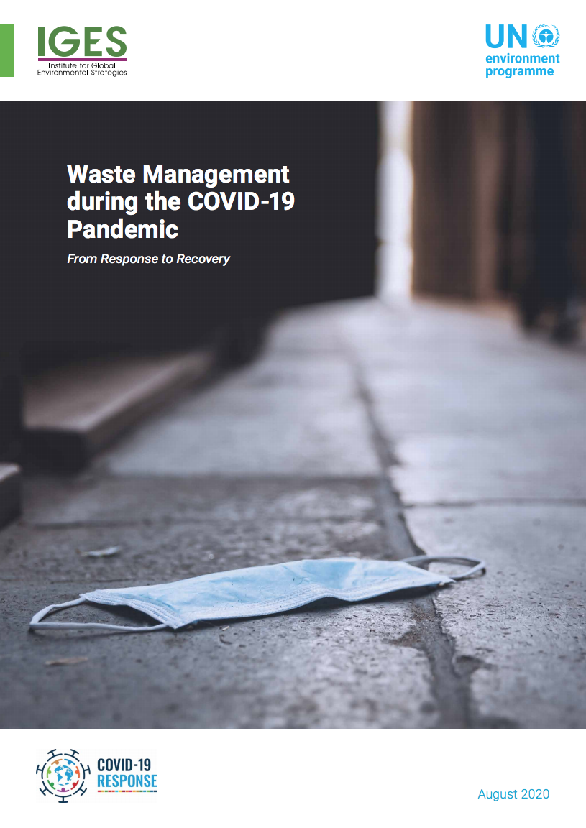
Case 2
Waste Management
RESPONSE
RECOVERY
REDESIGN
Responding to the crisis
Target medical waste
Suspended recycling
Target countries with weak WM systems
Recovery for more effective WM sectors
Map existing systems: segregation, transportation, treatment, final disposal
Avoid risks due to service interruptions
Allocate resource to reuse & recycle practices
Strengthen governance for Effective, Resilient & Inclusive WM systems
Multi-sector /multi-level cooperation to improve WM services
Harness energies of key stakeholder groups (women)
Address needs of disadvantaged communities
© IGES
UNEP & IGES, August 2020
13
13
Notes:
Bangladesh, India, Indonesia, and Japan
Waste management during the COVID-19 Pandemic
Countries with inadequate waste management systems (for municipal and medical waste) prior to the pandemic are more vulnerable to impacts.
Governance and sound policymaking are critical “throughout the emergency management cycle – from preparedness and readiness to response and eventual evidence-based recovery from COVID-19”
Survey results show that some governments were managing healthcare waste inadequately under normal circumstances → this was made worse during the pandemic
Key priority areas for governments (source segregation, discharge and collection, transportation, treatment, final disposal) have short-term and long-term actions necessary to respond, recover, and redesign the waste management system for greater resilience.
E.g. for transportation, one emergency response measure might be to adjust collection service schedules to meet the current demand, but in the recovery phase and beyond, it is prudent to improve collection service across the board, strengthen operations at transfer stations, and encourage greater involvement of the informal sector.
These longer-term measures may help redesign the waste management system to become more effective, resilient, and inclusive.

Slide 14

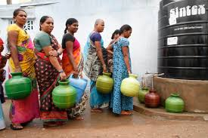
Case 3
Water and Wastewater Management
RESPONSE
RECOVERY
REDESIGN
Responding to the crisis
Ensure sufficient supplies for hygiene
Employ wastewater for RNA tracing
Recovery for more effective water and wastewater
Anticipate reductions in industrial water revenues
Allocate stimulus to avoid water service interruptions
Strengthen wastewater and water systems
Automation of wastewater treatment plants
Enable disadvantaged communities to participate in
© IGES
14
14
Notes:
Waste management during the COVID-19 Pandemic
Countries with inadequate waste management systems (for municipal and medical waste) prior to the pandemic are more vulnerable to impacts.
Governance and sound policymaking are critical “throughout the emergency management cycle – from preparedness and readiness to response and eventual evidence-based recovery from COVID-19”
Survey results show that some governments were managing healthcare waste inadequately under normal circumstances → this was made worse during the pandemic
Key priority areas for governments (source segregation, discharge and collection, transportation, treatment, final disposal) have short-term and long-term actions necessary to respond, recover, and redesign the waste management system for greater resilience.
E.g. for transportation, one emergency response measure might be to adjust collection service schedules to meet the current demand, but in the recovery phase and beyond, it is prudent to improve collection service across the board, strengthen operations at transfer stations, and encourage greater involvement of the informal sector.
These longer-term measures may help redesign the waste management system to become more effective, resilient, and inclusive.

Slide 15
Discussion Questions
How can we assist policymakers in strengthening the coherence and alignment within and between the response, recovery and redesign elements of their COVID plans?
How can we assist policymakers in distinguishing 'unsustainable’ from ‘sustainable’ response, recovery, and redesigns?
What evaluation criteria and decision-making tools could prove useful in this regard?
How can we encourage policymakers and other stakeholders to adopt a 'redesign mindset' and transform systems and institutions that lock in unsustainable policies and practices?
How can we improve the current presentation and application of the ‘Triple R Framework'?

