Slide 1
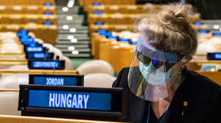
Reflections on The United Nations General Assembly 2020
Eric Zusman, Research Director
Picture Source: UN.org

Slide 2
Overview
Source: UN
75th Session of the United Nations General Assembly
Significant potential to strengthen international collaboration
Clear signs of distrust and isolationism
Notes:
'The future we want, the United Nations we need: reaffirming our collective commitment to multilateralism – confronting COVID-19 through effective multilateral action'.

Slide 3
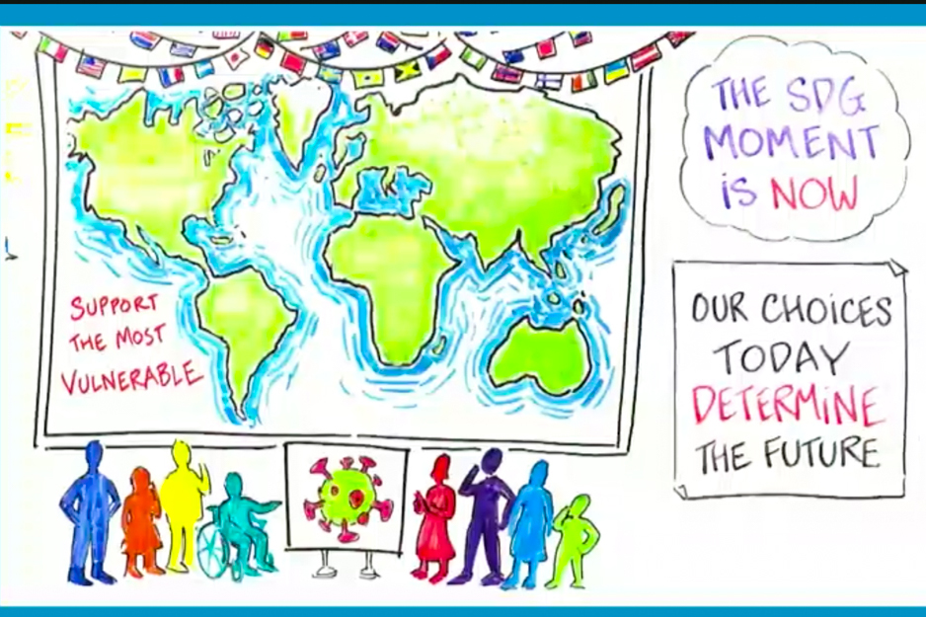
UNGA and the SDGs
Progress on SDGs too slow with some notable regression on some SDGs
First time in three decades with a global increase in poverty
SDG Moment
SDG Reality Check
SDG Gaps and Plans
SDG Opportunity-Contributions from Stakeholders
Source: IISD

Slide 4
UNGA Spotlights Five Interrelated Crises
Climate crisis-Growing experience with climate impacts and need for ambition
Natural resource crisis-Heightened attention on biodiversity and finance
Public health crisis-COVID deaths topped one million people globally
Inequality crisis-Are COVID and other environmental crises widening inequalities?
Multilateralism crisis-“The world has a surplus of multilateral challenges, but a deficit of multilateral solutions”

Slide 5
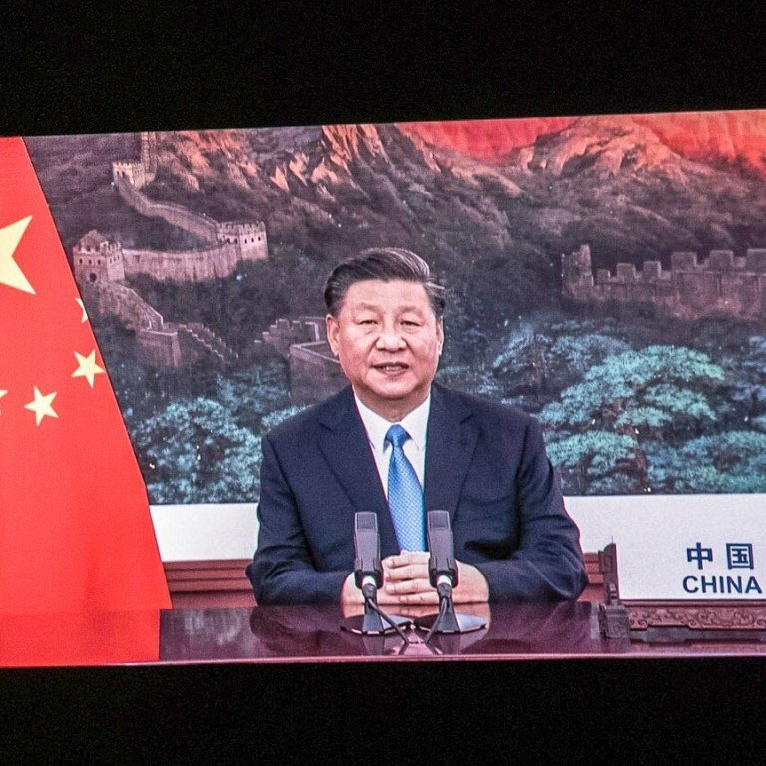
Can climate change lead the way?
China aims to see CO2 emissions "peak" before 2030 and achieve carbon neutrality by 2060
EU climate plans
Potential shift in United States climate policy
Private sector actions
Source: South China Morning Post

