Slide 1




Action for Plastic Waste Reduction in Indonesia
Miwa Tatsuno
Programme Coordinator, IGES/CCET
Lake Toba, Feb 28th 2020

Slide 2
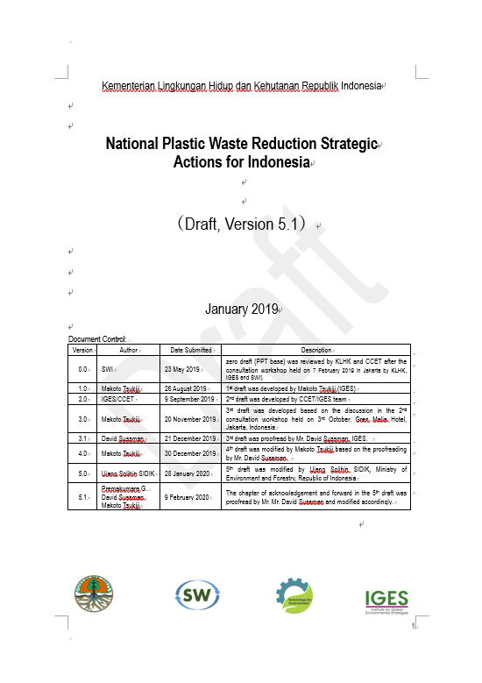

Cooperation between KLHK and IGES/CCET
National Level (Output-1)
Development of “National Plastic Waste Reduction Strategic Action
for Indonesia”
Provincial level (Output-2)
Development of JAKSTRADA
Pilot project (Material recovering facility at Balige)

Slide 3
National Plastic Waste Reduction Actions
1. Forward
2. Executive Summary
3. Introduction & Background
  3-1. Background
  3-2. Indonesian Context
4. National Overview of Plastic Waste Management
  4-1. National Regulation, Policy and Program
  4-2. Solid Waste Management in Indonesia
  4-3. National Waste Management Stakeholder Mapping
  4-4. National Plastic Industry
  4-5. Priority Issues on Plastic Pollution in Indonesia
5. Strategic Action for Plastic Waste Reduction
  5-1. Guiding principle, Goals, and Indicators & Target
  5-2. Action for National and Local Government
  5-3. Stakeholder Involvement (Non-government Sector)
  5-4. A 5-year Action for Plastic Waste Reduction in Indonesia (2020 – 2025)
6. Monitoring, Evaluation and Review

Slide 4
Plastic industry development
Ministry of Industry
Capacity = 5.33 – 7.09 million tons Plastic production (2015-2019) = 4.68 – 6.23 million tons Plastic consumption (2015-2019) = 17-23 kg/capita/year Capacity = 7.80 – 11.43 million tons Plastic production (2020-2024) = 6.85 – 10.03 million tons Plastic consumption (2020-2024) = 25-40 kg/capita/year Capacity = 12.57 – 32.60 million tons Plastic production (2025-2035) = 11.04 – 28.62 million tons Plastic consumption (2025-2035) = 44-100 kg/capita/year
Currently there are no target (by MoI) for:
plastic waste recycling
using a certain percentage of recycled raw materials for plastic products
Source: SWI analysis from MoI data, 2019

Slide 5





Indonesia Municipal Waste Source and Composition
Source of Waste | Proportion (%)
Household | 42.51
Office | 5.47
Traditional market | 23.17
Commercial area | 6.17
Public facilities | 9.04
Other areas | 8.09
Source: SIPSN, 2018
Source: SWI analysis from Adipura Program data by MoEF, 2017

Slide 6
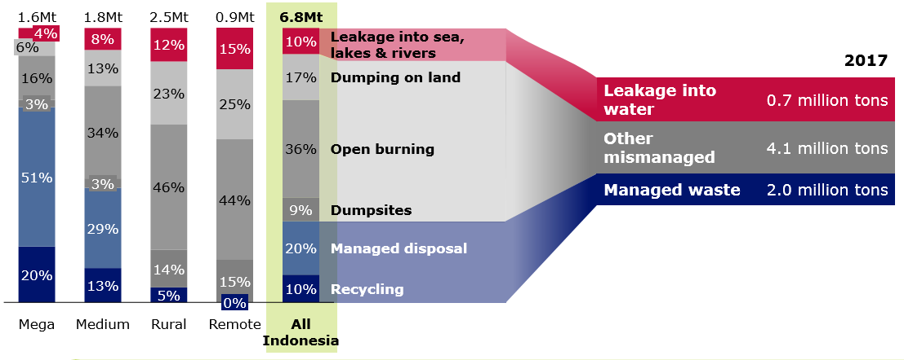
Collection & Recycle rate
Collection rate (from JAKSTRADA database)
Around 39% of the total plastic waste is collected.
In rural areas, the rate is as low as 16%.
Recycle rate
Only 10% of plastic is recycled.

Slide 7
STRATEGIC ACTIONS
A. Data Management & Feasibility Study
1. Improve database on waste and waste management through JAKSTRANAS and ADIPRA programme
2. Identify the best available plastic recycling (and treatment) technology
B. Policy Measures and Options
3. Phase-out/bans the use, sale, etc. of certain single-use plastic items (Target: 7 items)
4. Develop policy options mandating that Importers, Manufacturers, Food and Beverage companies bear some responsibilities in recovering packaging wastes
C. Stakeholder Involvement
5. Establishment a stakeholder committee to tackle with plastic pollution (among public, private, academia, NGO and community, etc.)
6. Promotion of PPP including voluntary reduction strategies and agreements
7. Strengthen monitoring and outreach
D. Improvement of SWM System
8. Improvement of solid waste management including availability of facilities and its operation
9. Seek possible funds to improve WM for local governments
E. Awareness raising & Clean-up Campaign
10. Promote awareness activities for 3Rs and waste management in schools and communities
11. Promote awareness activities for Clean-ups and Marine debris
F. Play a role for international agreements and cooperate with donors and international organizations
12. Seek possible funds to tackle with marine plastic pollution

Slide 8
STRATEGIC ACTIONS | National and Local authority | Private Sector | Community
D. Improvement of SWM System
8. Improvement of solid waste management including availability of facilities and its operation | 8-1. Monitor proper solid waste management in area of responsibility (tourism area, ports, marine transportation, small and outer islands) 8-2. Share case studies on waste management activities in LGs through JASKTRANAS/ADIPRA programme 8-3. Provide training opportunities for WM providers and community leaders 8-4. Support the training programme conducted by national and local governments for communities | 8-1. Support the training programme conducted by national and local governments for communities 8-2. Strengthen with existing plastic waste collectors/pooler informal sector, such as waste banks, TPS3R and waste pickers for recyclables utilisation 8-3. Reinforce operation collection, segregation, processing, packing and transporting recyclables material through informal sector and/or community-based institution (i.e. waste banks) 8-4. Operate plastic recycling in collaborate with manufacturing, FMCG companies and retailers through EPR | 8-1. Strengthen community-inspection to stop illegal dumping and identify hotspots 8-2. Participate in waste segregation, plastic waste return (take-back scheme) and wise use/buying of plastic product
9. Seek possible funds to improve WM for local governments | 9-1. Develop activities and pilot projects on plastic waste management with local governments 9-2. Strengthen operation for collection, segregation, processing, packing and transporting recyclables material through informal sector and/or community-based institution (i.e. waste banks) 9-3. Review and improve the landfill operation and maintenance (Linked with 1-4)

Slide 9
Strategic Goals and Target Indicators
 | Strategic Goals | Target Indicator
 |  | Baseline (2017) | 2025
 | 1. Reduce plastic waste generation | Amount of Plastic Waste Reduction
 |  | 2.26% | 30%
 | 2. Reinforce the plastic recycling system | Amount of plastic wastes recycled
 |  | 0.696M (t/y) (7%) | tbc
 | 3. Reduce mismanaged plastic wastes | Amount of mismanaged plastic waste
 |  | 3.22 million (t/y) in 2010, or 4.8million (t/y) in 2017 (SYSTEMIQ) | 70% Reduction
 | 4. Consolidate stakeholders’ responsibility with EPR | Number of EPR programme implemented
 |  | N.A | tbc

Slide 10
Thank you

