Slide 1

Waste management in science education
Science textbook review workshop
Gelephu, Bhutan
Jan 29th 2020

Slide 2
Contents
Environmental education in Japan (Kitakyusyu city)
Ecology note Bhutan
Integrate into the science curriculum

Slide 3
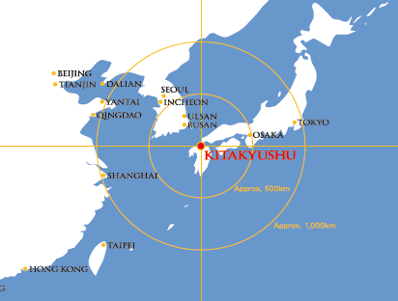
Japanese case : Kitakyusyu city

Slide 4
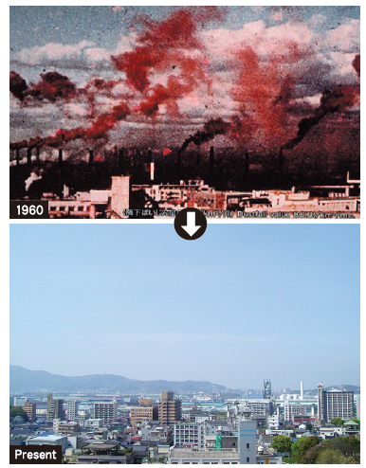
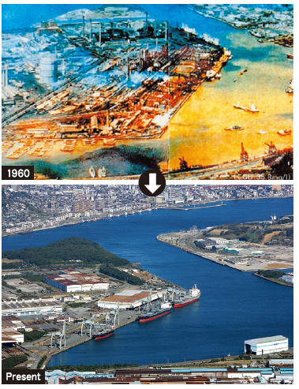
Kitakyusyu city
“Grey city” to “Green city”
1960
Present
(Source: Kitakyusyu city)

Slide 5
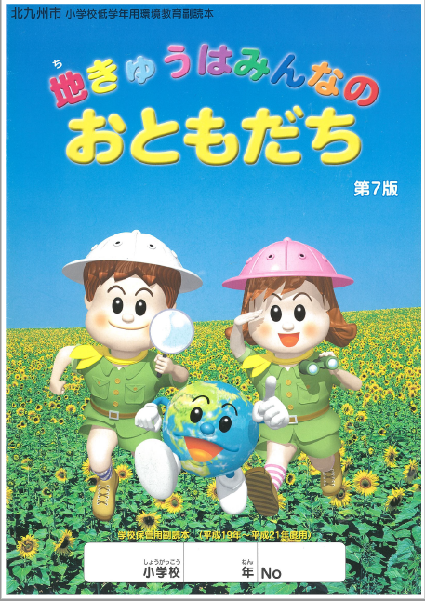
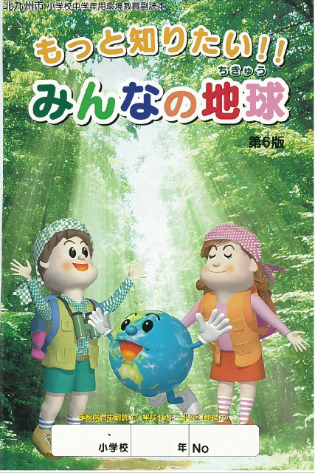
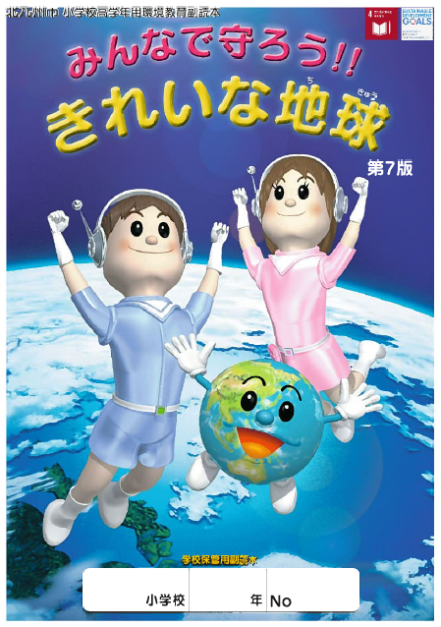
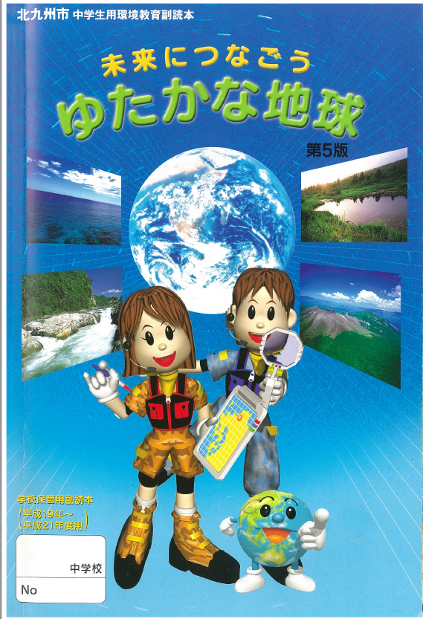
Environmental education material
- Kitakyusyu city-
(Junior high school)
(Grade 1-2)
(Grade 3-4)
(Grade 5-6)
(Grade 7-9)
(Source: Kitakyusyu city)

Slide 6
Contents (Grade 1-2)
Explore the nature; listen, touch, watch, smell, taste
Living things in river, field, sea
Earthworms in soil
Play with plants, flower
Play in forest
Play with what you find in forest
Look around your daily life
Save water, electricity
Tips to reduce waste
Expand recycling
Let’s clean our city
Children’s Eco club
City eco museum
*Topics related to waste management
Notes:
Introduce some pages of the booklet of the Kitakyusyu city.

Slide 7
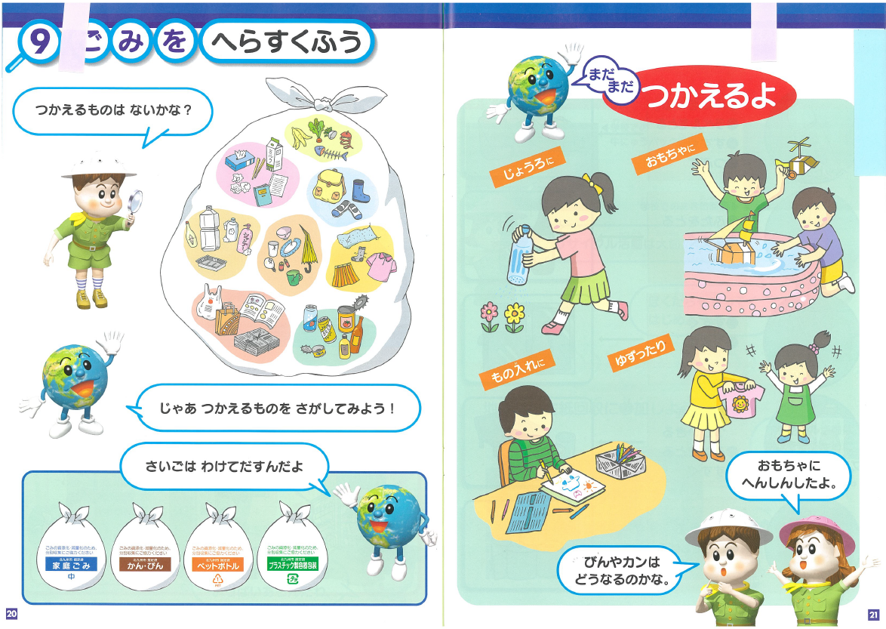
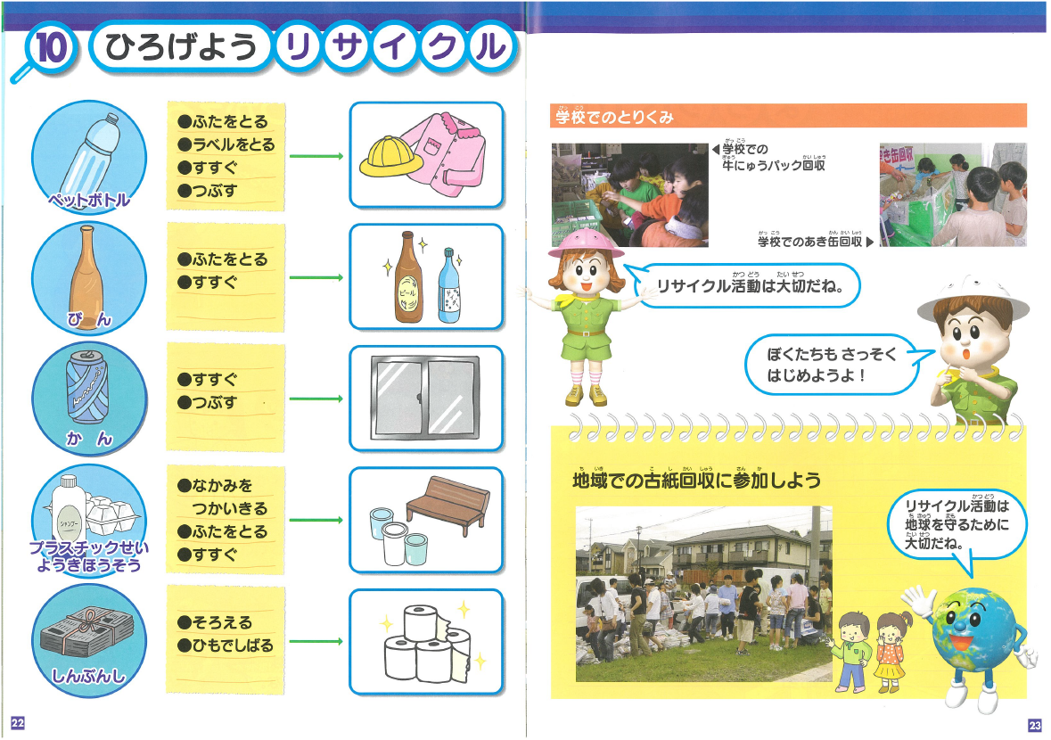
(Source: Kitakyusyu city)
Notes:
数枚入れる。

Slide 8
Contents (Grade 3-4)
Nature in the city
Forest in the city
Rivers in the city
Sea along the city
Sound in the city
Air, sky in the city
Water and daily life
Daily life and waste: waste generation in daily life, waste handling,
How to collect waste from household, rules for waste separation, incineration factory, recycling center, recycle of plastic container
Waste as resource (recycle of can, bottle, plastic bottle, paper, large-size garbage, organic waste, metal, and light bulb)
The history of waste management
What we can do, tips to reduce waste
Eco activities: Eco-club, eco museum, etc.
Notes:
Introduce some pages of the booklet of the Kitakyusyu city.

Slide 9
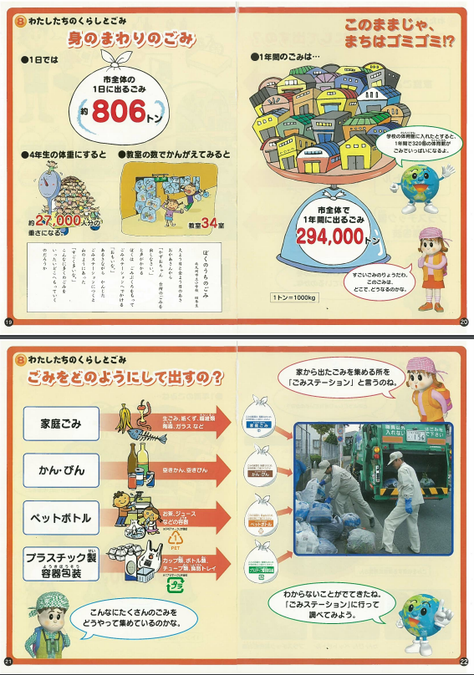
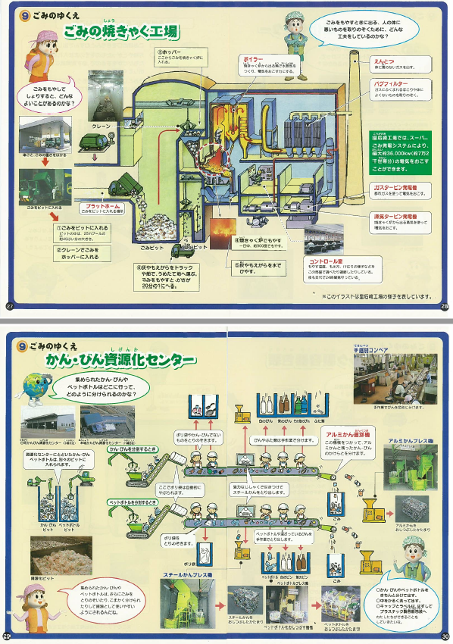
(Source: Kitakyusyu city)

Slide 10
Contents (Grade 5-6)
Our environment, how can we protect the environment?
Who/how cleaned the polluted air and sea in the city? (History of pollution )
Japanese environmental technology to prevent pollution through international cooperation
Rich forest and its function
Let’s protect our beautiful river
Sea and our lives, its function
Clean air
Global warming
Effective energy use
Our lives and recycle
Look back our daily life
Let’s make our city clean
Introduction of city eco museum
(Grade 5-6 includes more observation, consideration of cause and effect in scientific approach, digging into the details of what they found at 1-4 grade.)

Slide 11
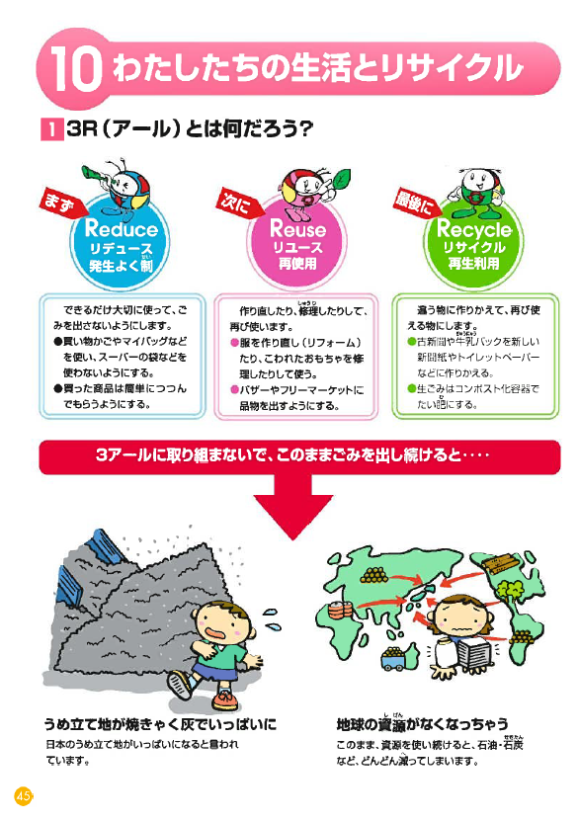
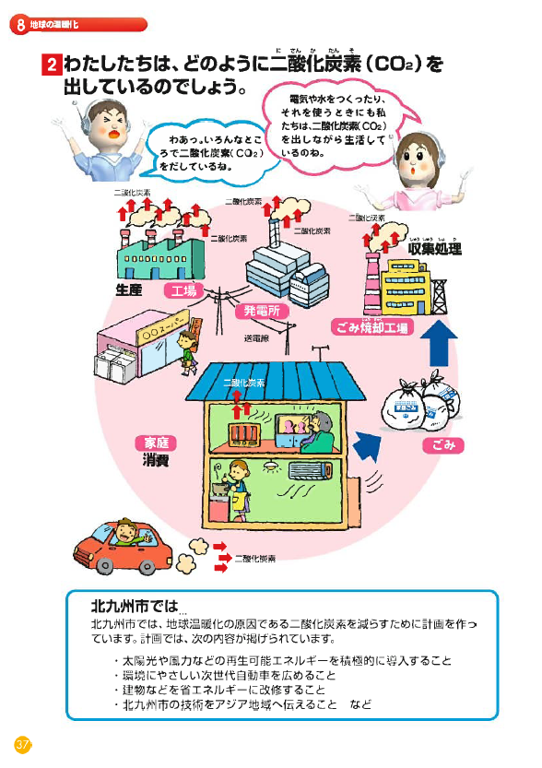
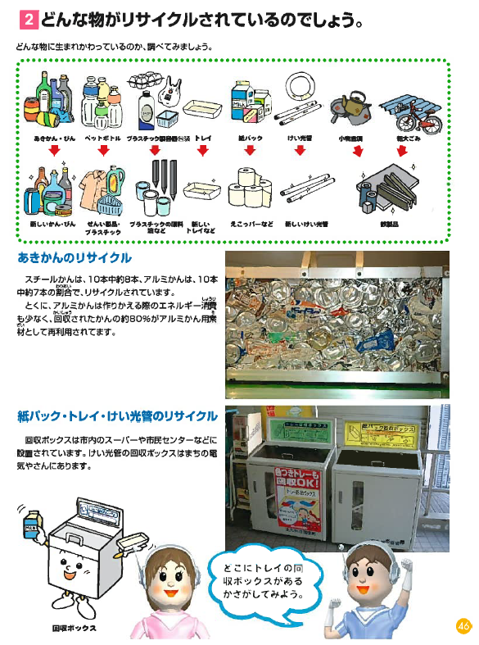
(Source: Kitakyusyu city)

Slide 12
Contents (Grade 7-9: Junior high school)
Detail pollution history of the city
Environmental terminology
The message from the earth
Beautiful nature of the city
The city nature and its legend
Traditional technology
The history of the city development
Harmony between human life and nature
Research projects, experiments
  e.g. waste, air, river, water, etc.
Companies activities for eco-conscious business
Eco town
Bioplastic
Global warming
Environmental technology
Food waste recycle
Waste as resources
Visit eco museum, field trips
*Those topics are also somewhat
related to waste management
(Grade 7-9 focuses on more scientific research/experiments, technical terminology, details of pollution history, industry, socio economic aspect,etc.)
Notes:
Introduce some pages of the booklet of the Kitakyusyu city.

Slide 13
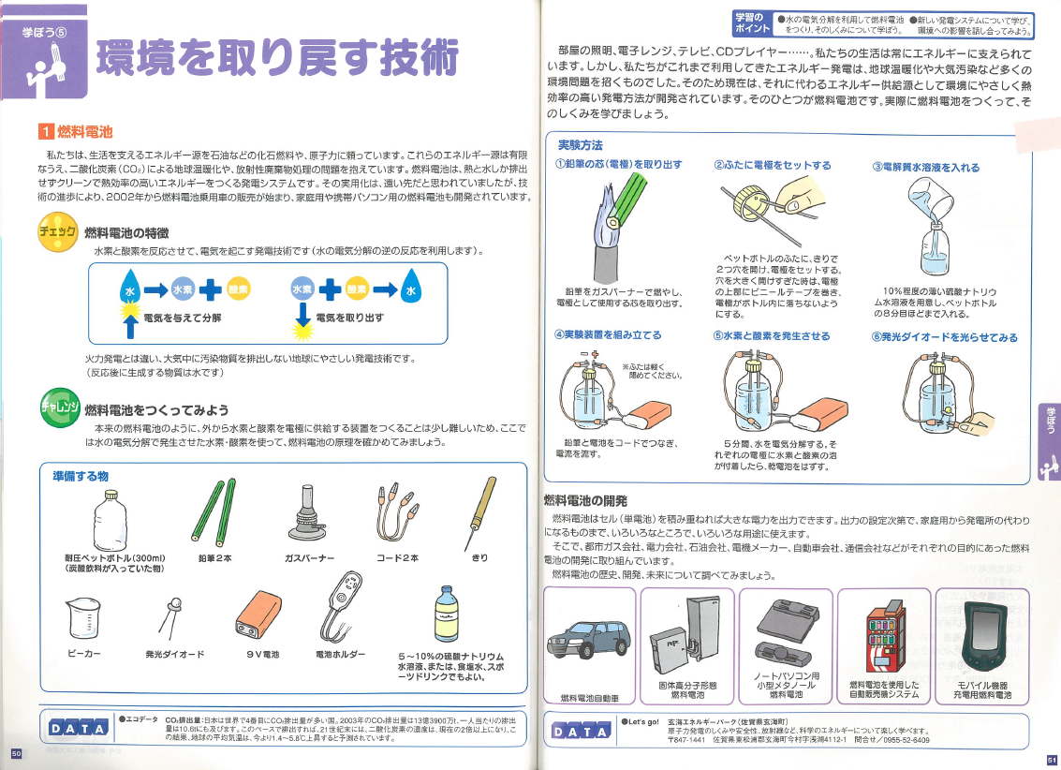
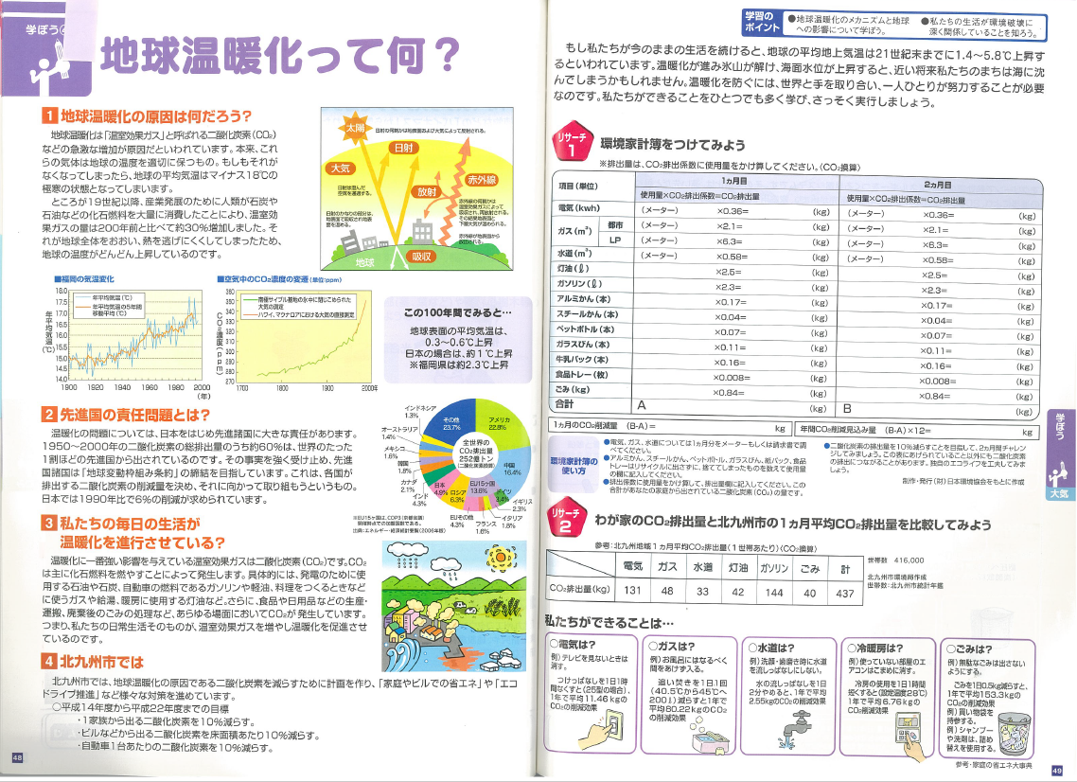
(Source: Kitakyusyu city)

Slide 14
The impact of 3R in Japan

Slide 15
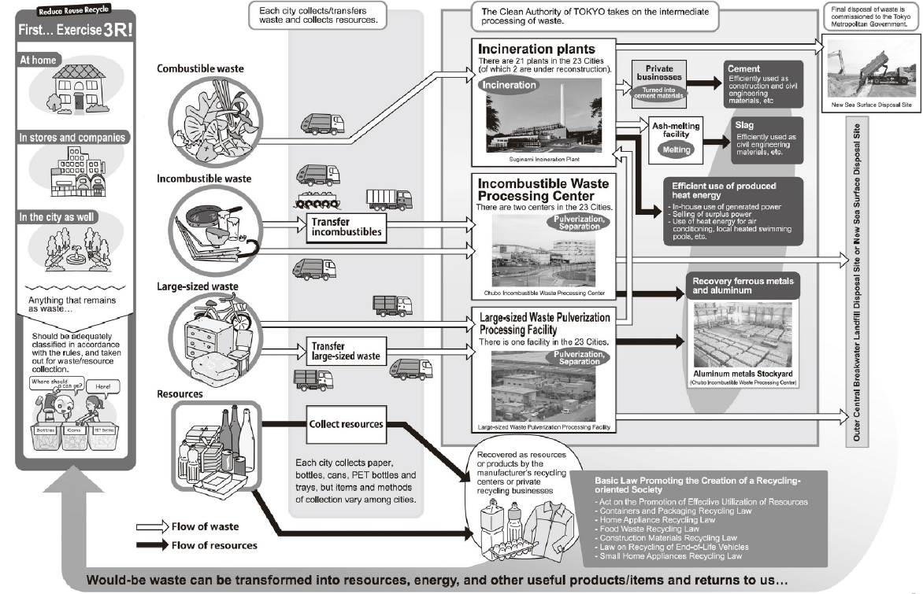
Flow of waste treatment and recycle
*80.3%
*9.5%
(*Source: Ministry of the Environment “Survey on disposal of municipal solid waste in 2017” https://www.env.go.jp/press/files/jp/press/2dtgw29.pdf.pdf)

Slide 16
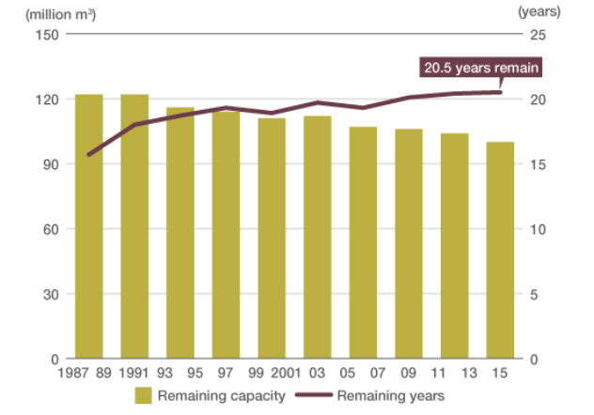
Remaining capacity and years of use
of waste landfill sites
(Source: Nippon.com/Based on Ministry of the Environment “Survey on disposal of municipal solid waste” )

Slide 17
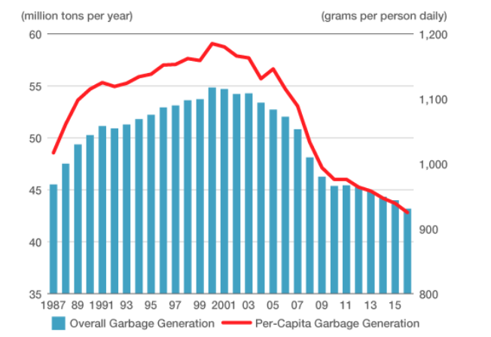
Overall and per-capita waste generation
Legal system for establishing a “sound material-cycle society”
The basic act for establishing a sound material-cycle society (2000)
Effective resource utilization promotion act (1991)
Recycling laws (1990s, 2000s)
  Containers and packaging recycling act
  Home appliance recycling act
  Food recycling act
  Construction recycling act
  Automobile recycling act
  Small home appliance recycling act
(Source: Nippon.com/Based on Ministry of the Environment “Survey on disposal of municipal solid waste” )

Slide 18
Ecology Note Bhutan

Slide 19
Contents in Ecology Note (Bhutan ver.)
Making a green map for our neighborhood (Grade 1-3) (*Grades in Japanese curriculum)
Let’s find out the present solid waste management in our country (Grade 1-6)
Issues related to ineffective waste management *Added for the Bhutan version
Gross National Happiness and waste
Do you know about the 4Rs? (Grade 4-6, 7-9)
Religious institutions and waste
Ideas for reducing waste (Grade 1-3)
Let’s promote waste separation and recycling (Grade 4-6)
Let’s learn how waste can be changed into resources (Grade 4-6)
Let’s try making compost (Grade 4-6, 7-9)
How to use compost, how compost helps the plants glow
Organic agriculture in Bhutan
Sustainable development goals and waste (Grade 4-6, 7-9)
Plastic waste reduction and management (Grade 4-6, 7-9)
Negative impact of mismanaged waste on the hydropower sector
Let’s think about global warming change and climate change
  What is global warming? (Grade 4-6, 7-9)
  On what occasions is CO2 emitted? (Grade 4-6,7-9)
  Looking back on our lives; CO2 reduction (Grade 4-6, 7-9)

Slide 20
Making a green map for our neighborhood

Slide 21
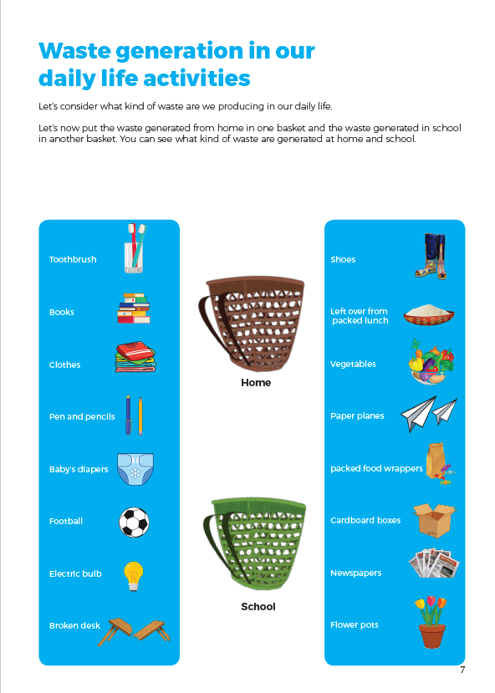
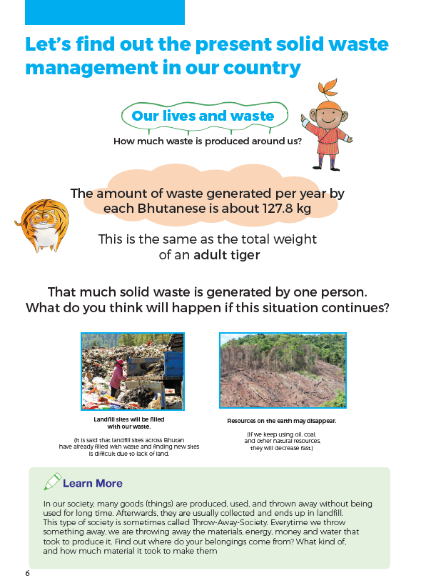

Slide 22
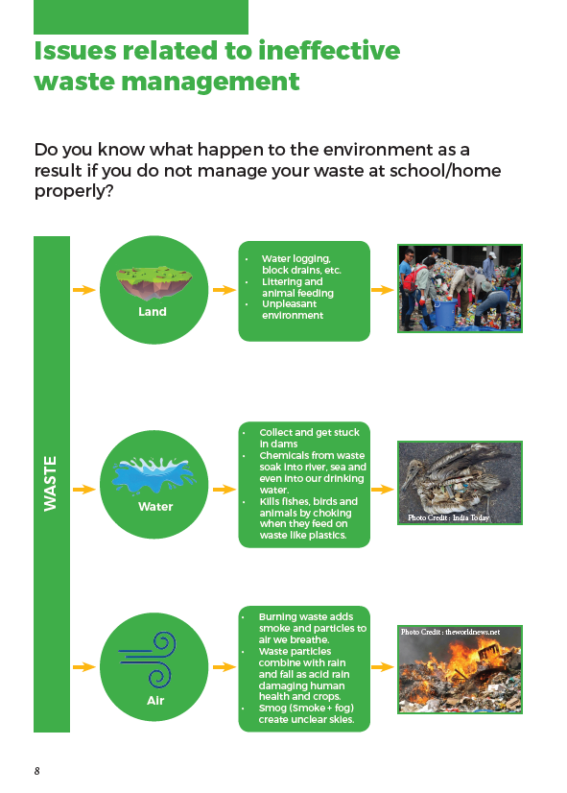
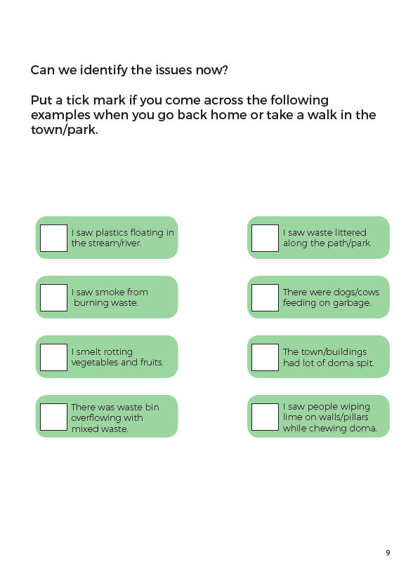

Slide 23
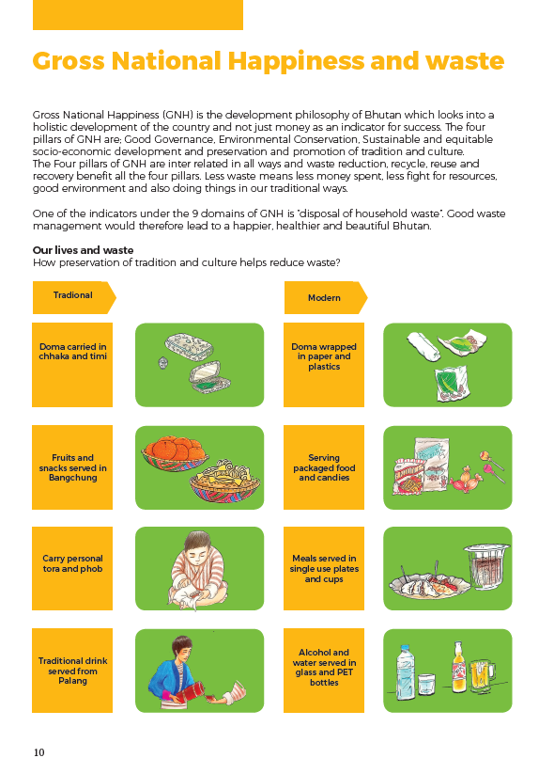
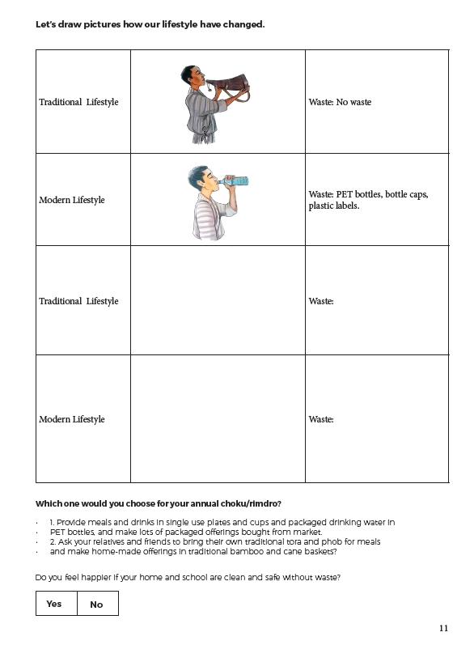

Slide 24
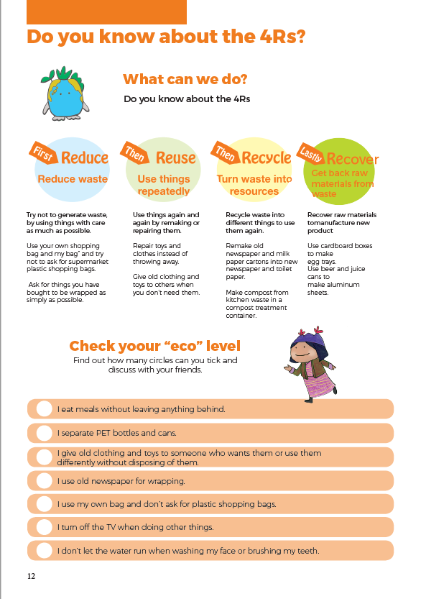
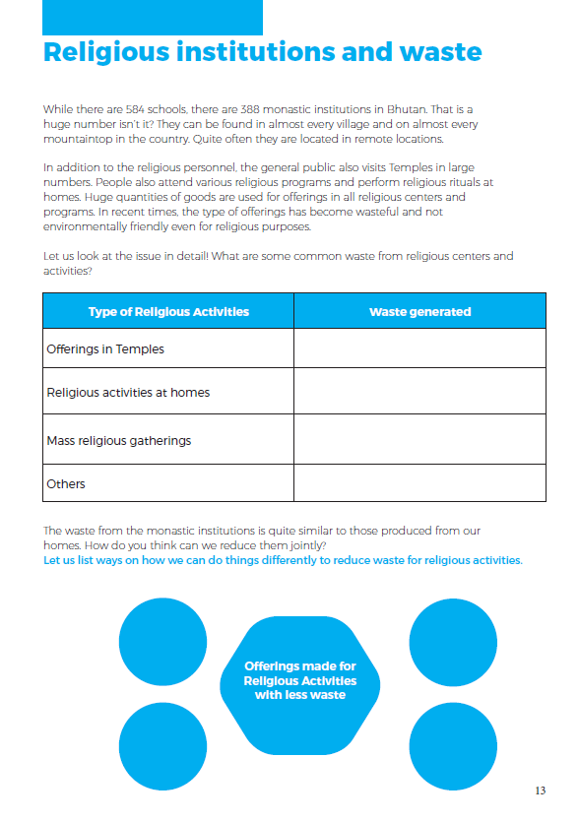

Slide 25
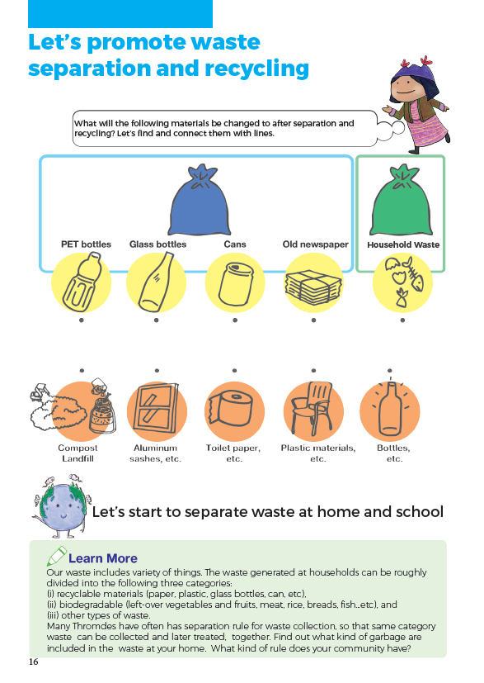
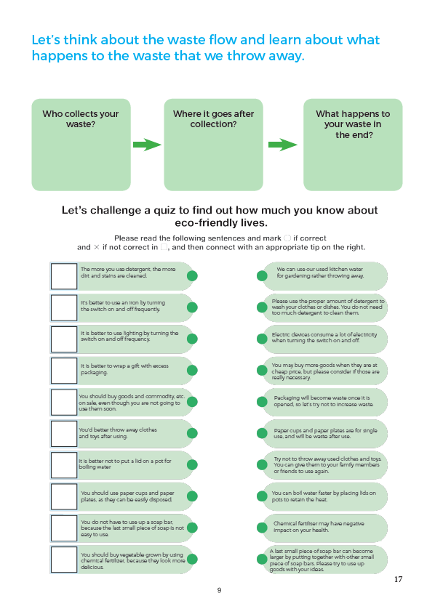

Slide 26
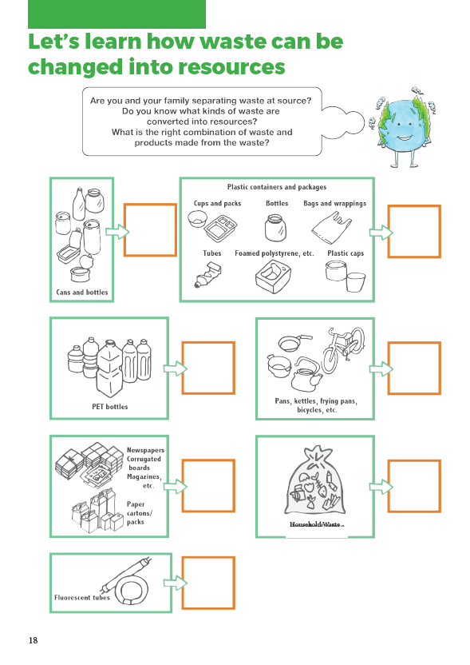
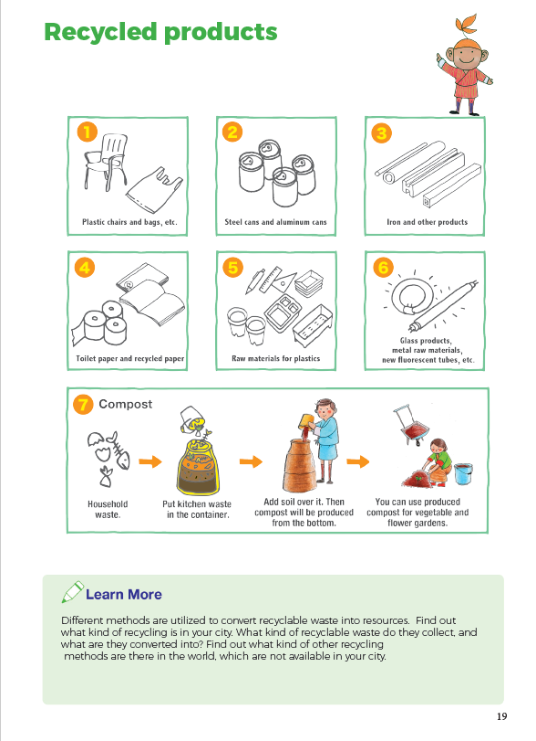

Slide 27
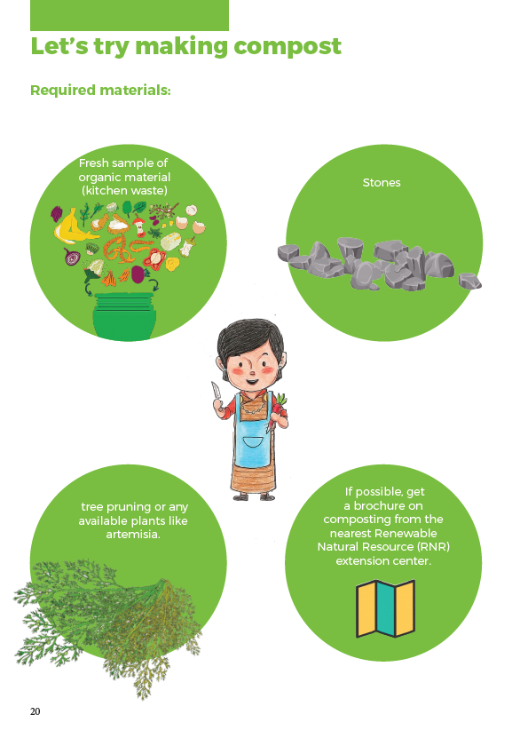
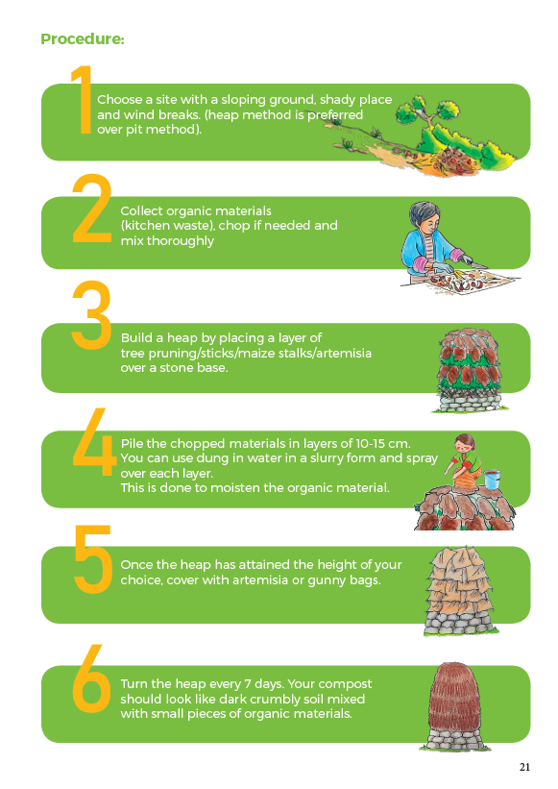

Slide 28
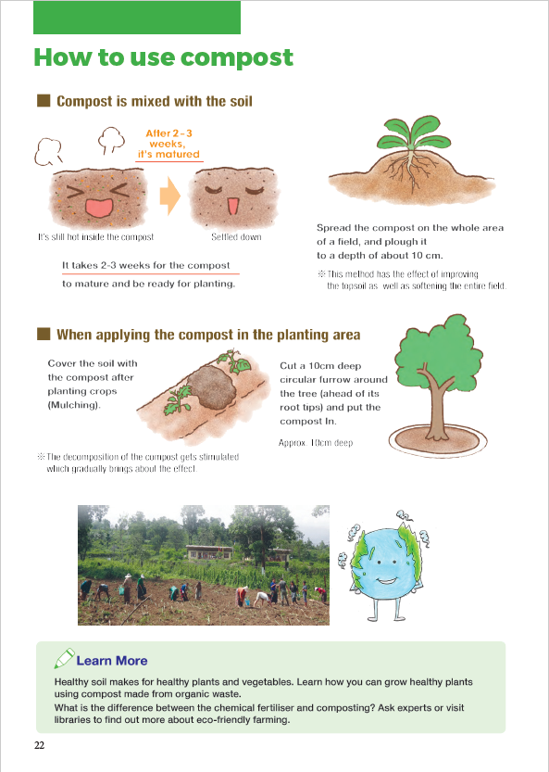
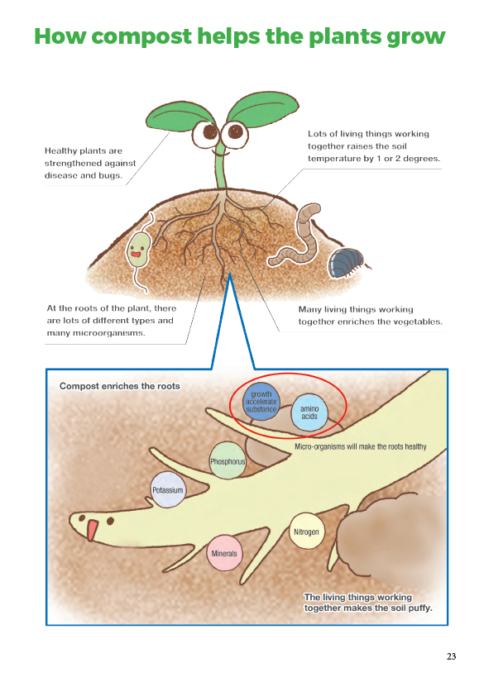

Slide 29
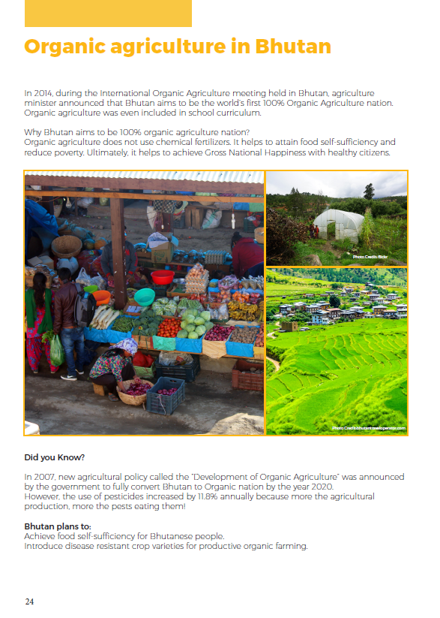
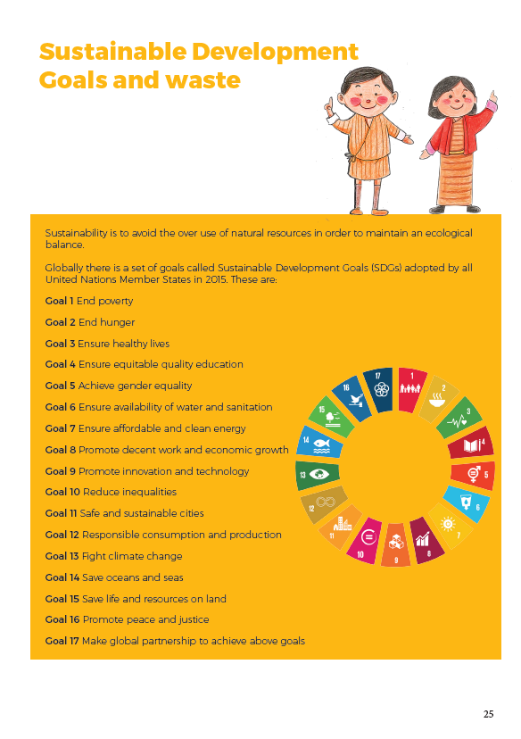

Slide 30
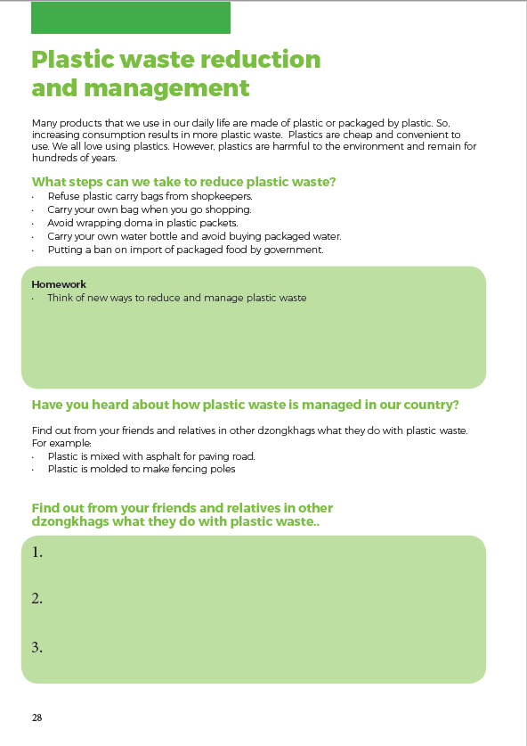
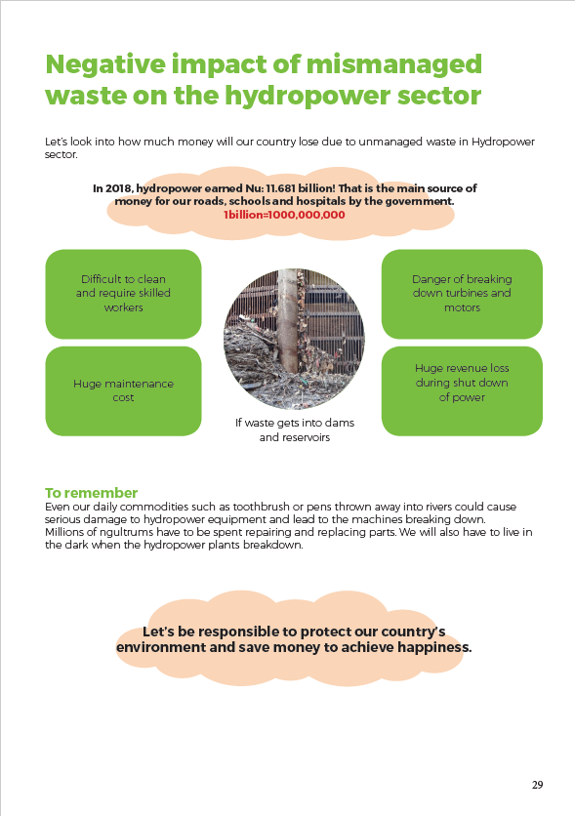

Slide 31
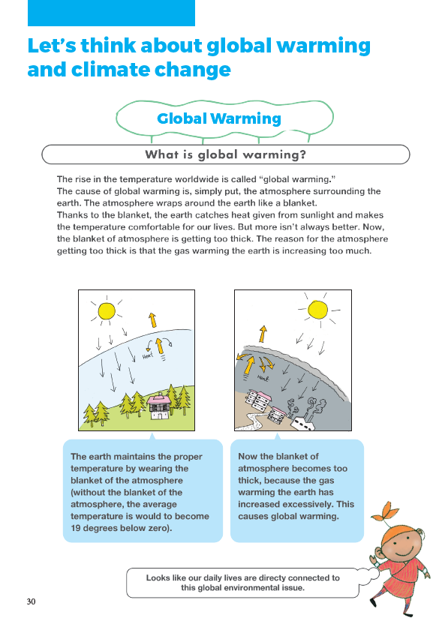
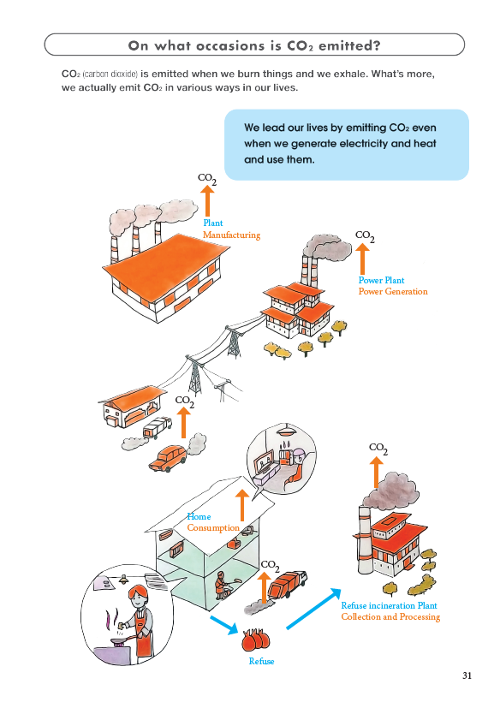

Slide 32
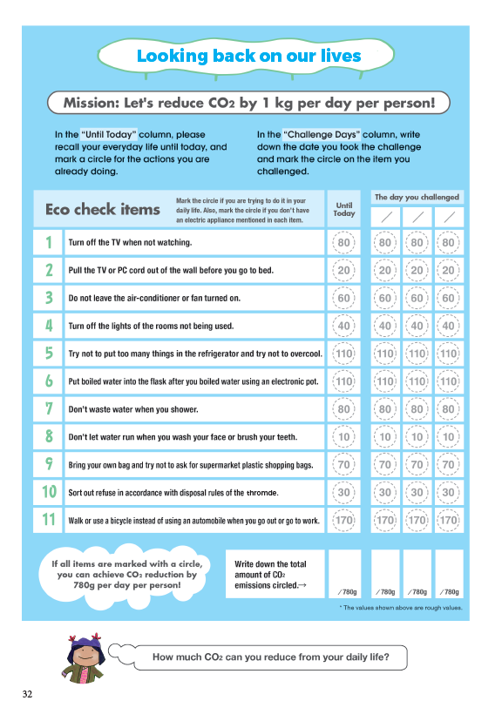
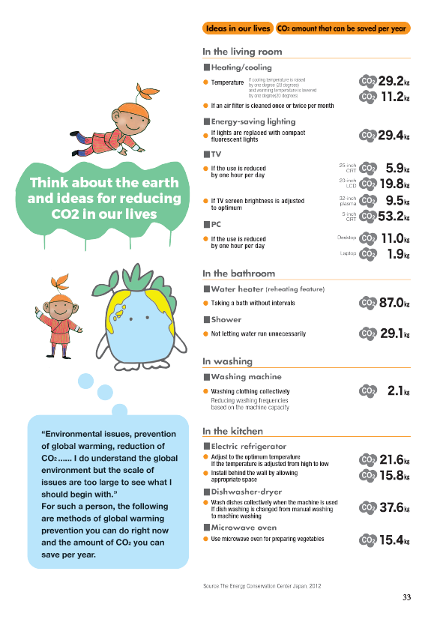

Slide 33
Integrate into the science curriculum

Slide 34
The science textbooks contents and Ecology Note

Slide 35
Grade 4
Science text book | Ecology Note (Examples)
Chapter 1. Materials in Our Surrounding
1.1 Everyday Materials | “Waste generation in our daily life activities” Students are expected to learn: Notice the materials are going to be waste in the end and how much waste they are generating every day, and learn the attitude to take good care of things.
1.2 Sorting Materials | “Let’s promote waste separation and recycling” Students are expected to learn: Characteristic of materials which is the important fundamental knowledge of waste separation.
1.3 Floating and Sinking
1.4 Natural and Human-made things | “Plastic waste reduction and management” After students learn the difference between natural and human-made things, plastic can be introduced as one of the widely used human-made things which are causing serious issues on the environment now.
1.5 Degradable and Non-degradable Things | “Let’s try making compost” ”How to use compost" After students learn the function of microorganisms, composting can be introduced. The questions on p.13 "Test Yourself" are very good questions to consider waste issues.
Chapter 2. Matter | “Issues related to ineffective waste management” Waste can be in solid, liquid or gas form.
2.1 What is Matter
2.2 Solid as Matter
2.3 Liquid as Matter
2.4 Gas as Matter
2.5 Heating and Cooling of Substances

Slide 36
Chapter 3. Materials in Mixtures
3.1 Pure Substances and Mixtures
3.2 Soluble and Insoluble Substances
3.3 Solid-Solid Mixtures
3.4 Solid-Liquid Mixtures
3.5 Liquid-Liquid Mixtures
Chapter 4. Separating Mixtures
4.1 Sedimentation and Decantation
4.2 Separating Insoluble Substances by Sedimentation and Decantation
4.3 Separating Insoluble Substances by Filtration
4.4 Making Water Safe for Drinking
Chapter 5. Forces
5.1 Let Us Look at Forces
5.2 What a Force can do
5.3 Contact Force
5.4 Non-contact Force
Chapter 6. Light and Sound
6.1 Sources of Light
6.2 How Light Travels
6.3 Light and Shadow
6.4 Making a sound
6.5 Fading Sound
Chapter 7. Electricity and Magnetism
7.1 Sources of Electricity | “Negative impact of mismanaged waste on the hydropower sector”
7.2 Where Electricity is Used
7.3 Making Connections
7.4 Things that are Magnetic
7.5 Magnets at Home

Slide 37
Chapter 8. Living Things and their Environment
8.1 Living Things and Non-Living Things
8.2 Plants and Animals in their Habitat
8.3 How Plants Adapt in their Habitat
8.4 How Animals Adapt in their Habitat
8.5 Living Together | “Issue related to ineffective waste management ”
8.6 Feeding Habits
Chapter 9. Green Plants | "Issues related to ineffective waste management" "Let’s making compost" "How to use compost"
9.1 Effect of Light on the Growth of Plant
9.2 Effect of Air on the Growth of Plant
9.3 Effect of Temperature on the Growth of Plant
9.4 Effect of Water on the Growth of Plant
9.5 Flower
Chapter 10. Food | "Let’s making compost" "How to use compost" "Organic agriculture in Bhutan“
10.1 Different Kinds of Food
10.2. Food for Activity
10.3. Food for Growth
10.4. Food for Protection
10.5 Eat all Types of Food
Chapter 11. Our Earth
11.1. Shape of the Earth
11.2. Rotation of the Earth
11.3. Day and Night
11.4. Revolution of the Earth
11.5. Seasons in a Year | "Let’s think about Global Warming"

